Slide 1
Information Session for Students, Parents and Guardians
Transition from Grade 8 to 9
Choices for Nine
2016 - 2017
Notes:
(School may want to personalize first page with your name, title and school name )
Key Messages:
These information nights are one part of an Exit Program for students and their families. The goal of an exit program is to “help students make successful transitions to the next stage of their life” Ontario Schools (OS), Page 27 Section 2.4.1.
Orientation and exit programs are an important aspect of a comprehensive Guidance and Career Education program.
Students will be engaged in educational planning sessions throughout the year, including preparation and completion of course selection for Grade 9.
Parents should know that they may hear or see the term high school and secondary schools being used interchangeably.

Slide 2
Goals for the Evening
Choices for Nine
To inform students, parents and guardians how to make a smooth and successful transition from Grade 8 to 9
To assist students, parents and guardians in making informed choices about courses, programs and schools
To raise student, parent and guardian awareness of the various program pathways available throughout the Toronto District School Board
For more about Education Planning go to:

Slide 3
Creating Pathways to Success, 2013
Notes:
Provincial Policy document that guides Educational and Career/Life planning from Kindergarten through to Grade 12. Making choices and transitioning from Grade 8 to Grade 9 for students and families is an inquiry approach.
Tonight you may have come to this information evening:
with many questions
seeking answers
guided by possible future thinking
Your decisions may be guided by these 4 questions:
What you know about your son or daughter (e.g., Achievement, learning styles, interests abilities, passions, etc) (Who am I?);
Thoughts and ideas about possible postsecondary plans (hopes and dreams) ;
What kinds of programming including extra-curricular activities are available
(Opportunities);
Goals and decisions for getting there will include: course types, learning styles, learning goals and work habits, etc. (Who do I want to become?);
What plan are we making for now and the future? (Achieving Goals);
This type of strength based framework encourages students with support from their family and teachers, to continue to return to these questions as they grow and develop.
This is where the Individual Pathways Plan (IPP) process is very helpful as students revisit and revise the plan along the way through their High School experience.

Slide 4
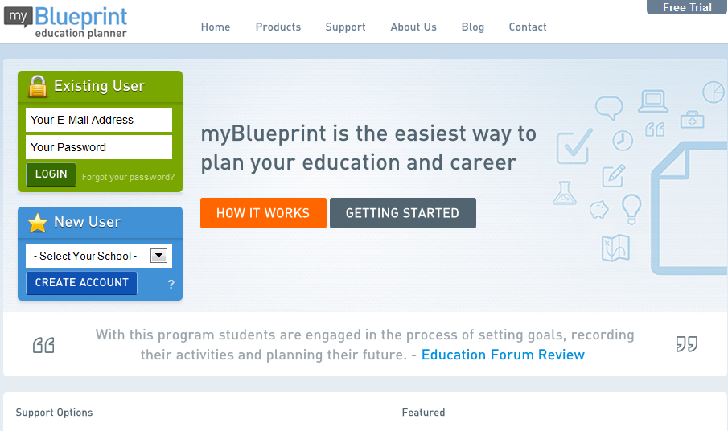
Accessing myBlueprint.ca/tdsb
Online educational & career planning tool for students and parents
www.myBlueprint.ca/tdsb
Notes:
Key Message:
myBlueprint is a career and post-secondary planning tool provided by the TDSB
Designed for present and future planning (e.g. High School Planner/Post-Secondary Planner/Occupation Planner).
All students in Grades 7 to 12 in the province will have access and support with educational planning through this web-based tool.
Parents may have their own myBlueprint account, or be linked to their child’s account for planning and conversation purposes.
Tutorials and videos on how to best utilize the site are available for parents on the myBlueprint site.
School specific offerings (Specialization, Elective courses offered , future planning (e.g., Specialist High School Major - SHSM).
Allows students to navigate many and varied pathways to success.
Designed for present and future planning (e.g., High school Planner/Post-Secondary Planner/Occupation Planner).

Slide 5
What Can Families Do to Help Students Make Good Choices?
Choices for Nine
Access and investigate myBlueprint career planning tool
Attend Secondary Information Evenings/Open Houses
Encourage continued participation in extracurricular activities
Choose courses of interest
Discuss future plans
Stay involved and connected with the school
Notes:
Key Messages:
Students, parents and guardians will find details on Secondary Information Evenings and Open Houses with dates and times on the TDSB website -
www.tdsb.on.ca

Slide 6
Considerations When Choosing a High School
Choices for Nine
The range of subjects and programs offered in each grade
Semestered versus non-semestered
The range of extracurricular activities, clubs and sports offered
The supports available for English Language Learners and students with special education needs
Notes:
Key Messages:
Students in the Regular, French Immersion and Special Education programs in TDSB schools are encouraged to attend the secondary school in their designated attendance area.
For some students with specific interests, skills and learning needs/styles, investigating other secondary school options may be appropriate.

Slide 7
Choices for Nine
The Year Ahead: Educational Planning and Course Selection Process
Planning for the coming year is a process
Begins now and will continue until Course Selection Sheets are due in late February
www.tdsb.on.ca/GoingtoHighSchool
Notes:
Key Messages:
The process will include:
The use of myBlueprint for the completion of Individual Pathways Plans and the Course Selection Process
Gathering information about Specialized Schools and Programs
High School Information Nights outlined in Choices for Nine publication and online

Slide 8
Find Your School
Choices for Nine
www.tdsb.on.ca
Click on “Find your School”
Notes:
Key Messages:
First entry point is to encourage families to consider their secondary home school.
The home school is based on the student’s residential address.
There are many ways in which academic and extra-curricular interests can be met at the secondary home school.
All TDSB schools strive to offer a wide range of academic and extra-curricular programming designed to meet student needs, interests and passions.
Optional Attendance to Specialized Schools or Programs is for students who have a passion in an area of specialty.

Slide 9
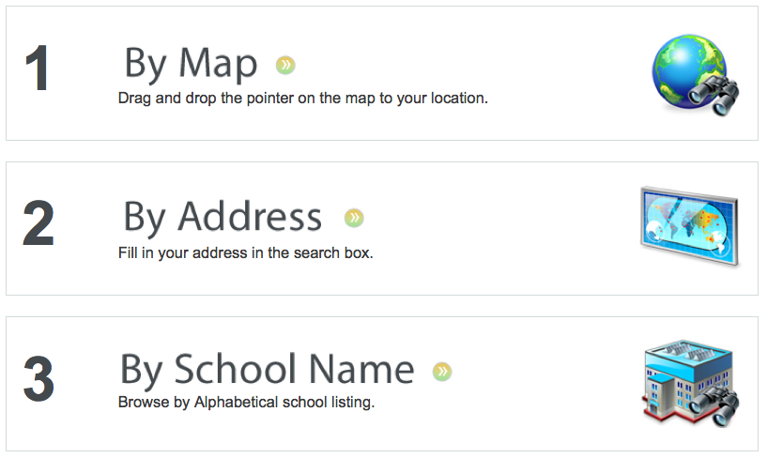
Find Your School
Choices for Nine
Find your school by selecting how you want to search.
Notes:
Key Messages:
Parents can type in their home address when they click on ‘By Address’ to find the secondary school in their area.

Slide 10
Choices for Nine
Information Nights at the High Schools
Program and school specific information is shared
Dates and times of High School Information Nights are listed in the Choices for Nine brochure and posted on the TDSB website
www.tdsb.on.ca/GoingtoHighSchool
Notes:
Key Messages:
Parents are strongly encouraged to attend their secondary home school information evening along with other schools they are considering through optional attendance.
Benefits of attending these evenings:
Get a feel for where your child will be spending the next 4 years;
Ask questions related to academic support and extra-curricular programs;
Speak personally with teachers and administrators ;
Listen and speak to school representatives and formulate personal thoughts on the fit for their child;
Visiting the school enables students and their families to make informed decisions about their child’s high school career.
Re-emphasize:
High school information nights will be listed in the Choices For Nine brochure and on the website

Slide 11
Choices for Nine
Information Nights at Specialized Schools
• To investigate specialized schools or programs, contact the
specific school for admission requirements
• Requirements may include auditions, tests, interviews, etc.
• Check deadline dates for application
Notes:
Key Messages:
Students and families:
Are encouraged to attend the specific school’s information nights for further information;
Should be informed and reminded of the secondary school information nights (TDSB Website/blog/announcements/school website/newsletter, etc);
Information nights will be listed in the Choices For Nine booklet;
Specialized programs and schools may have varying due dates re: application requirements and therefore parents should consult the school website and attend the information nights.

Slide 12
Making Course Choices
Choices for Nine
Ultimately, students and families make the final course choices
Grade 8 teachers or counsellors may make suggestions about course choices based on evidence of student’s achievement, learning style, interests, and abilities
Notes:
Key Messages:
This should be a collaborative effort:
You and your child will have your own ideas regarding course choices – make sure they are taking courses which align with their achievement, learning styles, interests, and abilities;
Grade 8 teachers will give recommendations based on their academic assessments;
Secondary schools will review the evidence of achievement from report cards and transition meetings;
Using all of the information available, students and families make the final decision.

Slide 13
What Course (Type) Choices Do Students Have in Grades 9 and 10?
Choices for Nine
Applied
Academic
Locally Developed
Open
Students should mix course types based on their achievement, interests, and skills. For example, a student may take applied English and French courses and academic Math.
Notes:
Key Messages:
Emphasize that all course types , especially in Grade 9, open doors to all destinations -the journey will be as varied as the unique learners that choose them.
Programs of study should be carefully considered and tailored to the student’s strengths and interests.

Slide 14
Academic and Applied Course Types
Choices for Nine
Academic Courses
Focus on theory and abstract problems
Applied Courses
Focus on practical applications and concrete examples
These courses include:
English, French, Geography, History, Math, and Science
14
Notes:
Key Messages:
Both academic and applied courses cover essential concepts.
Academic courses focus on theoretical and conceptual learning.
Applied courses focus on the concrete application of concepts and a greater emphasis on practical learning strategies.

Slide 15
Open Course Types
Choices for Nine
Open Courses
Optional courses that prepare students for further study and enrich their education
15
Notes:
Key Messages:
A common set of expectations for all.
Open courses compliment all pathways.
They are not considered “destination” based - meaning there is no pre-requisite for a Grade 11 course.

Slide 16
Locally Developed Course Types
Choices to Nine
Locally Developed
Compulsory courses for students who need more flexibility and support in their learning
Courses that may be developed locally include:
English, French, History, Math, and Science
Notes:
Key Messages:
Locally Developed courses were previously referred to as ‘Essentials’;
Locally Developed courses accommodate educational and/or career preparation needs.

Slide 17
What Are the Graduation Requirements?
Choices for Nine
Ontario Secondary School Diploma (OSSD)
Total of 30 course credits
– 18 compulsory courses – 12 elective courses
40 hours Community Involvement
– Begins in summer after Grade 8
Ontario Literacy Requirement
- Ontario Secondary School Literacy Test
Ontario Schools, Kindergarten to Grade 12:
Policy & Program Requirements, 2011
Notes:
Key Messages:
Credits
Students in Grades 9 and 10 will take 6 compulsory credits.
In Grades 9 and 10 , students will choose 2 elective credits each year (NB. Students with learning exceptionalities may be recommended for GLE (GLS where offered for some students) and therefore may only have 1 elective to choose from).
In Grades 11 and 12, students will have an opportunity to choose from a variety of elective courses.
Community Involvement
Students may begin community involvement activities as part of graduation requirements in the summer following Grade 8.
Community involvement activities for graduation requirement must not be part of any other program for which students receive credit: i.e. pay, badges, certification, etc.
Must be completed outside of regular classroom time - before, after school, during lunch period, or on week-ends.
Parents/guardians encouraged to be involved in monitoring appropriate volunteer activities for their children.
Students receive Community Involvement Passport at the end of Grade 9 in which to record volunteer experiences and track hours.
Students will be provided with a listing of activities which meet the criteria for community involvement (at times, they are asked to discuss with their guidance counsellor before beginning).
Literacy Test
Students will write the Literacy Test in the Grade 10 year.
Students who are unsuccessful on the first attempt at the Ontario Secondary School Literacy Test (OSSLT) may:
Attempt the test the following year OR
Enroll in the Literacy Course (credit course)

Slide 18
Can Students Change from One Type of Course to Another?
Choices for Nine
Yes, students can change their course types
To transfer from Grade 9 applied to Grade 10 academic math, students are required to take a transfer course or receive a recommendation from the Principal
Notes:
Key Messages:
The only transfer course that still exists is for Math.
This course is offered outside of the regular day school schedule (e.g., night school, summer school).

Slide 19
Do Students’ Course Type Choices Have an Impact on Postsecondary Options?
Choices for Nine
Yes!
The type of courses students take in Grades 9 and 10 affect their choices in Grades 11 and 12 and those choices affect students’ postsecondary options directly out of secondary school
Students who want to keep all postsecondary options open should choose academic courses in Grades 9 and 10
Notes:
Key Messages:
Current TDSB research informs us of limitations with respect to Applied vs. Academic programming.
The Applied course type programs, in the majority of the cases, do not lead to College and/or University.

Slide 20
Thinking About Programs of Study
Choices for Nine
The TDSB Board Improvement plan states…
By June 2017, the proportion of students enrolled in the grade 9-10 academic program will increase by 5%
Notes:
Key Message:
‘WHY’ this target: explanation in the next three slides…

Slide 21
What is the Data Telling Us?
Choices for Nine
Notes:
Key Messages:
TDSB data informs us that students in the Academic course type programs graduate ‘on time’ at a rate of 82% compared to students in the Applied course type programs that graduate ‘on time’ at a rate of 40%.
While Applied and Locally Developed course types are meant to meet student’s learning needs and provide viable pathways, it appears that students who take applied and Locally Developed as the majority of their course load have greater challenges with graduation outcomes.
Note: This does not mean that applied and Locally Developed Programs of Study (POS) are not viable options for some students, however, we need to be cognizant of the trends and failure rates in order to create successful outcomes for all students.

Slide 22
What is the Data Telling Us?
Choices for Nine
Notes:
Key Messages:
Research tells us that amongst the students who took the majority of their courses in the Applied Program of Study (POS), 4.2% confirmed an offer of admission to an Ontario university, 10.9% confirmed an offer of admission to an Ontario college, and 5.6% applied to a PSE institution without confirmation of an offer of admission.
Also Note:
Although the Applied POS is often a precursor to the College Preparedness POS for Grades 11-12, a surprising 79.3% of students did not apply to PSE at all. For the Locally Developed POS, only 5.7% of students applied to any PSE institution (1.1% confirming an offer to an Ontario university), while 94.3% did not apply.
When a deciding on post secondary destinations, the data is telling us:
“If you are thinking of University or College, then choose Academic”.

Slide 23
Undecided?
Choices for Nine
If unsure of the program of study, keep future options open and choose Academic.
Notes:
Key Message:
When possible, students should be encouraged to take an Academic POS rather than Applied courses.
In the past it may have been the practice of Teachers/Counsellors to be cautious and recommend Applied course types to students.
What the data is now suggesting is that the best possible outcomes for students are found through Academic course types.

Slide 24
What Course Type Choices Do Students Have in Grades 11 and 12?
Choices for Nine
Students choose courses depending on their destination after high school:
Workplace
College
University
Mixed (University/College Preparation)
Open
Notes:
Key Messages:
As the course types imply, they prepare students for their initial destination.
For example, a student who chooses the majority of their courses with the ‘College’ course type are preparing themselves for studies at College.
Open – has no destination – students may select these courses to gain a better understanding of subject that they are interested in, and to accumulate credits to fulfil graduation requirements.

Slide 25
What Happens if My Child Does Not Pass a Course?
Choices for Nine
Students may be recommended for Credit Recovery
Students may repeat the course in summer school
Students may repeat the course in the next semester or year
Notes:
Key Messages:
Students who obtain a mark of 50% or more have successfully completed a course.
Students will be informed of their achievement on a regular basis by their teachers. Parents will be informed of a student’s academic achievement through a variety of methods: contact by the teacher, Parent-Teacher Interviews, Interim and Provincial Report Cards.
Strategies and interventions are put in place to ensure that all students are successful.

Slide 26
What Kinds of Programs Are Available to High School Students?
Choices for Nine
See Choices for Nine for a full list of specialized schools and programs
Many home schools also offer these learning opportunities:
Specialist High Skills Majors (SHSM)
Cooperative Education (co-op)
Technological Education Programs
Dual Credit Programs
Ontario Youth Apprenticeship Program (OYAP)
Notes:
Key Messages:
The TDSB has made every effort to ensure that all Secondary Schools offer a variety of programming to meet the learning needs and interests of students.
As you attend Information Nights, every Secondary Schools will highlight the programs that they offer.
Details are also included in Choices for Nine and Choices (delivered in January).

Slide 27
Choices for Nine
Optional Attendance
Students are encouraged to attend the high school within the catchment area of their residential address (home school)
Use an Optional Attendance Application Form (PR545) when applying to a school other than your home school
Forms will be available at the Grade 8 school in January
Specific information regarding Optional Attendance Procedures will be communicated to students and families in early January
www.tdsb.on.ca/FindyourSchool/OptionalAttendance
Notes:
Key Messages:
High school information nights will be listed in the Choices For Nine brochure and on the TDSB website

Slide 28
Specific Dates
Choices for Nine
January 29, 2016 Optional Attendance applications due to secondary schools – delivered by student/parent/guardian
February 12, 2016 Secondary schools will inform Optional Attendance applicants by this date
Mid to late February 2016 Course Selections completed via myBlueprint and returned to elementary teacher/counsellor
February 26, 2016 All course selection sheets due to secondary schools – delivered by Elementary Counsellor
Note:
Only ONE course selection per student is submitted for
ONE secondary school by the elementary school counsellor
Notes:
Key Messages:
January
List of “Closed” and “Limited” schools made available; and
Optional Attendance applications available from elementary schools.
Distribution of Course Selection Sheets and/or myBluerprint course selection begins; and Parents/guardians are encouraged to consult the Choices for Nine brochure and the Choices book for information.
Parents/guardians are encouraged to be involved in their child’s educational planning through ongoing consultation with teachers and counsellors. Reviewing myBlueprint will also be helpful as descriptors are provided for the course types for Grade 9 and beyond.
Note for Teacher/Counsellors:
Establish the date with students for return of completed course selection sheets / myBlueprint. This will ensure that you have the course selection sheets submitted electronically to the secondary schools within the required timeframe.

Slide 29
Questions?
Choices for Nine

