Slide 1
Welcome to the Course Selection Assembly
February 2020

Slide 2
Important Dates
Dates | Activity
February 5 - 7th | Course Selection Class Visits Period 1: Grades 9 & 10 Period 2: Grades 11 & 12
February 7th | Course Fair (Per. 3 - Library)
February 4th | CO-OP Course Selection (Period 1 & 3)
myBlueprint Course Selection February 10 – 13th | Computer Lab A224 & Library Period 1: Grade 9 Period 2: Grade 10
myBlueprint Course Selection February 18 – 20th | Computer Lab A224 & Library Period 1: Grade 11 Period 2: Grade 12
February 21st | Last day for Course Selection

Slide 3
Graduation Requirements
Successful completion of literacy test
40 Hours of community involvement
30 Credits: (18 Compulsory & 12 Electives)
4 English
3 Math
2 Science
1 French
1 Geography
1 History
0.5 Careers & 0.5 Civics
1 Art
1 Physical & Health Education
Plus one credit for each of the following groups:
Group 1 | an additional English or French or a Social Science or Canadian & World Studies credit or a Guidance & Career Education credit or Cooperative Education credit
Group 2 | A Business Studies credit Or credit in Health & Physical Education Or credit in Arts Or credit in Cooperative Education Or credit in French
Group 3 | A grade 11 or 12 science credit Or a Technological Education credit Or a Computer Studies credit Or a Co-op credit Or a French credit

Slide 4
New Courses
Computer Programming (ICS4U1)
History of Race, Politics and Afro-Caribbean Diaspora (IDC3M1)
Spanish (LWSBD1)
Literacy: Reading & Writing (ELS2O1)
Videogame Design:
Media Arts (AMS2O1) & Computer Engineering Technology (TEJ2O1)

Slide 5
All Grade 10 Students Must Take…
8 Credits that include:
English
Math
Science
History
Civics and Career Studies
Elective #1 (your choice)
Elective #2 (your choice)
Elective #3 (your choice)
You must select 2 Alternative Courses

Slide 6
All Grade 11 Students Must Take…
8 Credits that include:
English
Math
You must select 2 Alternative Courses
All Grade 12 Students Must Take…
6 - 8 Credits that include:
English
You must select 2 Alternative Courses
Only senior students with more than 23 credits may have an unassigned period (spare) on their timetable.

Slide 7
Not Returning?
If you are going into grade 10, 11 or 12, please still fill out your course selections.
If you are graduating and not returning (you are entering the workplace, college, university, apprenticeship etc.), you must still fill out “not returning” on My Blueprint!
Last Step: Please fill out the Exit Survey.

Slide 8
Lenoard Braithwaite Program (LBP)
Our Africentric Specialized Program
Students planning to apply to the LBP program should pick regular stream courses.
Once you have been accepted into the program we will then make the necessary change
Interested in LBP? Fill out an application in guidance ASAP!
See the Course Selection board for LBP flow chart of required courses.
Current LBP students should pick courses that have a “P” at the end of the course code e.g. ENG4UP

Slide 9
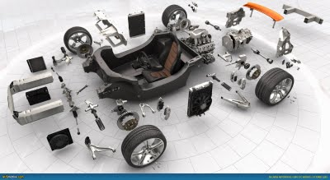
Specialist High Skills Major (SHSM)-Transportation
a ministry-approved specialized career-focused program that allows students to acquire technical knowledge and skills in Transportation Technology
Taken in grade 11 & 12
offers Transportation industry-specific education and training through high school Cooperative Education.
Receive a red seal diploma at graduation.
Can get SHSM specific bursaries at University.

Slide 10
myBlueprint
Students will choose and submit their courses on myBlueprint.ca
Everyone will receive step by step directions on how to select their courses.
Where to get help: Guidance Counsellors, Winston Churchill Website, Secondary Placemat, myBlueprint.ca
Course Selection video
Student Course Selection Video
https://www.myblueprint.ca/support/videos/course-selection/4DWTLIEMhGmo4wIqQasS6g

Slide 11
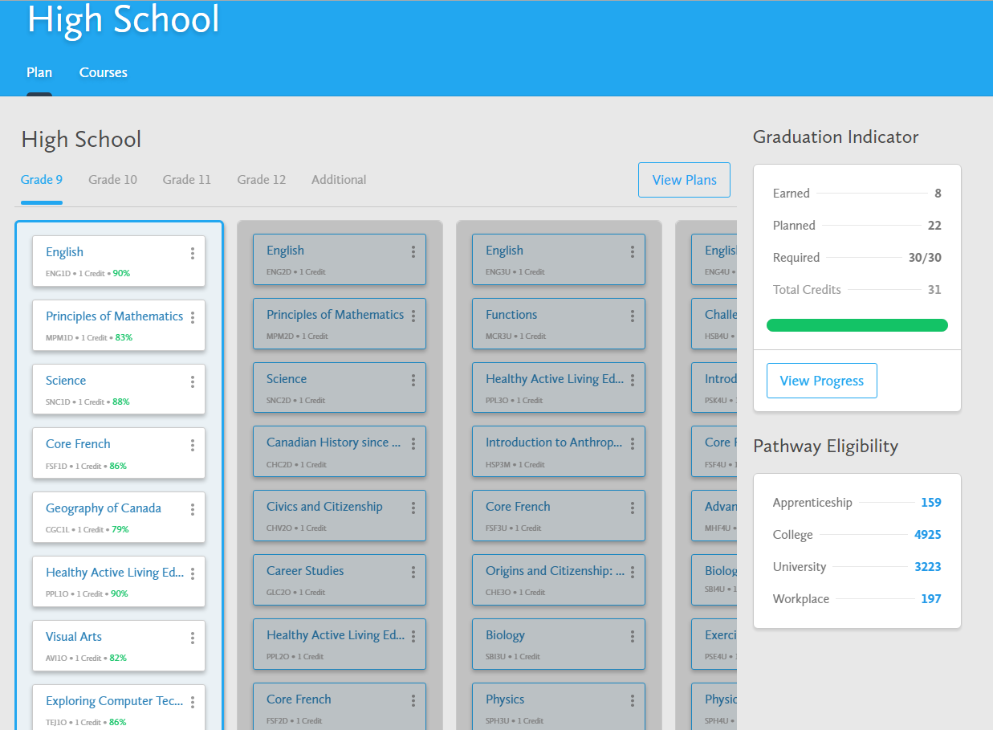
HIGH SCHOOL PLANNER

Slide 12
Where can you find information?
Choices Booklet
Winston Churchill website on the Guidance course selection tab.
Guidance Counsellor
www.myBlueprint.ca
www.tdsb.on.ca in the Secondary Schools Guidance tab

Slide 13
What should I do now?
Go onto www.myBlueprint.ca and reactivate your account before February 10th. If you need help, come to guidance after school. You will need your OEN number to reactivate your account.
Look at your Credit Counselling Summary to see the number of compulsory & elective courses that you need to take.
Review the course selection sheet and circle the courses you would like to take next year.
Go to myBlueprint to read the course descriptions to make sure you are interested in the course and that you have the pre-requisite to take the course.

Slide 14
Prizes!!
Choose your courses and submit your requests before February 21st and your name will be entered into a draw to win prizes e.g. Churchill Swag.

Slide 15
QUESTIONS?

