Slide 1
Scientist in the School:
Forces acting on Structures

Slide 2
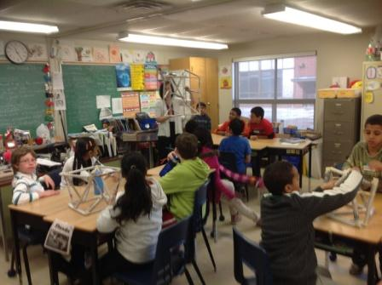
Each group constructed a free standing structure.

Slide 3
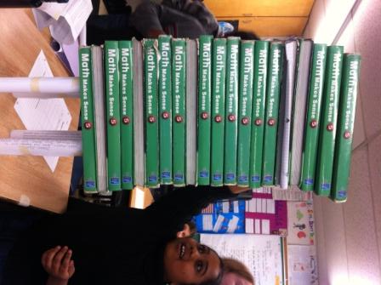
Shreela and Emily created a structure that held 21 math text books.

Slide 4
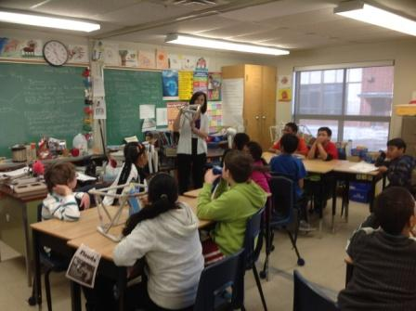
Structures containing triangles were stronger.

Slide 5
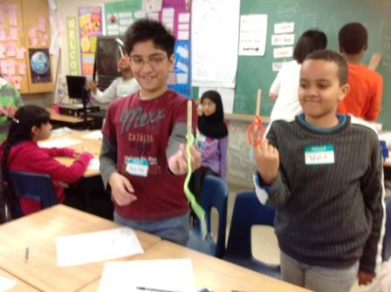
Abdullah and Walid balancing popsicle sticks. .

Slide 6
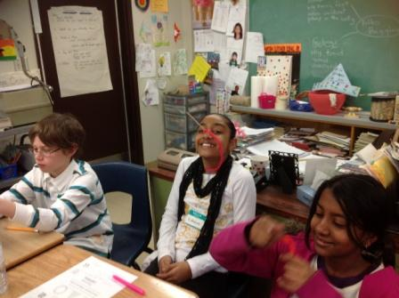
Eshaana was able to balance her popsicle stick on her nose.

Slide 7
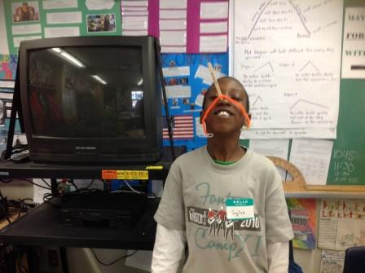
Sylva balancing his popsicle stick.

Slide 8
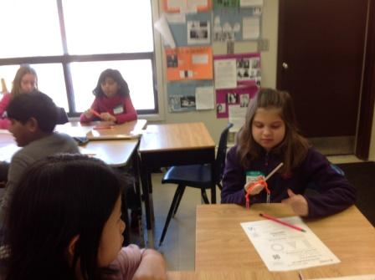
Barbara balancing her popsicle stick..

Slide 9
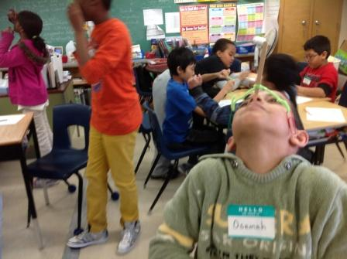
Osamah balancing his popsicle stick.

Slide 10
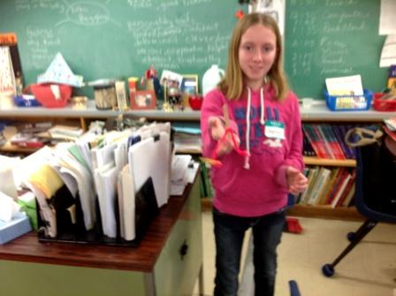
Jaylynn and her centre of gravity popsicle stick.

Slide 11
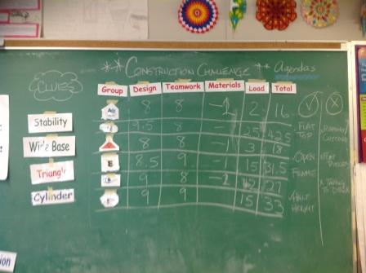
Construction Challenge was won by Team Hurricane .

