Slide 1
REGISTRATION NOW OPEN!
SEMESTER 2- 2016

Slide 3
TRY OUT A COLLEGE COURSE
Get a taste of college before you actually go
HUMBER COLLEGE
SENECA COLLEGE
GEORGE BROWN COLLEGE
CENTENNIAL COLLEGE

Slide 4
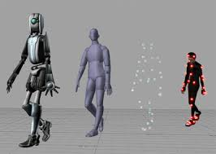
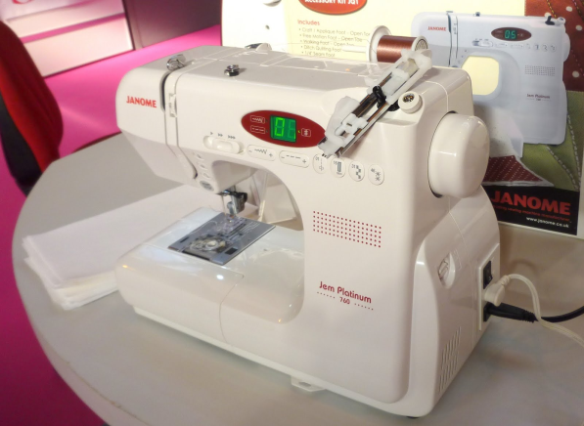
SOME OF THE COURSES OFFERED……..
Cosmetics
……….and many more
ANIMATION
Sewing and Drafting

Slide 5
REGISTER NOW!! Courses fill up quickly!!
If you are interested in signing up for a Dual Credit Course, speak to:
Ms. Gonya in the Coop office (Room 264).
See the list of available courses
You must be 16 years old and have at least 16 credits

Slide 6
DUAL CREDIT INFORMATION SESSION
Tuesday November 24, 2014
“LUNCH AND LEARN” SESSION
IN the Library 11:40am
PIZZA LUNCH PROVIDED
SIGN UP SHEET
IN COOP OFFICE AND GUIDANCE OFFICE

