Slide 1
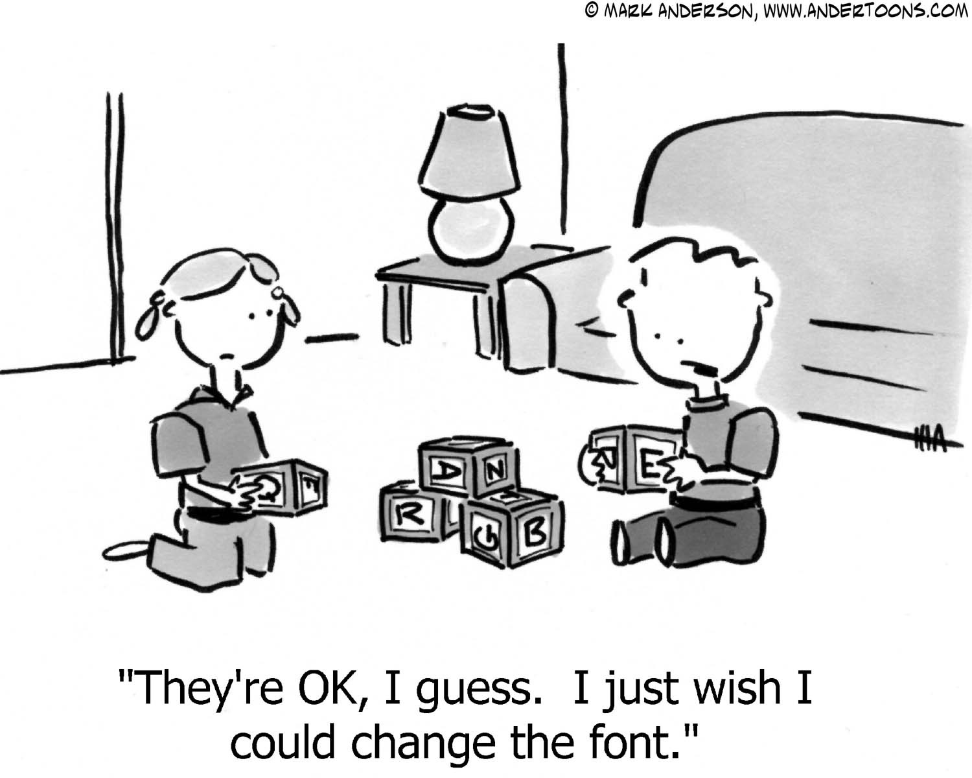
Overview of the Gifted Program
Forest Hill Public School
2014 - 2015

Slide 2
about the Gifted Program
Gifted students need to serve as examples to others, and they should always assume extra responsibility.
Gifted students are naturally creative and do not need encouragement
Gifted students do not need help. If they are really gifted, they can manage on their own.
The social and emotional development of the gifted student is at the same level as his/her intellectual development.
The primary value of a gifted student lies in his/her brain power.

Slide 3
Identifying the School-age Gifted Student (generalized characteristics)
Curious and enjoys learning new things
Absorb information rapidly and with less repetition
Excellent memory
Long attention span
Reasoning & problem solving skills
Intense interests
Unusual and/or vivid imagination
Intrinsically motivated to learn topics of interest
Concerned about fairness and (social) injustice
Energetic
Asynchronous development
A sense of humor
Perfectionistic
Prefer books and magazines meant for older children

Slide 4
Gifted Learners at Forest Hill
Social and real world application of learning; critical and creative thinking skills; and goal setting.
Students engage in critical thinking and reasoning abilities across the curriculum.
We provide an environment that encourages and fosters inquiry and challenging attitudes toward learning.
Students develop creativity through fluency, flexibility, originality, elaboration, problem-finding, and problem-solving exercises.
Teachers use students’ strengths and interests to determine explorations.
Needs are addressed through individual goal setting with an emphasis on organization, and inquiry skills

Slide 5
Teaching Strategies for Gifted Learners
Building relationships
Letting Go of "Normal"
Constructing curriculum based on individual interest
Compacting
Accelerating
Differentiating

Slide 6
How Forest Hill Teachers Differentiate
Students participate in self-assessment, goal setting, and reflection of goals for each term
Critical and creative thinking skills are developed
Continuous formative assessments are given to develop instruction.
Opportunities to go more in-depth on topics of interest and make deeper global connections
All grade levels participate in project-based curriculum that allows for students to select research subjects according to interest and ability.

Slide 7
Transportation
Bussing for students in grade 4-5 whose home school is outside of the 1.2 km radius of the school.
Bussing for students in grade 6 whose home school is outside of the 3.2 km radius of the school.
*TTC tickets are provided to students in grades 6-8 who live outside of the 1.2 km radius of the school. *must complete an application form

Slide 8
Tips for Parents
Discover Your Child’s Interests
Create multiple opportunities for your child to try a variety of activities
Explore your community. Actively follow the local newspapers, social media feeds, or local events and happenings
Don’t be afraid to introduce your child to a subject that you know little about

Slide 9
Tips for Parents
Link Interests to School
Help your child to see the real-world connection between curriculum introduced at school and experiences in everyday life.
Communicate with your child’s teacher if your child is passionate about specific topics or is showing interest in a new subject or event
Notes:
Grocery Shopping, money. Geography, help plan a trip. Math and sports

Slide 10
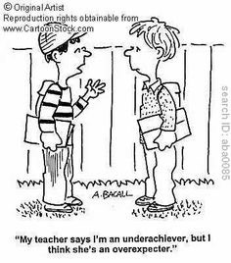
Tips for Parents
Gifted Underachievers
Set up an organizational system
Discuss the difference between effort and ability
Model your own willingness to try difficult tasks
Discuss with your child someone whom you admire and that person’s journey
Notes:
Read a biography

Slide 11
Tips for Parents
Consider Yourself to be Your Child’s Primary Educator
Take your child to places that will interest them or engage them higher-level thinking
Enter your child in competitions and contests
Participate in a book club with your child and engage him/her in discussions on character and plot.
Let your child plan family evenings, meals, or celebrations
Notes:
Exhibits, museums, the fair, poetry or writing contests,

Slide 12
Sit Back & Relax … and Let Them be Kids!!

