Slide 1
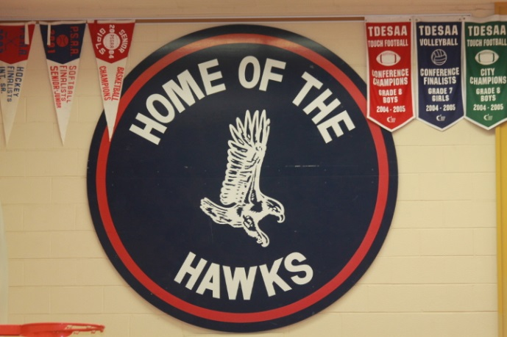
Welcome!
Hodgson Middle School
Parent Information Night
February 2, 2017

Slide 2
Our Goals
To provide our students and parents with a supportive, successful transition to Hodgson
To share information about the transition to Hodgson Middle School and the addition construction as it becomes available

Slide 3
What Will I Learn Here?
How to stay informed about progress and process
How are we getting ready for Middle School?
What will be different from your current school?
What will be the same as your current school?
What does the road ahead look like?

Slide 4
How Can I Stay Informed?
Schoolweb.tdsb.on.ca/hodgson
Hodgson’s Addition Webpage
Q and As:
-Update on the construction of the addition
-Update on the transition to Hodgson Middle school
@TDSBHodgsonSrPS
The Hodgson Update (sign up now on our website)
Trustee Laskin’s Weekly Update
ian.wilson@tdsb.on.ca – lori.campbell@tdsb.on.ca

Slide 5
Getting Ready for Middle School
Involves a lot of consultation and input:
Admin Transition Teams
School Transition Team (s)
School Council (s)
Hodgson Staff (Music, Phys. Ed., Library, etc.)
TDSB Staff (Superintendent, Planning, Facilities, etc.)
Trustee Laskin

Slide 6
Getting Ready for Middle School
We are planning for:
Transitions for Grade 6 and Grade 7
Staffing for 2017-2018 year
School Organization for 2017-2018 year
Portable placement and use
Grade 6 students to school community
Resources: Furniture, Instruments, Computers, Phys. Ed. Equipment, etc.
Planning, Design and Construction of the Addition

Slide 7
What Will Be Different?
Rotary timetable (More specialized teaching)
More teachers to get to know
More physical activity/exercise
More social opportunities
Choices for lunch
Extra-Curricular Activities: Music, Clubs, Teams, etc.

Slide 8
What Will Be the Same?
Safe, nurturing and caring environment
Subjects
Ontario Curriculum (Gr. 1 to 8)
School Day (300 mins per day)
Attendance
Supervision

Slide 9
Looking Ahead
Classrooms Renovation and Re-assignment
Student Transition Days
School Visits by Ian and Lori
Hodgson Mentors
Portables
Construction of the addition 2018-2020
First Day Planning “Welcome to Hodgson!”
Grade Team Building Overnight Trips (October and November)

Slide 10
The Hodgson Addition
Funding Approval, (November 2016)
Space Template Date, (February 2017): This is to be submitted to Ministry for approval to proceed.
Consultant Approval, (April 2017): After Space Template Approval, we can start the selection process for Consultants.
New School Review Team Mtg., (June 2017): The Consultants (Architects) will prepare a site plan before summer break.
New School Review Team Mtg. (September 2017): The Consultants will have plans and elevations ready for after the summer break.
Public Meeting(s), (October 2017): This is an estimated date. We will want to show the community a preliminary design for the project.
Sketch Plan Approval (Board), (November 2017): TDSB Board approval of preliminary design and costing.

Slide 11
The Hodgson Addition (continued)
Site Plan Approval Submit, (December 2017): Start of City of Toronto Planning review of the project, estimated to take one year.
Site Plan Approval Date, (December 2018): Estimated completion of City of Toronto Planning review.
Building Permit Approval, (January 2019): Estimated completion of Building Department review.
Tender Start, (November 2018): We go out to secure a Contractor just prior to City of Toronto approvals.
Contract Award (Board), (January 2019): TDSB Board approval and Ministry approval of Contractor.
Construction Start, (March 2019): Includes construction mobilization in February
Occupancy Date, (July 2020): Substantial Completion of project
School Start, (September 2020): Gives the summer to move furniture in and address any construction deficiencies.

Slide 12
What Don’t We Know Yet?
Staffing (Spring 2017)
Timetables
Student Enrolment
Extended Day program

Slide 13
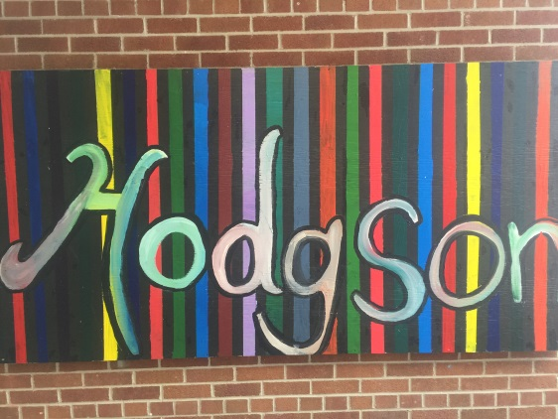
Thank you

