Slide 1
John Fisher Parent Council School Budget Year 2017 / 2018
UNDERSTANDING THE PROCESS
Funds raised in the prior year by the school parent council and associated committees are made available for spending on school activities that are either not part of the curriculum or are not covered by School / TDSB Funding.
In October John Fisher Parent Committees and the school had the opportunity to present their budgets and requests for funds to the persons attending the parent council meeting.
Following this meeting the finance committee has met, during the finance meetings the requests for funding were reviewed in detail, questions to clarify spend were posed to the budget requestors and the finance committee makes a recommendation to the parent council members for Budget Approval

Slide 2
John Fisher Parent Council Budget Year 2017 / 2018
Total funds raised in 2015 / 2016 and amounts from unspent from prior years for use during this school year are:
$83,877.56
Requests for funding came from 4 Parent Committees and from the school.
Requests for funds exceeded funds available by $32,832
Following the finance committee review The green committee and the school were asked to make changes to their budget. All other committee requests were proposed for approval unchanged.

Slide 3
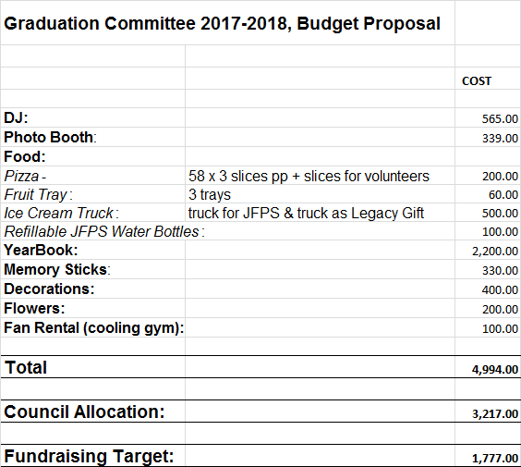
John Fisher Parent Council School Budget Year 2017 / 2018
The graduation budget is in line with prior years.
The finance committee proposes this budget be approved
Prepared by Kari-Lynn

Slide 4
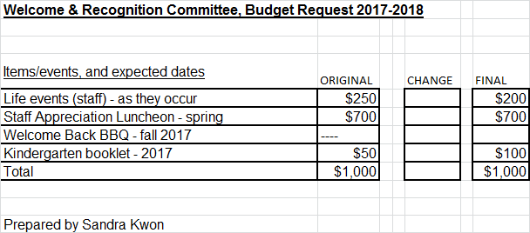
John Fisher Parent Council School Budget Year 2016 / 2017

Slide 5
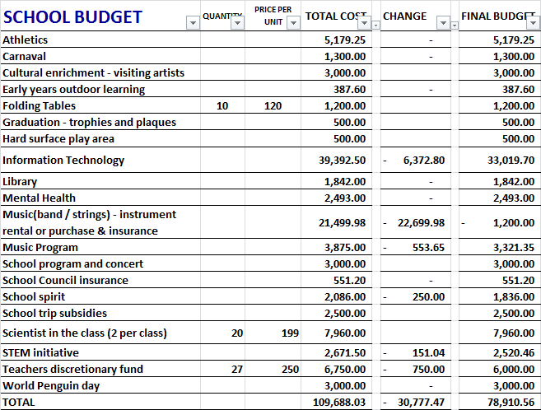
John Fisher Parent Council School Budget Year 2016 / 2017

Slide 6
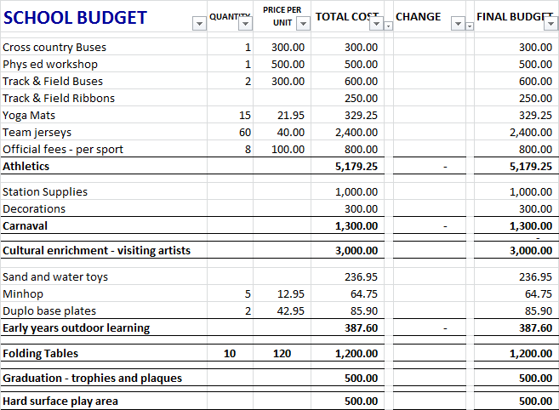
John Fisher Parent Council School Budget Year 2016 / 2017

Slide 7
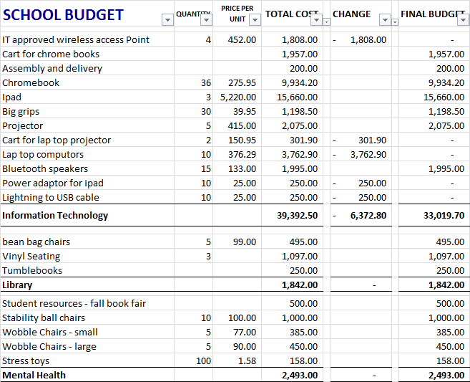
John Fisher Parent Council School Budget Year 2016 / 2017

Slide 8
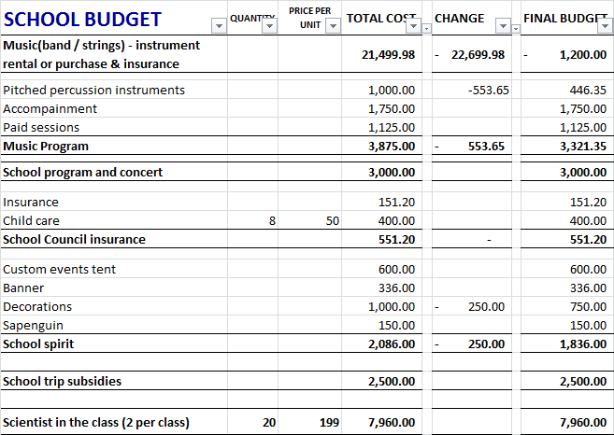
John Fisher Parent Council School Budget Year 2016 / 2017

Slide 9
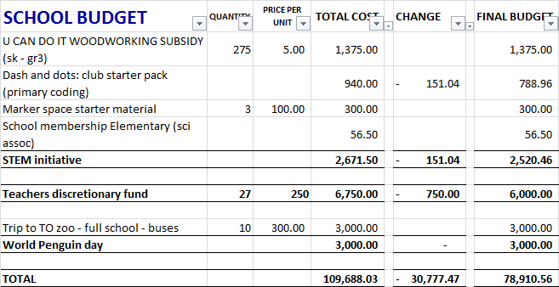
John Fisher Parent Council School Budget Year 2016 / 2017

Slide 10
John Fisher Parent Council School Budget Year 2016 / 2017
NEXT STEPS
FOLLOWING PRESENTATION OF THE BUDGET PROPOSED BY THE FINANCE COMMITTEE THE PARENT COUNCIL VOTE TO ACCEPT THE BUDGET
THE TREASURER IS THEN RESPONSIBLE FOR ENSURING THE FUNDS ARE SPENT AS APPROVED THROUGH THE YEAR 2017 / 2018

