Slide 1
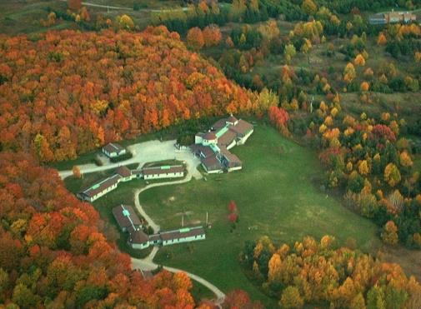
Mono Cliffs Outdoor Education Centre
Fall Visits 2019

Slide 2
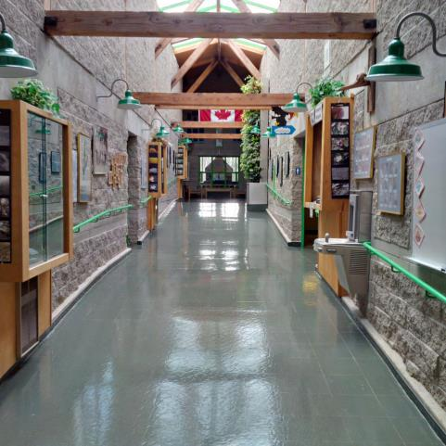
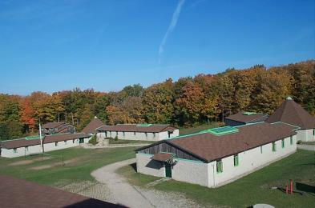
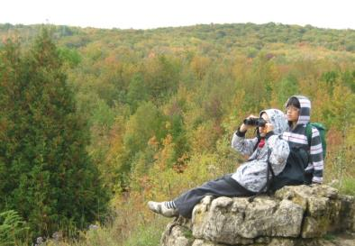
Students from your school will soon visit
Mono Cliffs Outdoor Education Centre.

Slide 3
We are proud to be a Platinum EcoCentre
(and a Platinum EcoSchool since 2009)
Are you an EcoSchool?
Talk to us about ideas to help with your certification.

Slide 4
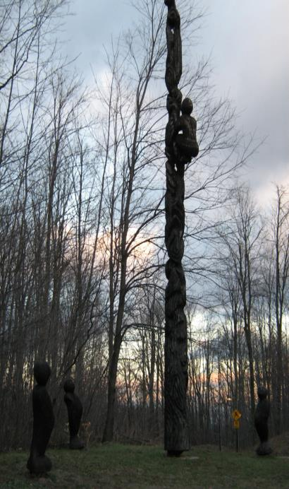
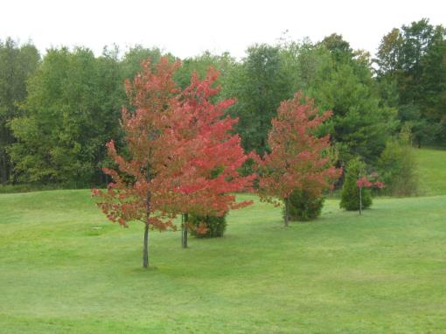
In this Presentation you will learn about:
• Mono Cliffs Outdoor Education Centre
• What activities you will be doing
• Where you will eat and sleep
• What you need to do before the visit
• What you need to bring with you
Our mission: To provide an outdoor education experience that inspires everyone who crosses our path.

Slide 5
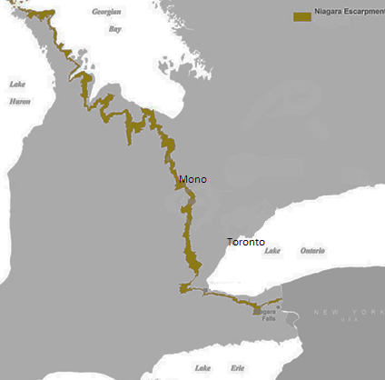
Mono Cliffs Outdoor Education Centre is owned and operated by Toronto District School Board
We are located on the Niagara Escarpment, about 1.5 hours from Toronto, just north of Orangeville, Ontario

Slide 6
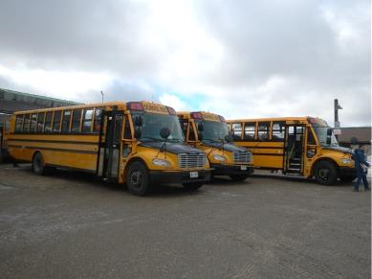
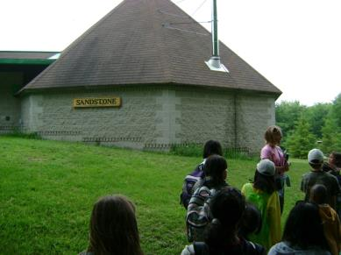
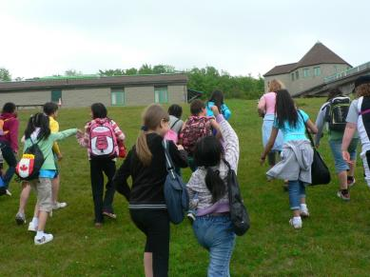
A school bus will bring you to and from your school and Mono Cliffs
When you arrive at Mono Cliffs you will be taken on a walking tour of our school

Slide 7
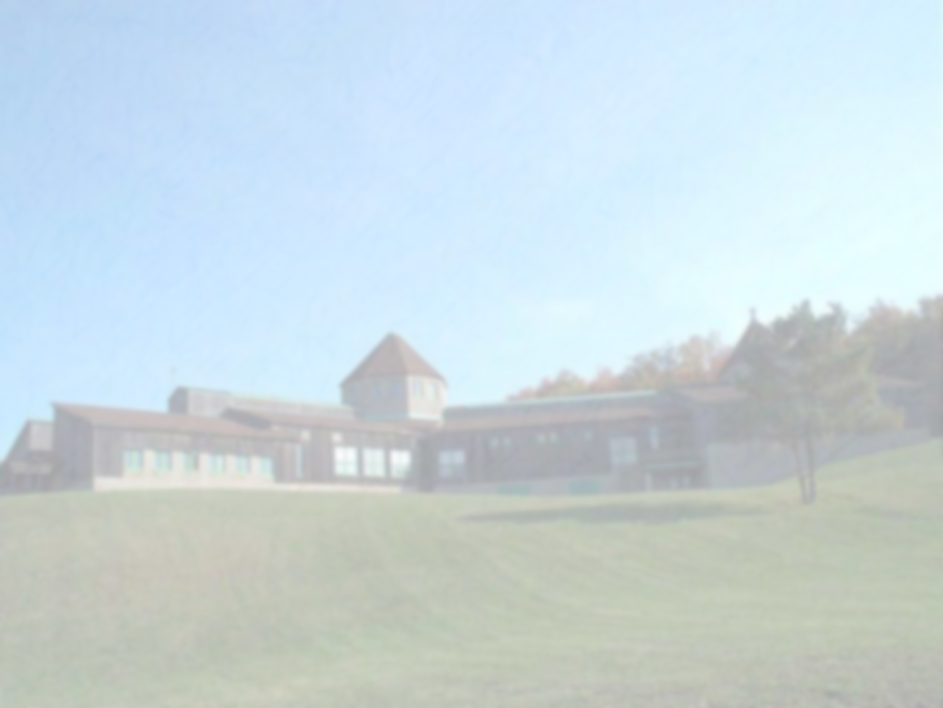
The following slides are of the programs that your teachers have selected for you to participate in during your visit:
Archery and Lacrosse
Digital Photography
Early Settlers
Ecology Hike
Environmental Improvement Project
Fur Traders
Geology Hike
High Ropes
Instincts for Survival
Mountain Biking
Nature Art Inspired by Andy Goldsworthy
Orienteering
Pond Study
Solar Energy
Survival Skills
Team Building
Watercolours
Wolf Prowl
Woodland Art
Woodworking
Delete all activities that you will not be participating in on this list
Please also delete the slides that correspond with those activities

Slide 8
Archery and Lacrosse
Archery is a half program that is often done with lacrosse or team building.

Slide 9
Digital Photography
This program can be done with an Arts focus or a Science and Technology focus.

Slide 10
Early settlers

Slide 11
Ecology Hike

Slide 12
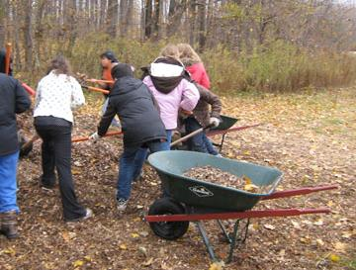
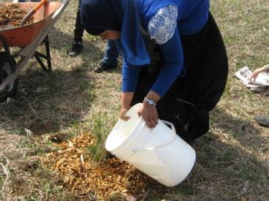
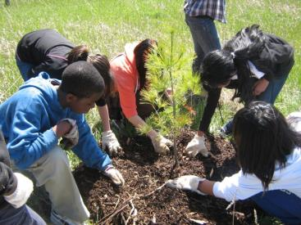
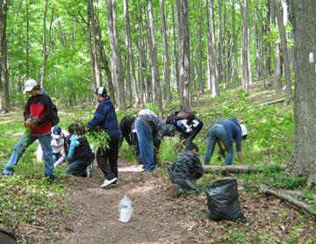
Environmental Improvement Project

Slide 13
Fur Traders

Slide 14
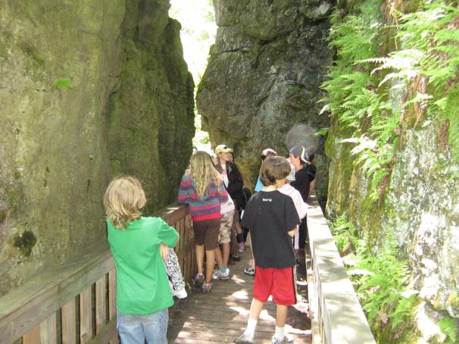
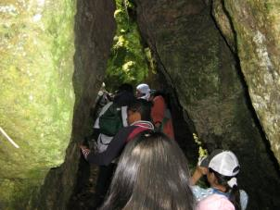
Geology Hike

Slide 15
High Ropes

Slide 16
Instincts for Survival

Slide 17
Mountain Biking

Slide 18
Nature Art Inspired by Andy Goldsworthy

Slide 19
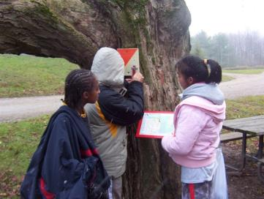
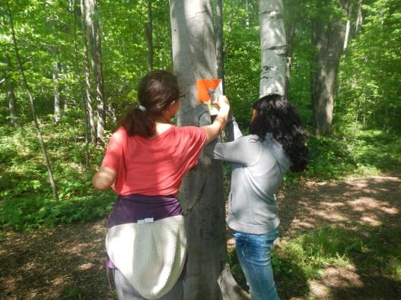
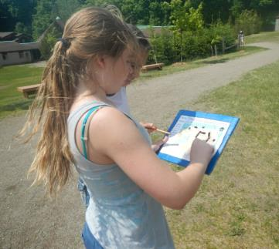
Orienteering

Slide 20
Pond Study

Slide 21
Solar Energy

Slide 22
Survival skills

Slide 23
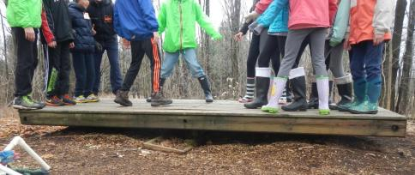
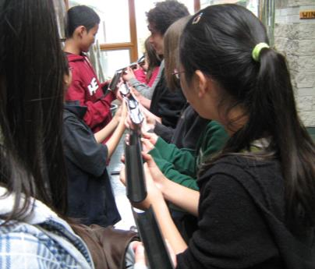
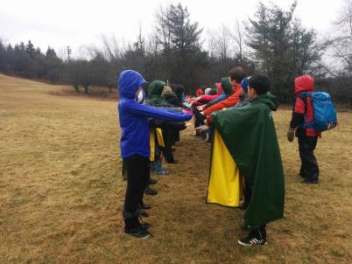
Team Building and Low Ropes

Slide 24
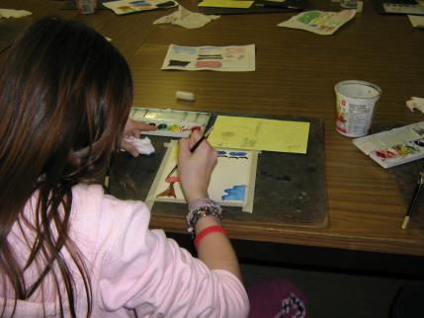
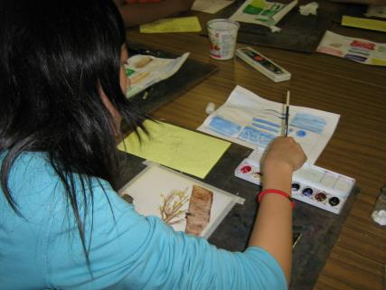
Watercolours

Slide 25
Wolf Prowl

Slide 26
Woodland Art Inspired by Norval Morrisseau

Slide 27
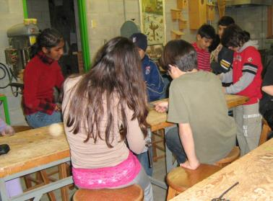
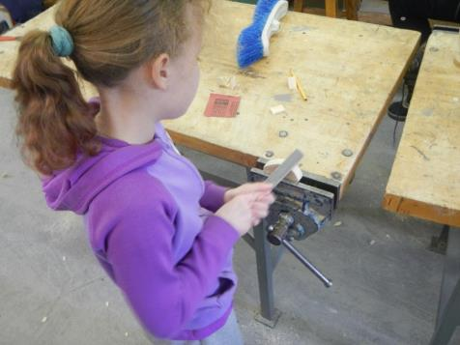
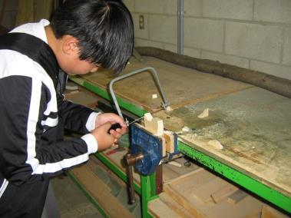
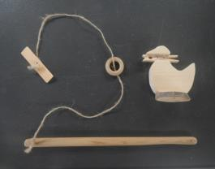
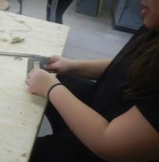
Woodworking

Slide 28
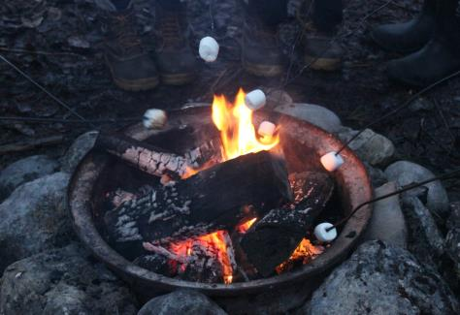
Evening programs
Mono Cliffs staff will lead evening program with visiting teachers. One evening program includes a campfire.

Slide 29
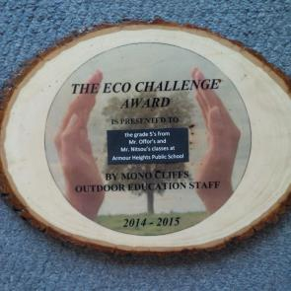
EcoChallenge Award
The EcoChallenge Award is open to all part of every school visit. It is designed to increase awareness about our impact the environment. There are four areas:
Reducing Food Waste
Reducing Water Waste
Turning off Lights
Last year the winners were Grade 5’s from Armour Heights Public School.
Sorting Waste

Slide 30
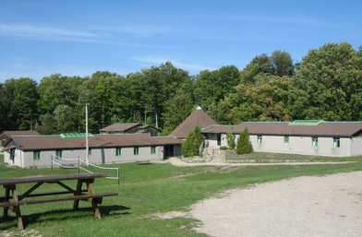
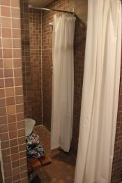
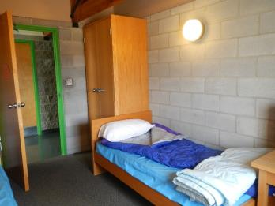
Where will you sleep?
Mono Cliffs has two separate dorm buildings: Sandstone, and Dolomite.
Each of these dorms has two separate wings and a communal Lounge.
Each dorm wing has its own separate rooms for the washrooms and showers.
Each dorm room has two beds, cupboards and desks. Students must bring their own bedding – either a sleeping bag or two sheets. We provide a clean pillowcase, pillow and blankets for each person.

Slide 31
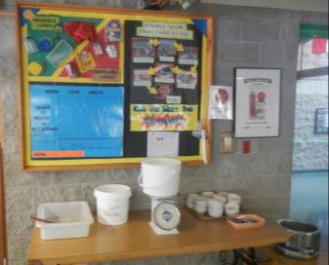
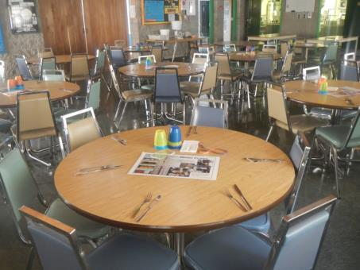
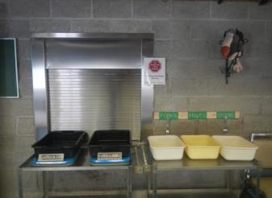
Food and the dining room
Our kitchen staff will accommodate dietary needs as requested on the medical and dietary form (for example requirements based on religious beliefs, allergies or food sensitivities).

Slide 32
Permission forms
You will need to fill out and return the following forms to your teacher:
511C – Permission form 511E – Medical form
Agreement to Participate Form

Slide 33
What to bring
Waste free lunch for the first day
Digital camera (optional)
Clothing appropriate
to the season (see packing
list)

Slide 34
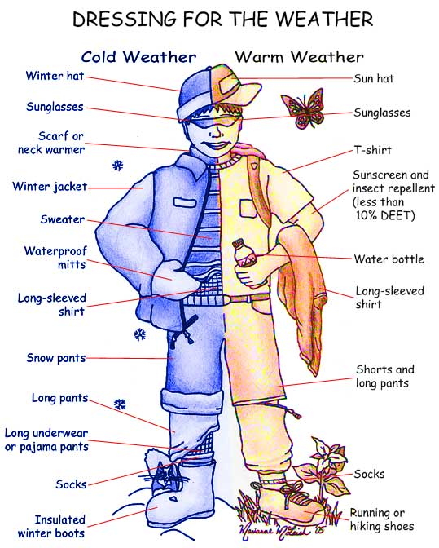
Dressing for weather

Slide 35
Do not bring
Scented products
Snacks or treats
Disposable water bottles
A cell phone or any
electronics

Slide 36
Looking forward to seeing you soon!
Check out our website for further information:
schoolweb.tdsb.on.ca/monocliffs

