Slide 1
Mono Cliffs Outdoor Education Centre
Winter Visits 2019-2020

Slide 2
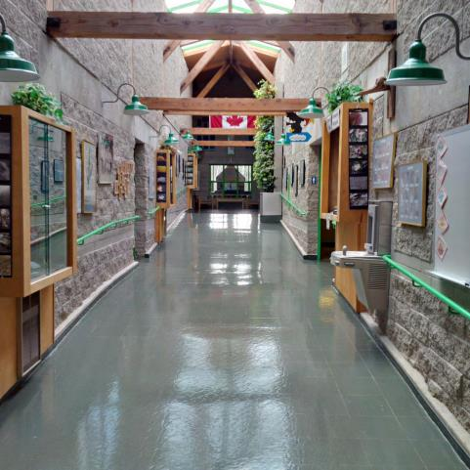
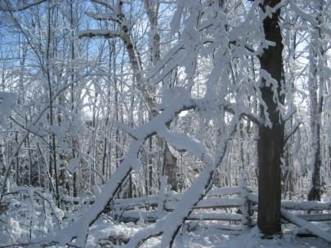
Students from your school will soon visit
Mono Cliffs Outdoor Education Centre.

Slide 3
We are proud to be a Platinum EcoCentre
(and a Platinum EcoSchool since 2009)
Are you an EcoSchool?
Talk to us about ideas to help with your certification.

Slide 4
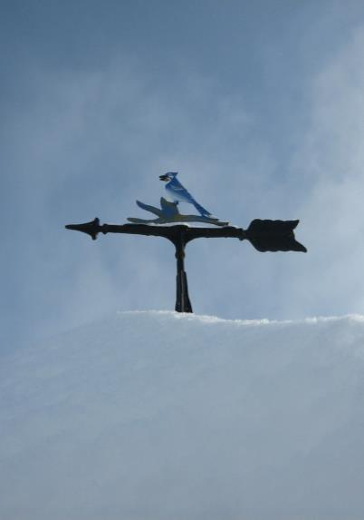
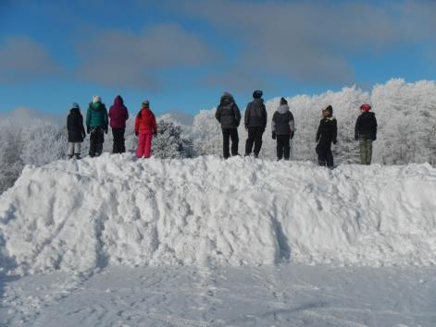
In this Presentation you will learn about:
• Mono Cliffs Outdoor Education Centre
• What activities you will be doing
• Where you will eat and sleep
• What you need to do before the visit
• What you need to bring with you
Our mission: To provide an outdoor education experience that inspires everyone who crosses our path.

Slide 5
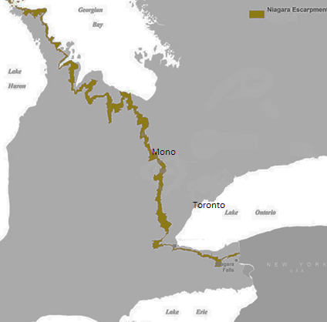
Mono Cliffs Outdoor Education Centre is owned and operated by Toronto District School Board
We are located on the Niagara Escarpment, about 1.5 hours from Toronto, just north of Orangeville, Ontario

Slide 6
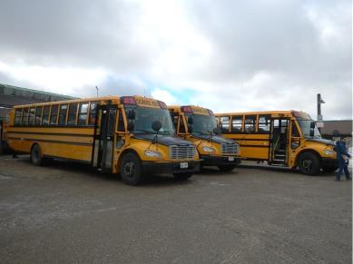
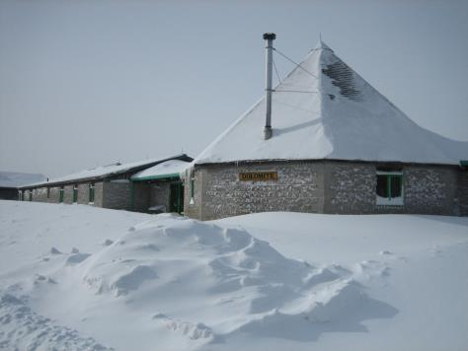
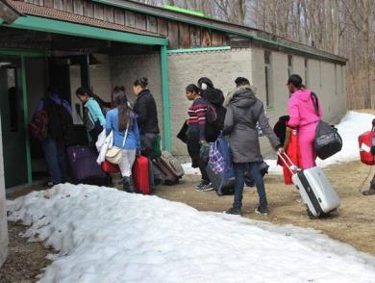
A school bus will bring you to and from your school and Mono Cliffs
When you arrive at Mono Cliffs you will be taken on a walking tour of our school

Slide 7
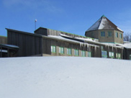
The following slides are of the programs that your teachers have selected for you to participate in during your visit:
Cross-Country Skiing
Digital Photography
Early Settlers
Ecology Geology Hike
Fur Traders
Instincts for Survival
Maple Syrup
Snowshoeing
Orienteering
Survival Skills
Team Building
Aurora Borealis
Wolf Prowl
Woodworking
Delete all activities that you will not be participating in on this list
Please also delete the slides that correspond with those activities

Slide 8
Cross-country skiing
Physical Education

Slide 9
Digital Photography
This program can be done with an Arts focus or a Science and Technology focus.

Slide 10
Early settlers
History

Slide 11
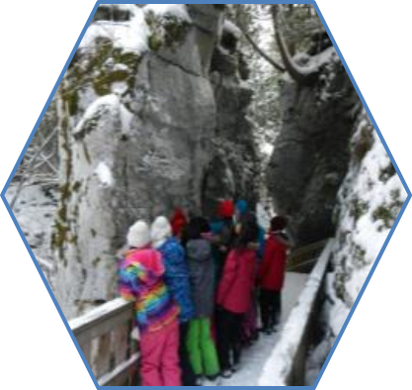
Ecology/Geology Hike
Science & Technology

Slide 12
Fur Traders
Social Studies, History

Slide 13
Instincts for Survival
Science & Technology

Slide 14
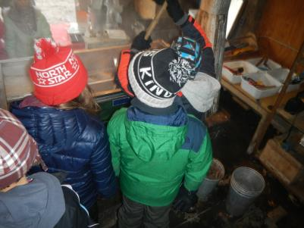
Maple Syrup
Science & Technology and Social Studies

Slide 15
Orienteering
Physical Education

Slide 16
Snowshoeing
Physical Education

Slide 17
Survival skills
Science & Technology

Slide 18
Team Building and Initiatives
Physical Education

Slide 19
Wolf Prowl
Science & Technology

Slide 20
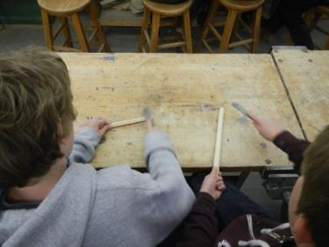
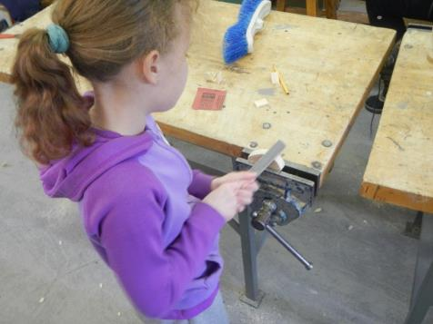
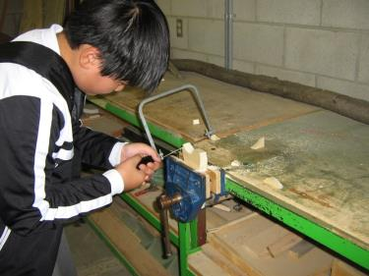
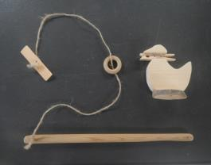
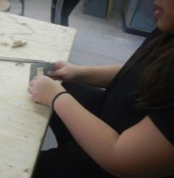
Woodworking
The Arts

Slide 21
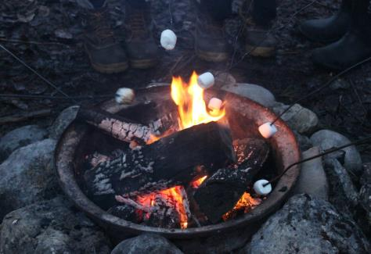
Evening programs
Mono Cliffs staff will lead evening program with visiting teachers.
One evening program may include a campfire.
Other options include Night Orienteering, Aurora Borealis, Fire Technology or a
Night Hike

Slide 22
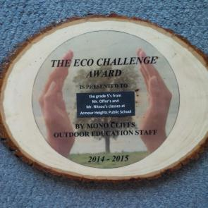
EcoChallenge Award
The EcoChallenge Award is open to all parts of every school visit. It is designed to increase awareness about our impact the environment. There are four areas:
Reducing Food Waste
Reducing Water Waste
Turning off Lights
Sorting Waste
Last year the winners were Grade 6’s from Hillmount Public School.

Slide 23
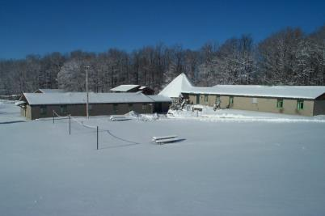
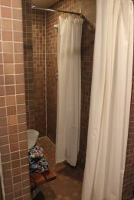
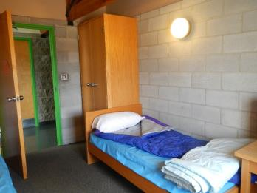
Where will you sleep?
Mono Cliffs has two separate dorm buildings: Sandstone, and Dolomite.
Each of these dorms has two separate wings and a communal Lounge.
Each dorm wing has its own separate rooms for the washrooms and showers.
Each dorm room has two beds, cupboards and desks. Students must bring their own bedding – either a sleeping bag or two sheets. We provide a clean pillowcase, pillow and blankets for each person.

Slide 24
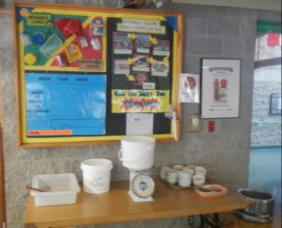
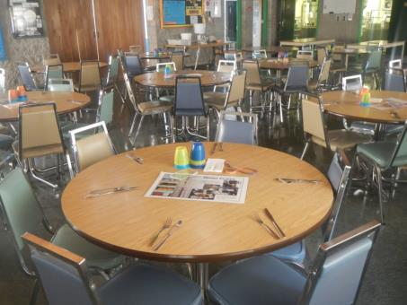
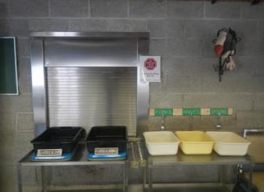
Food and the dining room
Our kitchen staff will accommodate dietary needs as requested on the medical and dietary form (for example requirements based on religious beliefs, allergies or food sensitivities).

Slide 25
Permission forms
You will need to fill out and return the following forms to your teacher:
511C – Permission form 511E – Medical form

Slide 26
What to bring
Waste free lunch for the first day
Digital camera (optional)
Clothing appropriate to the season (see packing list and check the weather before your visit)

Slide 27
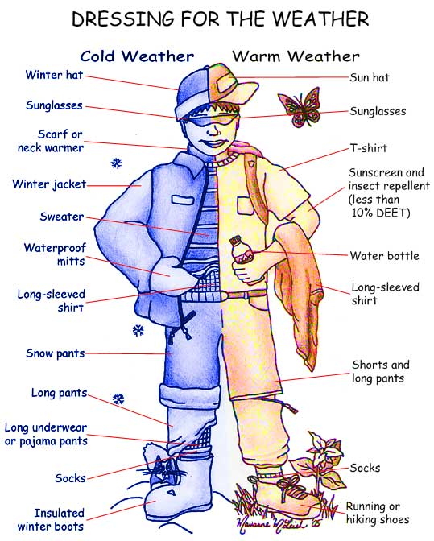
Dressing for weather

Slide 28
Do not bring:
Scented products
Snacks or treats
Disposable water bottles
A cell phone or any
electronics
Money

Slide 29
Looking forward to seeing you soon!
Check out our website for further information:
schoolweb.tdsb.on.ca/monocliffs

