Slide 1
Adjusting to university life
Written By Malcom Li Directed By Malcom Li
Narrated By Malcom Li

Slide 2
Background Information
1995, I arrived
Was raised in Toronto
Proud cat owner
I had my eyes set on University of Waterloo Computer Engineering early on
Looking back I wished I considered other options more seriously
Graduated A.Y. Jackson Secondary School in 2013
Just graduated Computer Engineering at the University of Waterloo
Will start full time as a Software Developer in San Francisco

Slide 3
Thoughts & expectations leading up to university
Focused on enjoying my last summer vacation for the next 5 years
Looked forward to making new friends
Worried that I would utterly fail
Excited to live independently
Ready. To. Party.
Expected great things from FROSH week

Slide 4
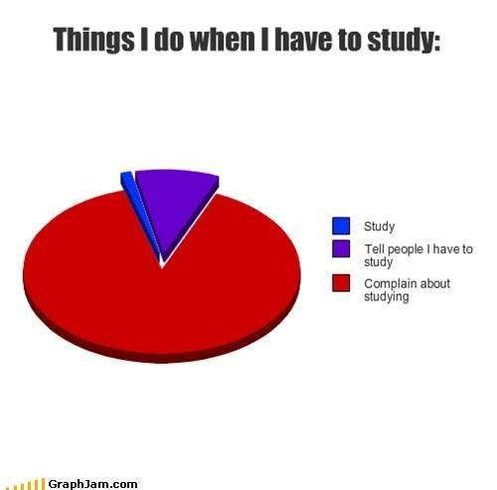
Reality of first year
Waterloo does not party much
Had a hard time making new friends
Had a set of existing friends
Comfort zone was too comfortable!
Always work to do
Courses weren’t very relevant

Slide 5
Things i wished i knew in first year
Some courses do not require you to purchase a textbook
Professors will tell you whether or not you need it
Resources could be found in the library
Get a head start on prepping for internships
There are some workshops provided (resumes, interview prep, etc)
Connect with upper years, they know more (FACT)
Live in a traditional residence
As opposed to a suite style residence
Take a gamble with a random person
If you can’t focus at home, LEAVE
Go to office hours & talk to TA’s
Don’t eat so much junk food…

Slide 6
My Humble Beginnings (First 2 coops)
1)
Had to rely on personal connections to an Internship
Worked in IT rather than software development
First full time job in a professional environment
MONEY!
2)
Used personal connections to land myself an interview
Was too unconfident and unprepared
Had to rush to find a job
Worked as a software developer
Light workload

Slide 7
My Coop journey
Was inspired from friends, coworkers, and classmates to work harder and aim higher
Focused on getting as much experience as possible
Had my eyes set on America
Passionate about finding my passion
Asked friends for advice on how to improve
Prepped A LOT for interviews
Was able to find a great company in SF by my 5th coop
Next goal was to find full time

Slide 8
Coop advice
Start Early!!!
PREP PREP PREP!!!!
It is easy to lose sight with 30-40 hours of class, tests, etc
There is actual money and experience on the line!
Talk to anyone
Employers, Alumni, Friends, Classmates, etc
Participate in seminars and career counseling
Attend info sessions
Try out different things
Aim to find that perfect fit by your last internship
Don’t be scared of looking outside of school job boards

Slide 9
My Later years in university
I found my later years to be routine
Slack, interview prep, interviews, catch up on school, finals
Cherished the time to spend with friends and family
Make time for building relations
Obsessed about improving time management skills
Made sure to find time to have fun

Slide 10
FInal thoughts on university
Top notch place to make connections
Socialize, socialize, socialize!!
Great place to kickstart career
Extremely grateful for the people I got to meet in University and the friends I kept in touch with
I frankly don’t like school, but I loved coops
Overall a great experience, but excited to move on

Slide 11
Thanks for listening!

