Slide 1
Grade 8 to 9
Transition Information Session for the
2019-2020 School Year

Slide 2
Goals for the Evening
Beyond 8 - Choices for Nine
To inform students, parents & guardians about high school choices in order to make a smooth and successful transition from Grade 8 to 9
To assist students, parents & guardians in making informed choices about courses, programs and schools
To raise student, parent and guardian awareness of the various program pathways available throughout the Toronto District School Board

Slide 3
Creating Pathways to Success, 2013

Slide 4
Accessing myBlueprint.ca/tdsb
Online educational & career planning tool for students and parents
www.myBlueprint.ca/tdsb Use your TDSB Computer User name & Password to login

Slide 5
What Can Families Do to Help Students Make the Best Choices?
Beyond 8 Choices for Nine
Access and investigate myBlueprint career planning tool
Attend ANY Secondary Information Evenings/Open Houses of interest including Regular or Specialized Programs
Encourage continued participation in extracurricular activities
Choose courses of interest
Discuss future plans
Stay involved and connected with the school
Contact your school’s Elementary Itinerant Guidance Counsellor

Slide 6
Beyond 8 - Choices for Nine
Information Evenings/Open Houses
at TDSB High Schools
Program and school specific information is shared
Updated dates and times of High School Information Evenings are posted on the TDSB website by accessing the link below:
http://www.tdsb.on.ca/HighSchool/GoingtoHighSchool/OpenHousesandInformationNights.aspx

Slide 7
How to Access Secondary Information Evenings and Open Houses:
Beyond 8 Choices for Nine

Slide 8
Considerations When Choosing a High School
Beyond 8 - Choices for Nine
The range of subjects and programs offered in each grade
Semester and non-semester schedules
“Composite” schools and “Alternative” schools
The size of the school – big or small settings
The range of extracurricular activities, clubs and sports offered
The supports available for English Language Learners and students with special education needs
Location from your home address
Where does your child want to go?

Slide 9
Beyond 8 - Choices for Nine
The Year Ahead: Educational Planning and Course Selection Process
Planning for the coming year is a process (myBlueprint)
That process begins now and will continue until Course Selection Sheets are due in late February
www.tdsb.on.ca/GoingtoHighSchool

Slide 10
Find Your School
Beyond 8 - Choices for Nine
www.tdsb.on.ca
Click on “Find your School”

Slide 11
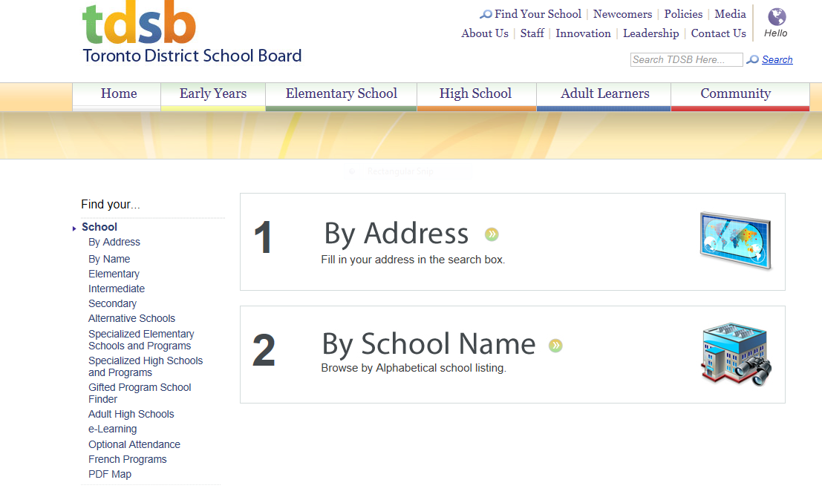
Find Your School
Beyond 8 - Choices for Nine
Find your school by selecting how you want to search.

Slide 12
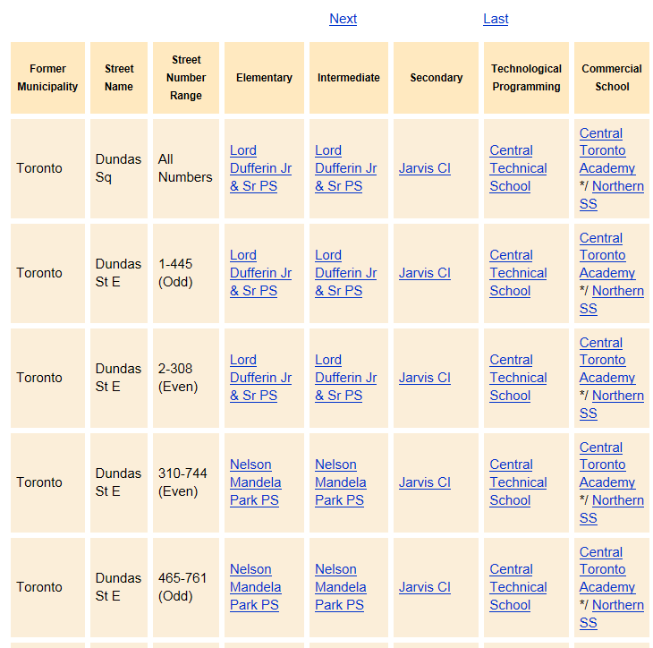
Beyond 8 - Choices for Nine

Slide 13
What Are the Graduation Requirements?
Beyond 8 - Choices for Nine
Ontario Secondary School Diploma (OSSD)
Total of 30 course credits
– 18 compulsory courses – 12 elective courses
40 Hours Community Involvement
– Begins in summer after Grade 8
Ontario Literacy Requirement
- Ontario Secondary School Literacy Test
Ontario Schools, Kindergarten to Grade 12:
Policy & Program Requirements, 2011

Slide 14
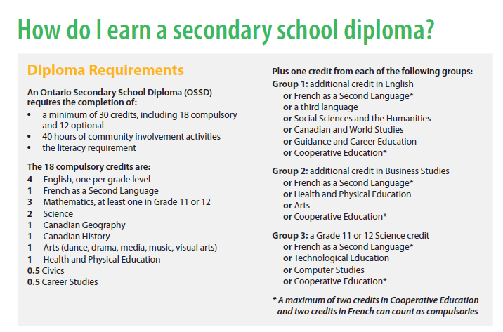
Beyond 8 - Choices for Nine
Ontario Secondary School Diploma (OSSD)
Ontario Schools, Kindergarten to Grade 12:
Policy & Program Requirements, 2011

Slide 15
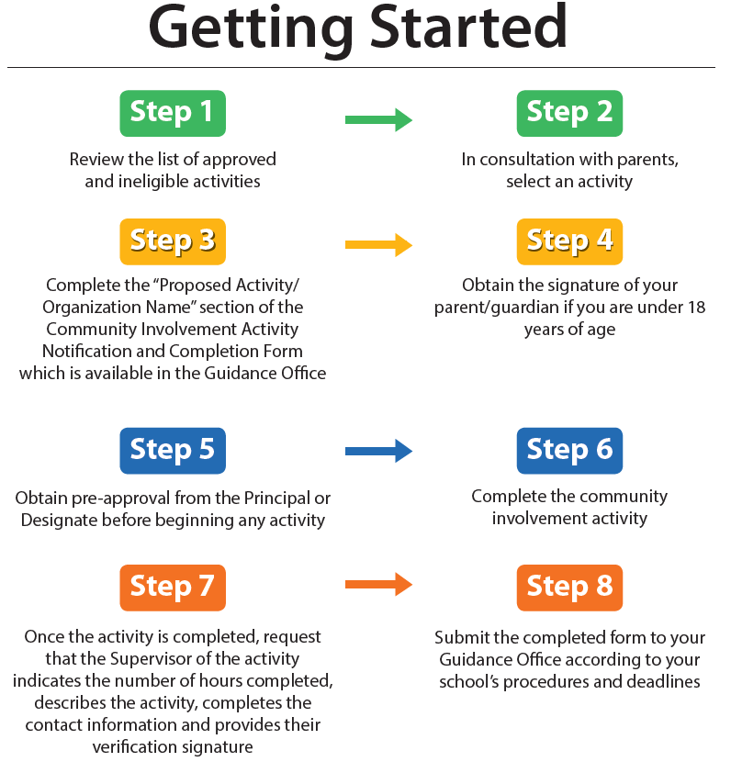
Beyond 8 - Choices for Nine
40 Hours of Community Service - Start the Summer before Grade 9
Ontario Schools, Kindergarten to Grade 12:
Policy & Program Requirements, 2011

Slide 16
Making Course Choices
Beyond 8 - Choices for Nine
Ultimately, students and families make the final course choices
Counsellors as well as your child’s Grade 8 teachers are there to offer their best suggestions about course choices based on evidence of a student’s achievement, learning style, interests, and learning goals
All Grade 8 students will complete a course selection sheet for their home school

Slide 17
What Course Type Choices Do Students Make in Grades 9 and 10? As per Ontario Schools, Kindergarten to Grade 12: Policy and Program Requirements, 2016 (OS)
Beyond 8 - Choices for Nine
Applied
Academic
Locally Developed
Open
Students can mix course types based on their achievement, interests, and skills.

Slide 18
Choosing Course Types
Beyond 8 - Choices for Nine
Let’s listen to Jenna who will outline the different Course types available for you to choose from for Grade 9:
Course Types to Choose From

Slide 19
Open Course Types
Beyond 8 - Choices for Nine
Open Courses
Optional courses that prepare students for further study and enriches the learning
These courses include (but not limited to):
Art, French, Music, Health and Physical Education, Social Sciences and the Humanities
19

Slide 20
Locally Developed Course Types
Beyond 8 - Choices for Nine
Locally Developed:
Compulsory courses for students provides more flexibility and support in learning
Together with our Special Education Department, we will collaborate to develop the best transition plan and program course type for your child
Courses that may be developed locally include:
English, History, Math, and Science

Slide 21
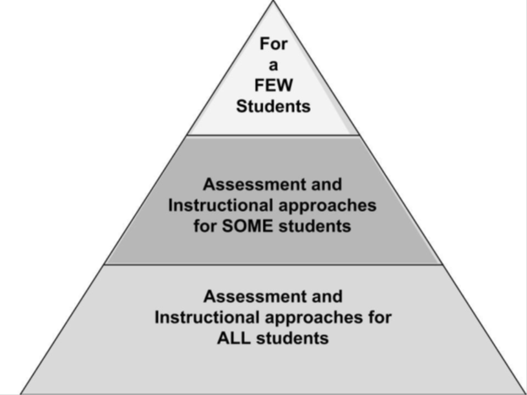
Special Education Supports
Beyond 8 - Choices for Nine
Section 1 of the Education Act: What is a special education program?
continuous assessment and evaluation
plan with specific objectives
outlines educational services that meet the needs of the student
Individual Education Plan (IEP)
Tiered Intervention
All: Universal Design for Learning,
Differentiated Instruction, Experiential Learning
SOME: IEP, GLE course, resource support
FEW: Intensive Support Program, Section Program

Slide 22
Beyond 8 - Choices for Nine
Optional Attendance
Students are encouraged to attend the high school within the catchment area of their residential address (home school)
Use an Optional Attendance Application Form (PR545) when applying to a school other than your home school
Forms will be available at the Grade 8 school in January *Specialized Programs may have earlier deadlines. Please review school specific deadlines for more information
Specific information regarding Optional Attendance Procedures will be communicated to students and families in early January
www.tdsb.on.ca/FindyourSchool/OptionalAttendance

Slide 23
Important Dates
Beyond 8 - Choices for Nine
January 31, 2020 Optional Attendance applications due to secondary schools – delivered by student/parent/guardian
February 14, 2020 Secondary schools will inform Optional Attendance applicants by this date
February 21, 2020 completed via myBlueprint and returned to elementary teacher/counsellor
February 28, 2020 All course selection sheets due to secondary schools – delivered by Elementary Counsellor
Note:
Only ONE course selection per student is submitted for ONE secondary school by the elementary school counsellor
It is the parent/guardian’s responsibility to deliver this application to the school or schools of choice. Faxed or scanned copies will not be accepted.

Slide 24
Questions?
Choices for Nine

