Slide 1
Cresthaven Public School

Slide 2
French
Korean
Bangla
Arabic
Hindi
Greek

Slide 3
Covid19
Information
Please note:
The information in this slideshow reflects our typical Kindergarten program and will need to be adapted this September 2020 due to our Covid Pandemic safety protocols.

Slide 4
Vision
Your child’s formal education begins here in Kindergarten. It is important it is a positive experience as this will ensure your child moves forward with the desire to keep learning.
The basis for future success in language and math begins in Kindergarten with their deep understanding of basic concepts.
Research shows us that beginning the teaching from the interests of your child helps them to engage in the learning process and develop all the skills they need to continue their learning.

Slide 5
Play based learning is a great way to teach children ages 4 to 6. It uses their natural curiosity and desire to “play” to teach language, math and science. For example, a teacher sees the student playing with a car and asks where the car is going. The conversation continues and soon the student has built a road with ramps (science), has added stop signs (language) and measured the height of the bridge to be sure their biggest car can go under (math). With an intentional and directed focus, the teacher engages the child so they are playing but they
are also learning!

Slide 6
The Four Frames of the Kindergarten Program
Belonging and contributing
What do they like to play with?
Who do they interact with and how?
Do they see themselves as part of a community and can they share how they contribute to that community?
Demonstrating language and math behaviours
Do they know their letters and letter sounds?
Are they able to write independently?
Do they know their numbers?
Can they make a pattern?
Do they know how to identify shapes?
Self regulation and well-being
Can they dress themselves and take care of their own basic needs?
How is their fine motor and gross motor control?
How do they handle a problem with their friends?
Can they follow 2 step instructions?
Problem solving and innovating
Can they make things like a tower without direct help?
How do they solve problems when given new materials?
Do they show creativity in centers such as water and art?

Slide 7
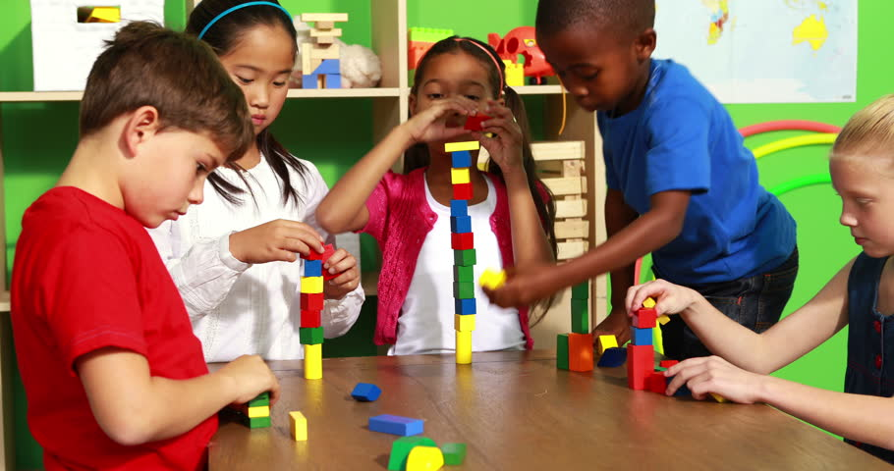
Meet Cresthaven’s Kindergarten Team
We have 2 wonderful teachers and 2 great ECE’s (early childhood educators).
Ms. Mounsey and and Ms. Tekmiri are in room 501. Ms. Mercer and Ms. Lu are in room 502.
We also have teachers who offer specific subjects such as music, gym, OEL and library.

Slide 8
This is an Example of a Kindergarten Timetable
Entry 8:13-8:15 am (Door 5) | Line up outside with your family, then say goodbye! Please be on time!
Period 1 8:15-9:00 | Outdoor Inquiry -We head outside, in all weather, to adventure and explore.
Period 2 9:00-9:45 | Circle time followed by Snack -A lesson, a story and a chance to share, to start the day.
Period 3 9:45-10:45 | Activity time -Children move through learning centers based on play.
Period 4 (15 mins) | Mindfullness and Yoga time -We calm our bodies and minds after a busy morning of learning.
Lunch 11:00-11:58 | They have lunch together (approximately 20 minutes), then head out to the kindergarten playground.
Period 5 12:00-12:30 | Outdoor Inquiry -We continue our student-led exploration in all weather.
Period 6 12:30-1:35 | Circle time and Snack -Another circle time gets us focussed for the afternoons tasks, do a science experiment or read. Activity and focus time -We continue with the activities from the morning
Period 7 1:35-2:15 | Gym/Music/Drama/Dance -Other teachers will be with the students once a day.
Period 8 2:15-2:45 (30 mins) | Circle time -We meet briefly one last time to wrap up the day and get ready for home.

Slide 9
Our Outdoor Play and Learning (OPAL) Program
At Cresthaven, Outdoor Adventures are a central part of our program. Your children will develop their independence, self confidence, social skills, and resilience while enjoying our beautiful neighbourhood. Please make sure you dress your child appropriately for all weather.

Slide 10
Rules and Routines
Here are a few rules and routines we all share.
Take turns talking and raise your hand if you would like a turn when we are in a group.
Always keep your hands and feet to yourself and solve problems peacefully. Do not hit or kick or disrupt the learning of others.
Share the materials and be part of the classroom community by taking care of our class and our school.
Walk through the halls by following those in front of you and be quiet so you don’t disrupt the learning of others.
Try again when you haven’t figured out how to do something and don’t give up!

Slide 11
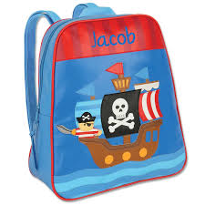
Things to Remember for the First Week
Your child will need a backpack that can hold their lunch (if they are staying) a water bottle and a communication folder that the teachers send home. Check the backpack every day please!
Your child will need 2 pairs of shoes - an indoor pair that stays at school and an outdoor pair that they wear back and forth from home.
PLEASE PUT LABELS ON EVERYTHING. Your child’s name should be on their lunch bag, their shoes, and all of their clothes, so they won’t be lost as easily.
Please have a full set of extra clothes (labelled) in your child’s backpack as sometimes accidents happen!
Please do not send juice boxes or candy to school in your child’s lunch. Those treats are for home, and will be sent back home if brought to school.
WE GO OUTSIDE EVERY DAY, regardless of the weather. So, please dress for all types of weather. Rain boots, rain coat, snow boots, winter coat etc… and don’t forget to label those items!
Savita
Ali

Slide 12
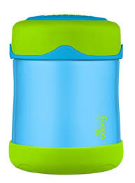
Lunch and Snack Tips
To prevent any allergic reactions there are
no peanuts or any nut product allowed in school. This includes Nutella. We suggest WOW butter instead which looks and tastes like peanut butter.
Think about using a thermos for things like pasta or soup as the school cannot heat up a lunch.
Please do not give candy, chips or sweets. Start now to introduce veggies (and salad dressing dip for example) or fruit such as berries so they are used to them by September.
Alia

Slide 13
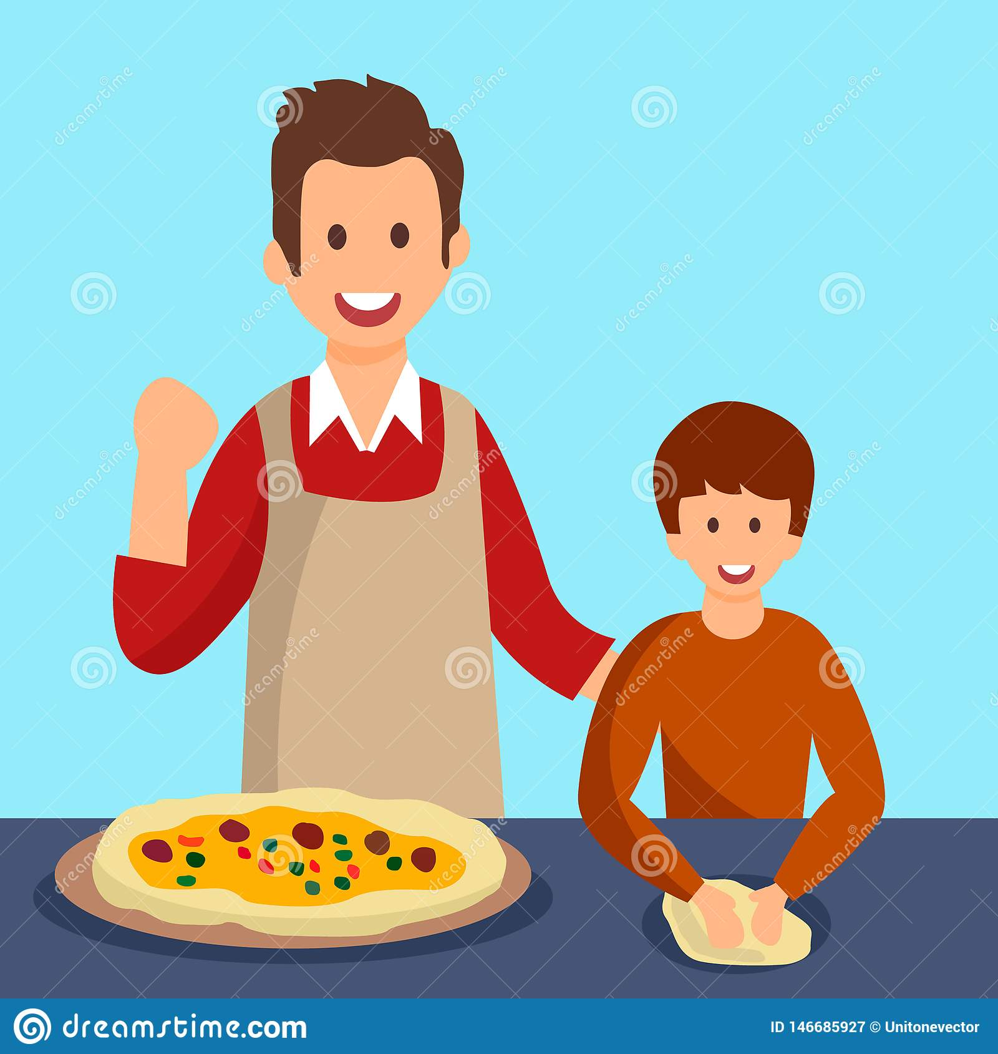
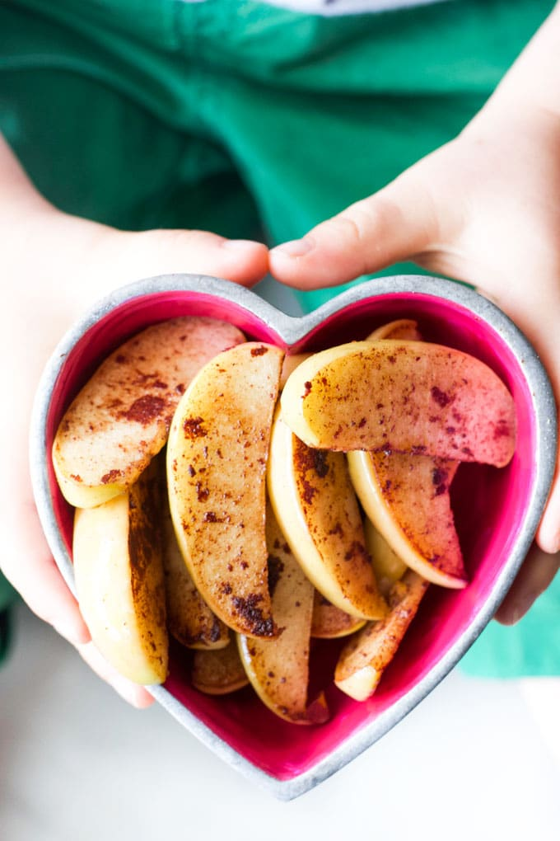
Have your child participate in the preparation of their lunch! They will enjoy selecting the types of things included and will to help them be comfortable when eating lunch at school.
Include extra snacks for our 2 snack times during the day. A cut up apple sprinkled with cinnamon (apples look fresher and taste great) are a good snack. Kindergarteners also like celery with a bit of cheese whiz, wow butter or cream cheese on it.
Keep portions small and not overwhelming.
Apples
Veggies

Slide 14
Your Important Role as a Parent
Your role in your child’s educational experience is essential because you are their first teacher! Here are some ideas to guide you, as you guide them:
Read with them every day. It is so important to have conversations about the stories and to be a role model for reading. As the year progresses, they will bring home small books to share and practice together. Any reading will work though!
Help your child learn to hold a pencil and write their name in lowercase letters. They should be able to recognize and name those letters.
Get your child ready now to make the beginning of September easier by encouraging them to dress themselves (including jackets and shoes) and to get to the washroom independently. Encourage them to wash their hands frequently as they will be expected to do so at school.

Slide 15
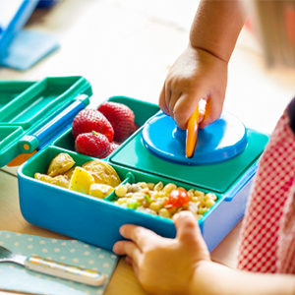
Your Important Role as a Parent
Have “school lunch days” this summer! For example, put their soup or pasta in a thermos and practice using that for lunch. Your child should practice opening and closing their containers and getting it all back into the lunch bag. We will not be able to heat up lunches at school.
Establish routines now. Kindergarteners need to be in bed between 7:00 and 8:00 p.m. to get enough sleep. Practice getting up at around 7:00 a.m. to get ready in time for school.
It is not uncommon for children to be upset the first few days of school. We are pros at handling this and you can be guaranteed that they will quickly adapt and begin to play with their new friends. If possible, practice spending some time away from them now, have play dates when you are not there, or have a trusted babysitter or other non-family friend to mind them if possible.

Slide 16
How can I prepare my child for starting kindergarten? (Ministry of Education)?
The Newcomer's Guide to Elementary School in Ontario
Kindergarten Program 2016 (Min. of Ed.)
How Does Learning Happen?
WTK Kindergarten Curriculum Support and Family Connection document

