Slide 1
STUDENTS HEADING TO Post-secondary EDUCATION
What’s Next? Pathways Planning

Slide 2
Congratulations! You’re almost at the finish line!

Slide 3
Unique Circumstances? No Problem ☺ !
You’ve got structure!
You’ve got organization!
You’ve got planning!
You’ve got flexibility!
You’ve got understanding!
You’ve got support!
You Got This!!!!!!!!!!!

Slide 4
What we’re going to cover:
The process of applying for college and/or university.
Options and opportunities for Funding your future.
PLEASE NOTE: as we navigate through this unprecedented school-year, information could change (keep checking all the relevant sites and connect with your guidance counsellor for clarification and direction)!

Slide 5
September-November = time to reflect, research, plan!
Postsecondary meeting with your Guidance Counsellor to make sure you are on track to graduate:
30 credits (18 compulsory, 12 elective)
Literacy requirement (OSSLT or OLC4O) - WAIVED
40 hours of community involvement – REDUCED TO 20
This is the link to the Hours Completion Form (it includes the list of eligible and ineligible activities) https://www.tdsb.on.ca/portals/0/highschool/docs/communityinvolvementform.pdf
Cost it out: tuition, funding your education
My Blueprint: Matchmaker & My Skills (Assessments)

Slide 6
Do Your Research! September-November
College & University Presentations/Fairs
Open Houses $ Campus Tours (VIRTUAL TOURS)
Speak with: parents, teachers, friends, others, etc.
Visit College & University websites.
Check program booklets, social networking sites.
Consider valid options such as apprenticeships and other long-term planning strategies (reflect on your interests, skills, goals, immediate and distant opportunties).

Slide 7
Ontario universities: OUINFO www.ontariouniversitiesinfo.ca
Ontario colleges: www.ontariocolleges.ca

Slide 8
Do Your Research!
Look for programs and schools that will meet your learning needs and interests.
Look at program information and ensure you will have the pre-requisites and marks to get in.
Call admissions and ask questions.
Look into their disability services and what they have to offer you. Get this process started early.
If you need documentation from me- Come See Me!

Slide 9
Postsecondary Applications - College November-January
Ontario colleges: www.ontariocolleges.ca (Deadline: February 1, 2020) → Application open now!
Online application opens → Early October 2020
→ Colleges start to receive applications
February 1, 2021→ Equal Consideration (DEADLINE)- after this date- first come first serve basis based on program availability. Colleges also start to send out offers.
February 1, 2021 → Earliest date that colleges may send out offers of admission.
May 1, 2021→ Deadline to confirm offers of admissions (some colleges MAY EXTEND this date; this will be communicated to you in the offer).

Slide 10
Postsecondary Applications November-January
Ontario universities: www.ontariouniversitiesinfo.ca (Deadline: January 15, 2021) → Apply late November or beginning of December.
January 21, 2021 → Target date for Ontario Universities to receive marks and data from OUAC.
Feb 25, 2021→ Target date for universities to receive all available/final U/M level course marks.
May 4, 2021 → Target date for Ontario universities to receive all midterm/final grades available for 4U/M courses and interim grades for full-year courses from OUAC.
May 27, 2021→Latest day you can expect an Ontario university response
June 1, 2021→ Earliest day you may be required to respond to an offer.
Out-of-province colleges or universities: check with the individual school, and/or see me in Guidance.

Slide 11
General Admissions Requirements: College Diploma or Certificate Programs
OSSD + ENG4C
Specific grade 11/12 courses may be required
Supplemental application or test may be required for specific programs (e.g., portfolio, audition, entrance exam, police check).

Slide 12
General Admissions Requirements: University or College Degree Programs
Six (6) courses at the 4U/4M level including ENG4U + any other required courses (will be used to calculate average).
Check each school (e.g. McGill requires 4 courses at the 4U level, Queen’s requires 3 at the 4U level)
Supplemental application/form for some programs (e.g. portfolio, audition, interview, personal statement of experience).

Slide 13
Applying to Ontario Colleges
For out-of- province/ country colleges, apply directly to the institution.
Notes:
*

Slide 14
Ontario Colleges: What You Need to Apply
www.ontariocolleges.ca - Create an account (use your legal name)
Your OEN (found on your Report Card or Credit Counselling Summary)
A valid email address
A valid credit card OR online banking OR money order or certified cheque via mail (no personal cheques or cash)
Cost: $95 application fee for 5 college programs (no more than 3 at one college)
Include your 9-digit application number if applying by mail

Slide 15
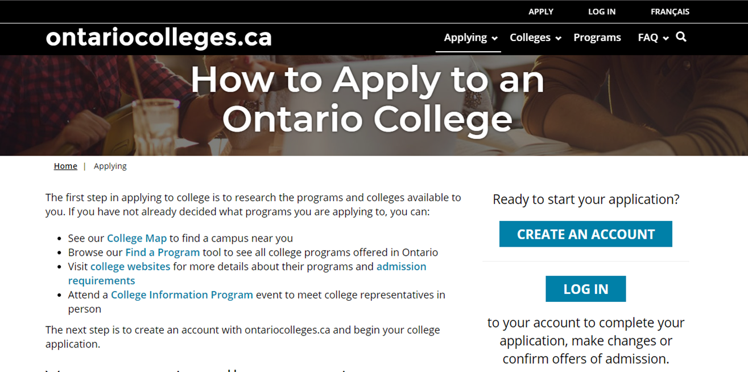

Slide 16
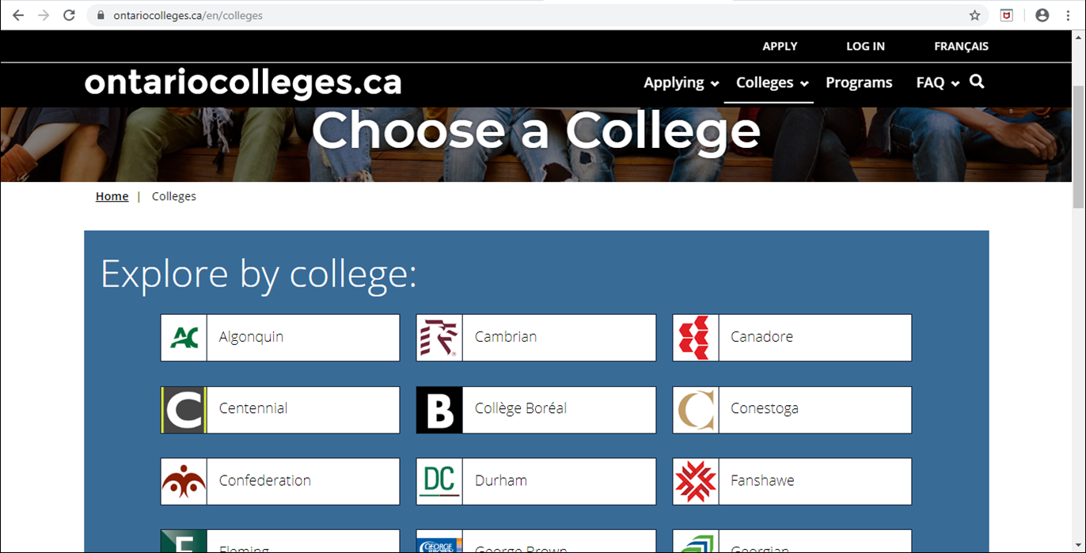

Slide 17
Ontario Colleges: Tips
Record your application number in a safe place.
If you are applying to a “highly competitive program” as listed on the website:
Verify the additional requirements and ensure you complete them Apply to a backup program! (e.g., Pre-Health Sciences if applying to Vet Tech, Nursing, etc.)

Slide 18
Ontario Colleges: Key Dates
February 1, 2021 - deadline for equal consideration
Also the earliest date that colleges can send offers and earliest date that students can accept offers.
May 1, 2020 - offers must be accepted by this date (unless offer is made after May 1)
Mid-June, 2020 - deadline to pay the $500 non-refundable tuition deposit to secure your spot in the program you have accepted.

Slide 19
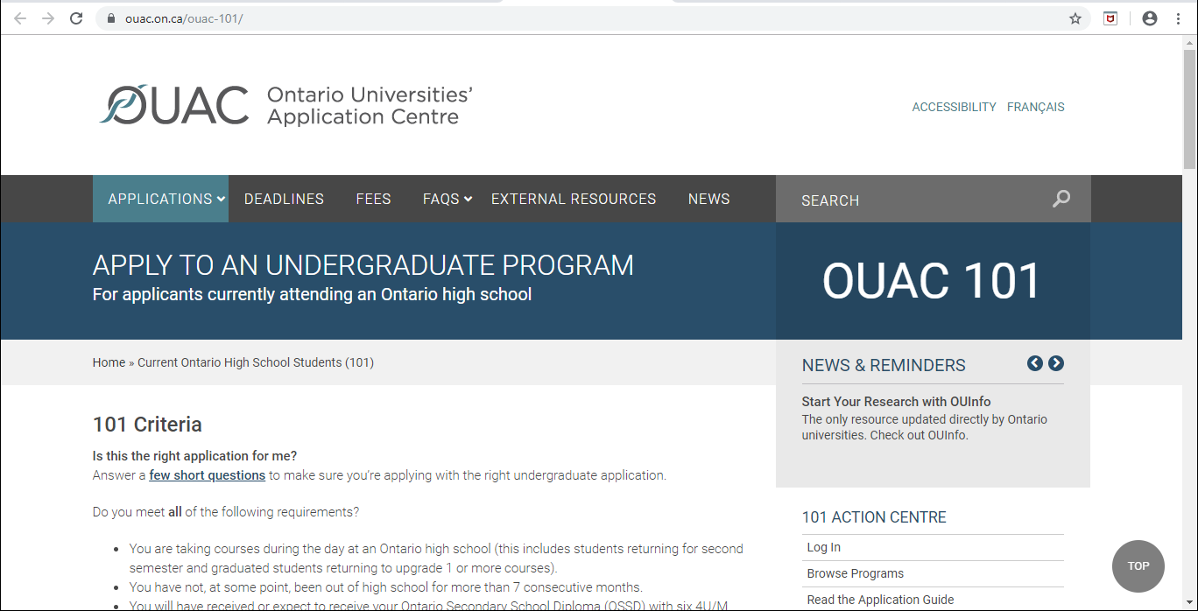
Applying to Ontario Universities
For out-of- province/ country universities, apply directly to the institution.
Notes:
*

Slide 20
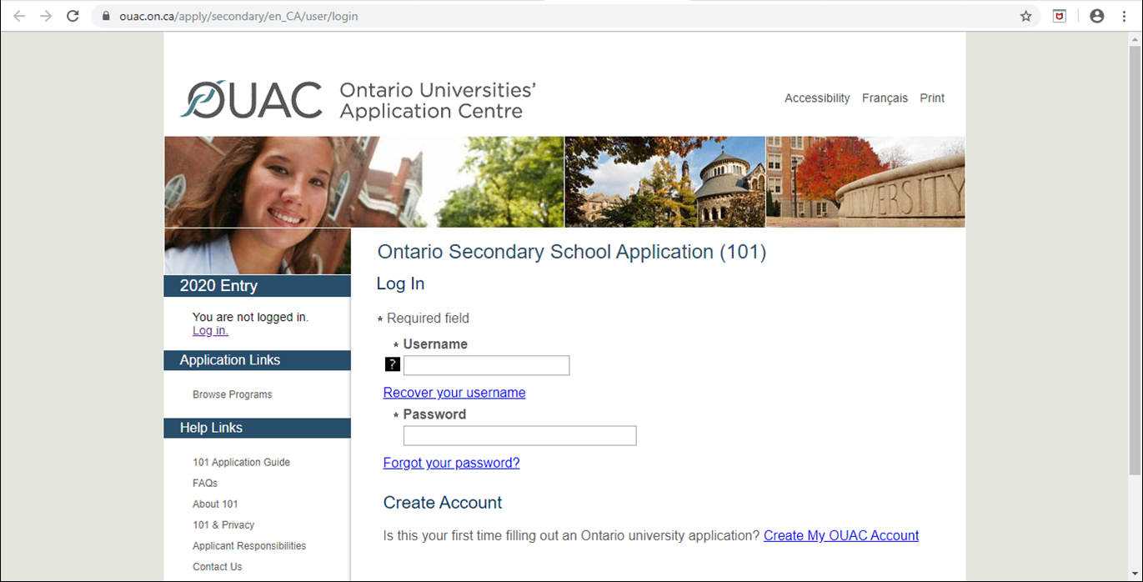

Slide 21
101 Application: How-to Videos
https://www.ouac.on.ca/101-tutorials/
Apply Online (How to apply to university using the 101 online application)
Review and Change Your 101 Online Application
Responding to Offers of Admission (OUAC) (Also, video for students intending to apply to OSAP)

Slide 22
ON Universities: What You Need to Apply
www.ouac.on.ca - OUAC 101 (application)
Your PIN (unique access code), school number, student number from OUAC which you will receive in November - EMAILED
A valid credit card (online only) OR online banking.
Cost: $150 application fee for 3 university programs (no more than 3 at one university), $50 for each additional program
New as of 2016: any program changes after application submitted is $50 (except if within same university)

Slide 23
Ontario Universities: Key Dates
January 15, 2021 - deadline for applications to OUAC
Note: OUAC website will not be supported between Christmas & New Year’s
Record your 11-digit OUAC Reference Number (2020-XXXXXX) → you will receive this immediately after you have applied.
You will need this number to login and accept offers.
OUAC will receive an initial mark upload (end of January), mark update (March, May), final marks (July), summer school and eLearning (Aug).

Slide 24
Ontario Universities: Key Dates
May 27, 2021 - latest date that Ontario university decisions will be released (offer, refusal, or deferral).
June 1, 2019 - earliest date that Ontario universities can require a response to an offer of admission and a financial commitment of any kind (e.g., tuition deposit, residence deposit).

Slide 25
Ontario Universities: Key Dates
Students who take a summer school course and have been given a conditional offer of admission MUST submit results directly to the university:
Proof of registration in the summer school course.
Final mark in August prior to the school’s deadline.

Slide 26
ON Universities: Special Notes
Review each university’s policy on alternate offers and on repeated courses (see OUINFO)
Averages based on top 6 marks (4U/4M), but may also have minimum average for prerequisite courses.
Arts (B.A.) programs typically hear earlier than those who have portfolio, auditions, or Calculus as a prerequisite.

Slide 27
ON Universities: Offers? When?
Conditional offer of acceptance: conditional based on your final grades being similar to the grades used to evaluate your application
Some applicants may get an offer (early acceptance) in Dec/Jan based on grade 11 marks (very small %), or in Feb/Mar based on semester 1 marks and grade 11 marks
Note: You can’t apply for early acceptance
Note: Most offers will be given out after in April/May
July: Offers may be made based on program availability
Notes:
*

Slide 28
Out-of-Province Universities
OUAC agreements:
Acadia, Bishop’s, UBC, University of Calgary, Concordia, Dalhousie, McGill, UNB, Saint Mary’s, Simon Fraser, UVic
Apply to these schools directly, but first apply to Ontario universities and provide your OUAC reference number (2018-xxxxxxx0), so that they can access your marks electronically. All other schools will require transcripts!
Note: It is your responsibility to verify and meet application deadlines for any schools outside Ontario!

Slide 29
Next Steps
Regularly check your OCAS or OUAC account.
See Guidance if you:
see any discrepancies with your academic info
need to add courses taken outside of school (i.e., night school)
Check your Spam folder for college or university emails
Order transcripts (min. 3-5 days) for out-of-province institutions not connected to OUAC (done online - https://www.tdsb.on.ca/High-School/After-High-School/Transcripts
Accept offers and pay tuition by the deadline indicated

Slide 30
Funding Your Education
So, how much will it all cost?

Slide 31
Average annual cost of College:
$2,400-6,100 tuition + books and supplies ($1,300) + living expenses
Average annual university costs:
$7,539 tuition (avg.) + books and supplies ($1,300) + living expenses
Costs are simply estimates by Ontario Colleges and Statistics Canada.
All program expenses (tuition, books and supplies) will vary by college or university and by program. Living expenses (residence and meal plans) will also vary.

Slide 32
Sources of Funding
Scholarships
Entrance - based on marks (80%+ may be eligible), come with offers of admission.
Direct application - external and institutional.
Bursaries
Based on financial need, per institution.
RESPs (Registered Education Savings Plan), savings from summer or P/T job
Work-Study Programs = co-op
Some programs start in 1st year, most require application after first term.

Slide 33
Sources of Funding
OSAP (Ontario Student Assistance Program)
Loans and grants based on financial need
Apply before June to ensure your application is processed prior to tuition deadlines and $$ is available by September
Student line of credit, bank loans.
Visit https://www.ontario.ca/page/student-loans-grants-scholarships-and-bursaries for more information on scholarship and bursary opportunities.
Notes:
Changes to OSAP in 2017-18
Starting in the 2017-18 school year, Ontario is bundling many existing provincialOSAP grants into a single Ontario Student Grant.
The changes will make average college and university tuition free for the majority of eligible students, whose parents make a combined household income of less than $50,000 per year. The grant will be available to full-time students only.
The changes also apply to middle-to-upper income families and include:
providing grants to most students whose parents make a combined household income of $83,000 per year or less to cover their tuition
providing additional financial support to full-time mature and married students
changing eligibility so that grant approval isn’t tied to how long a student has been out of high school
giving students from middle- and upper-income families (making $83,000 to $130,000 per year) more access to interest-free and low cost loans throughOSAP
capping the maximum OSAP debt level at $10,000 for an academic year
making sure no eligible student receives less grant money under the Ontario Student Grant than they would have under the 30% Off Tuition grant
reducing the amount parents and spouses contribute towards the costs of college/university starting in the 2018-19 school year
The grant will adjust for inflation and increases to tuition.

