Slide 1
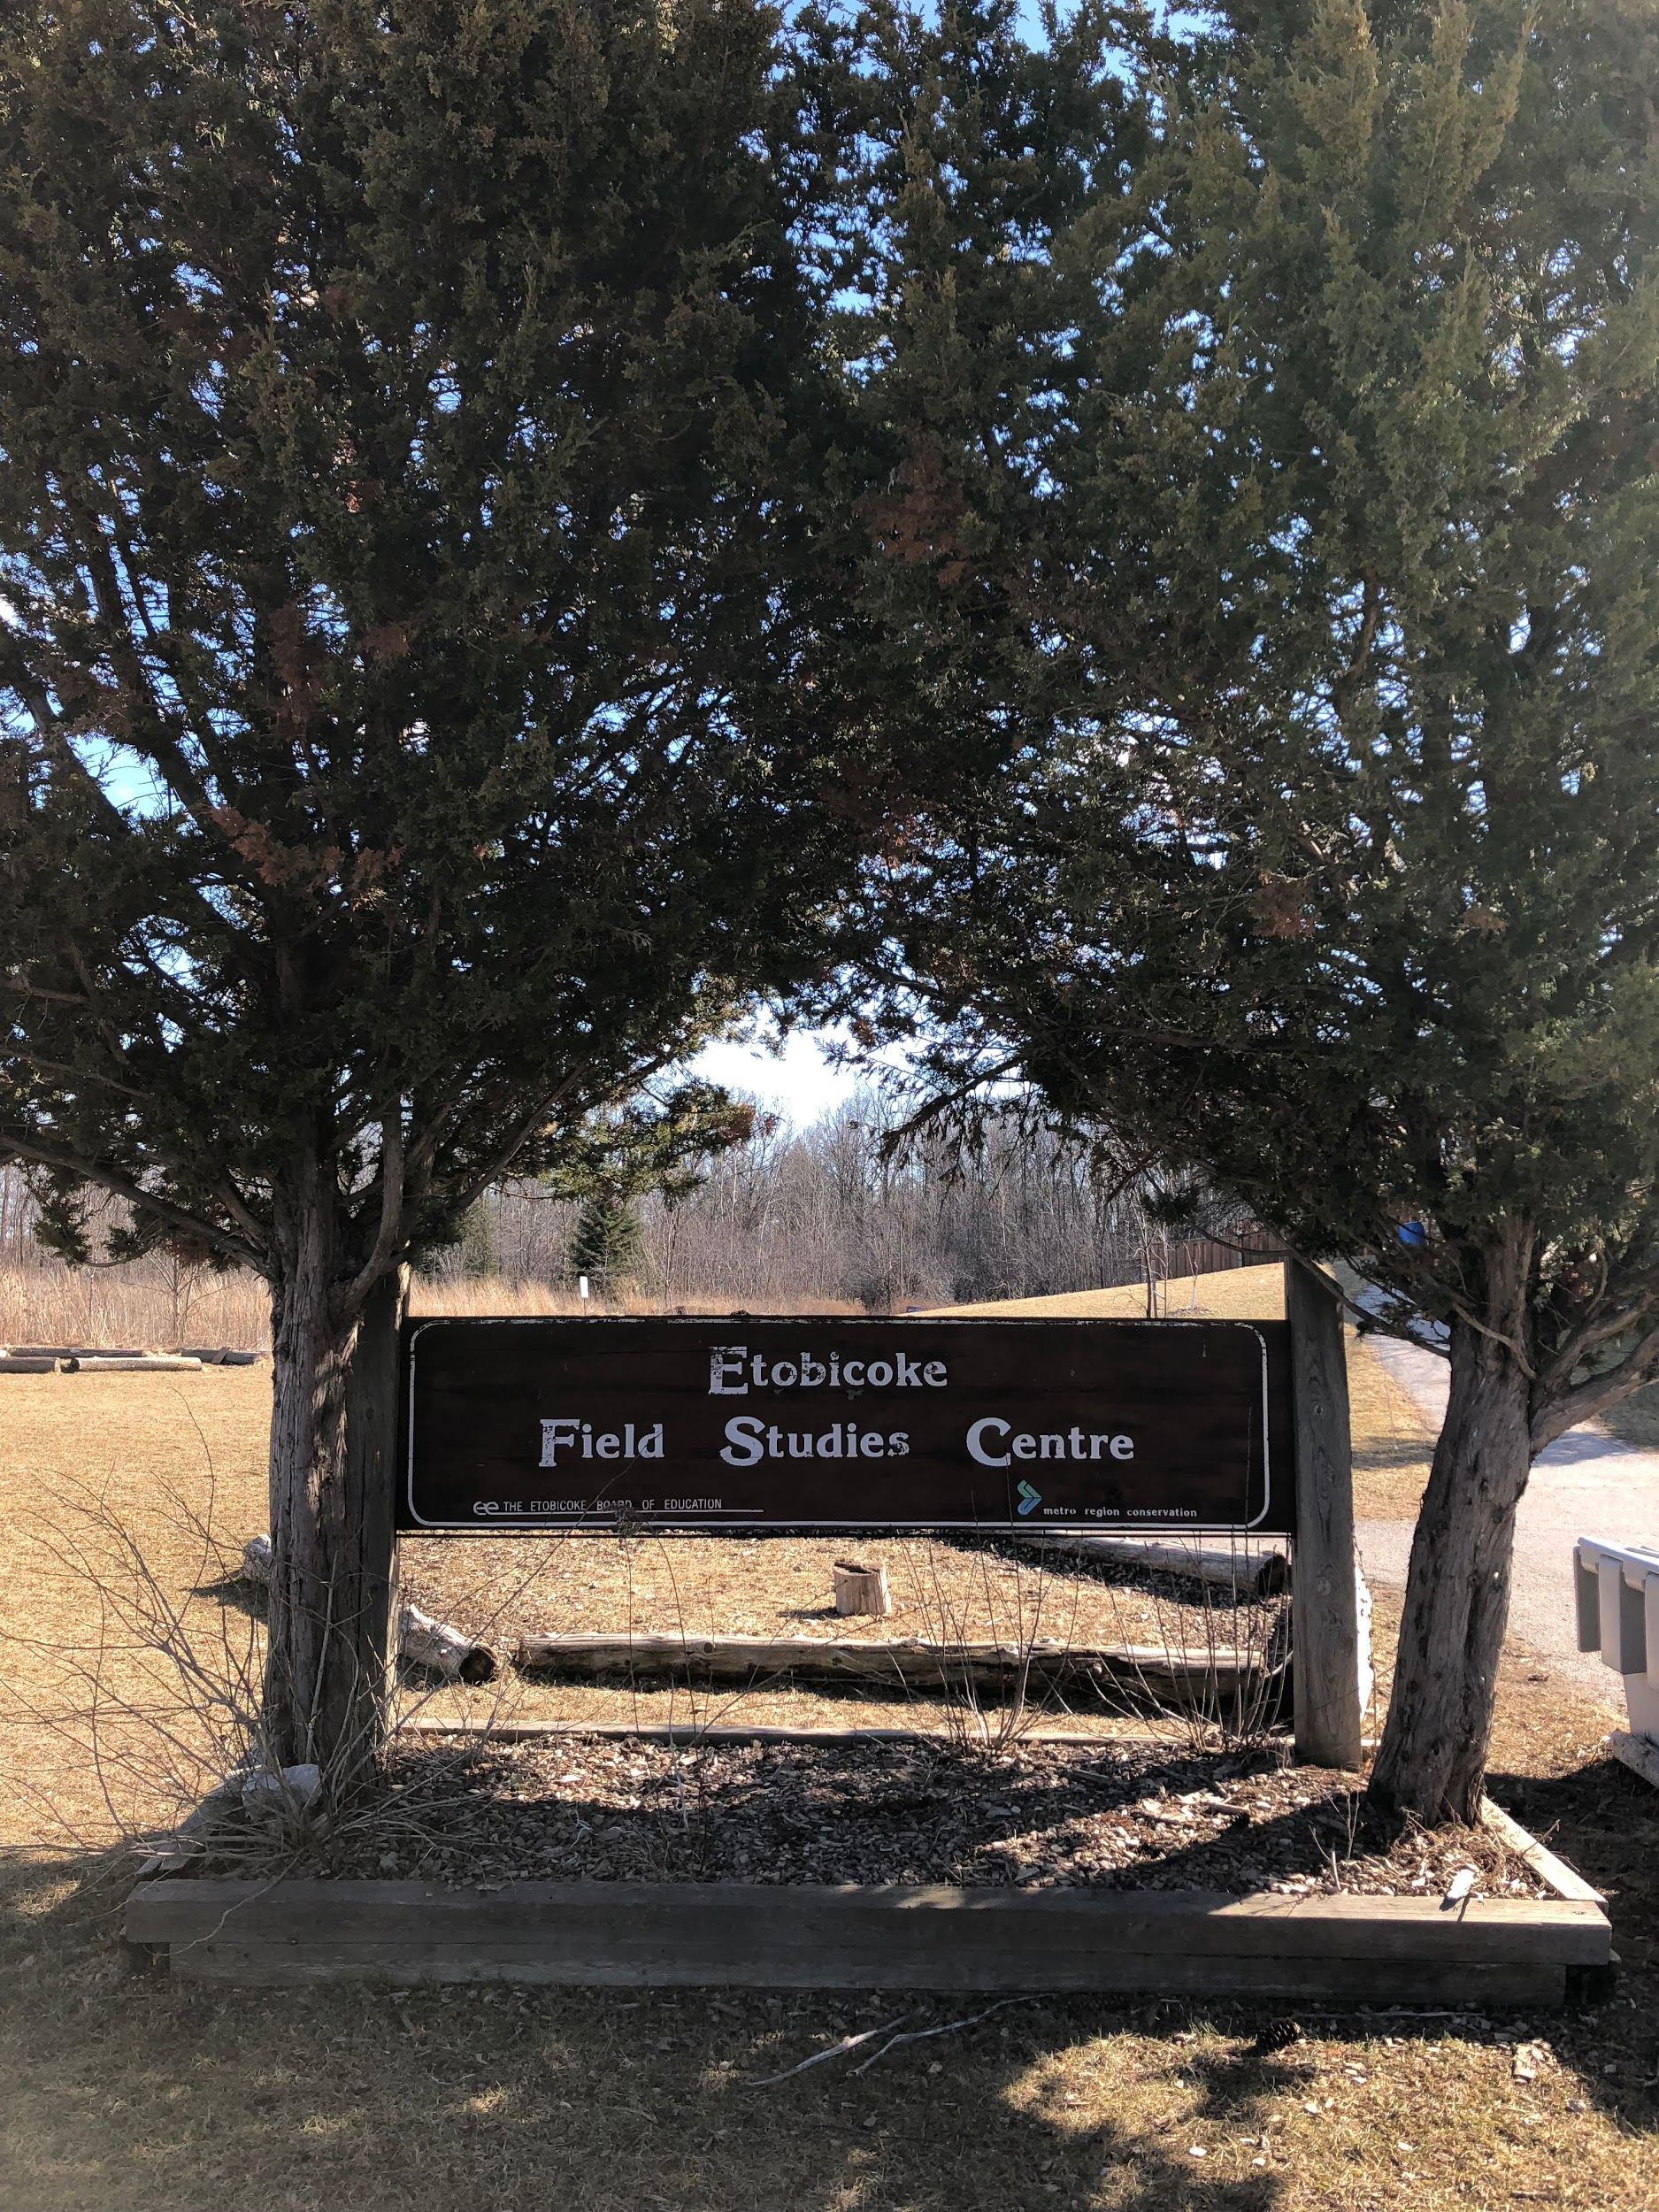
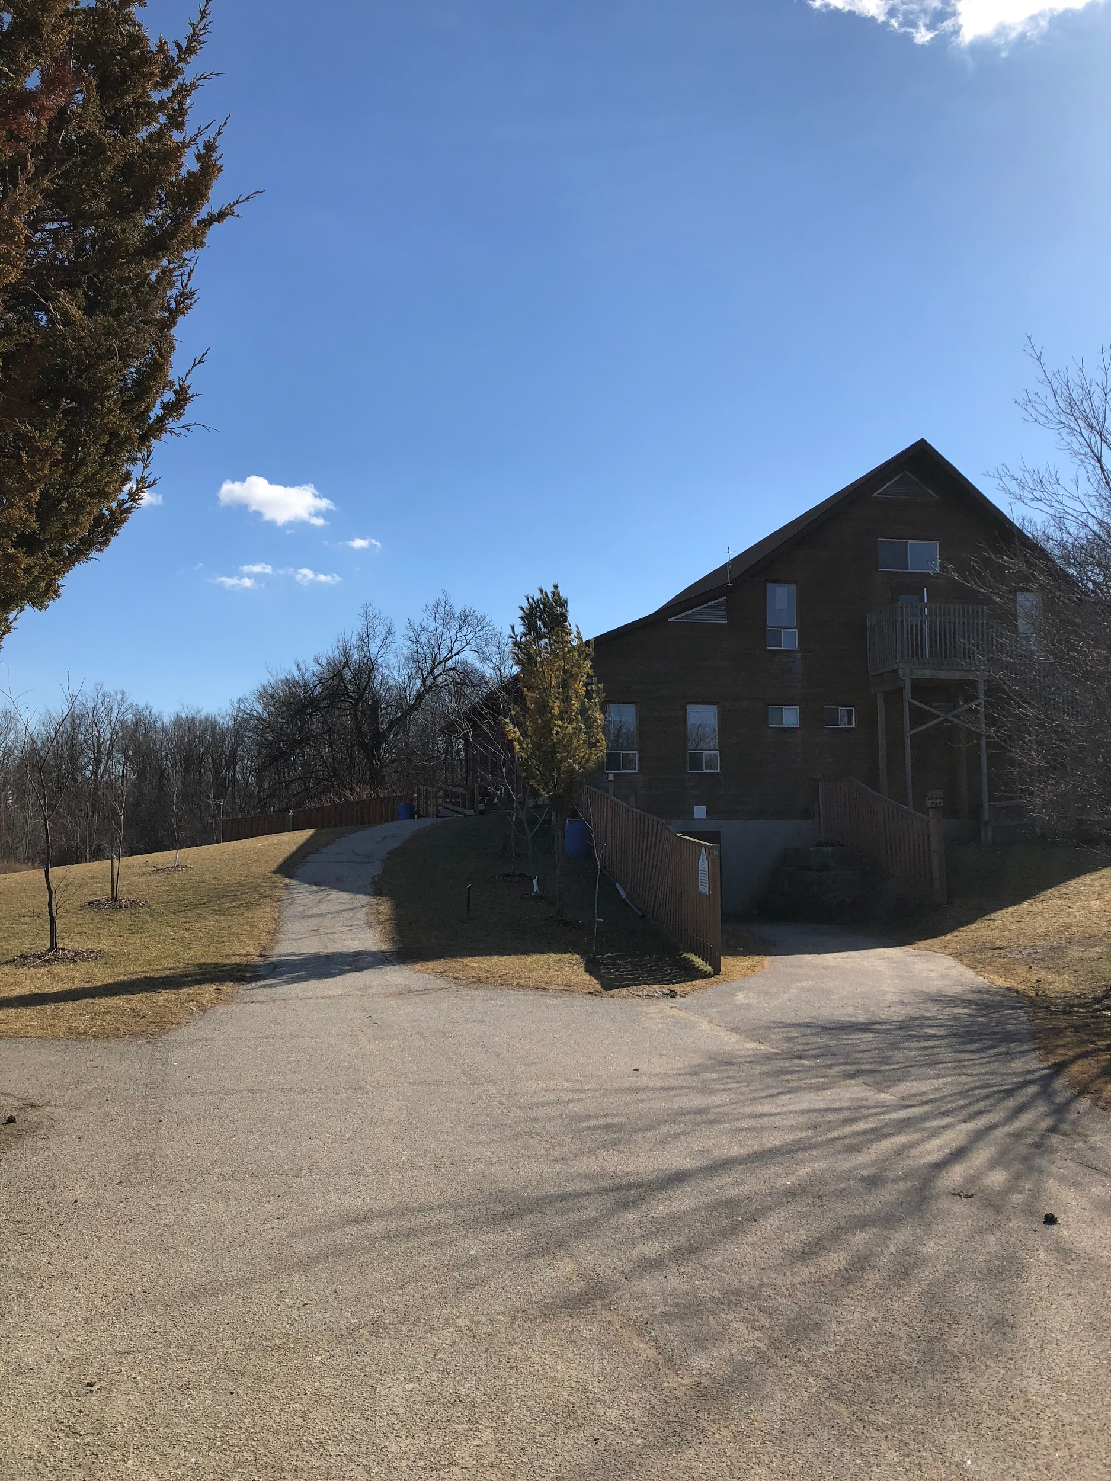
Our Trip to the Etobicoke Field Studies Centre

Slide 2
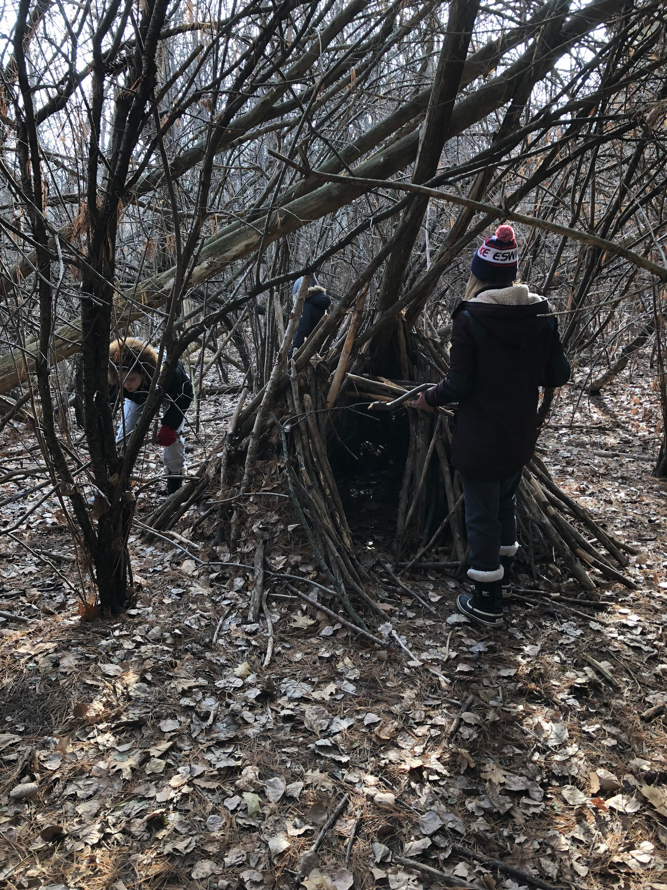
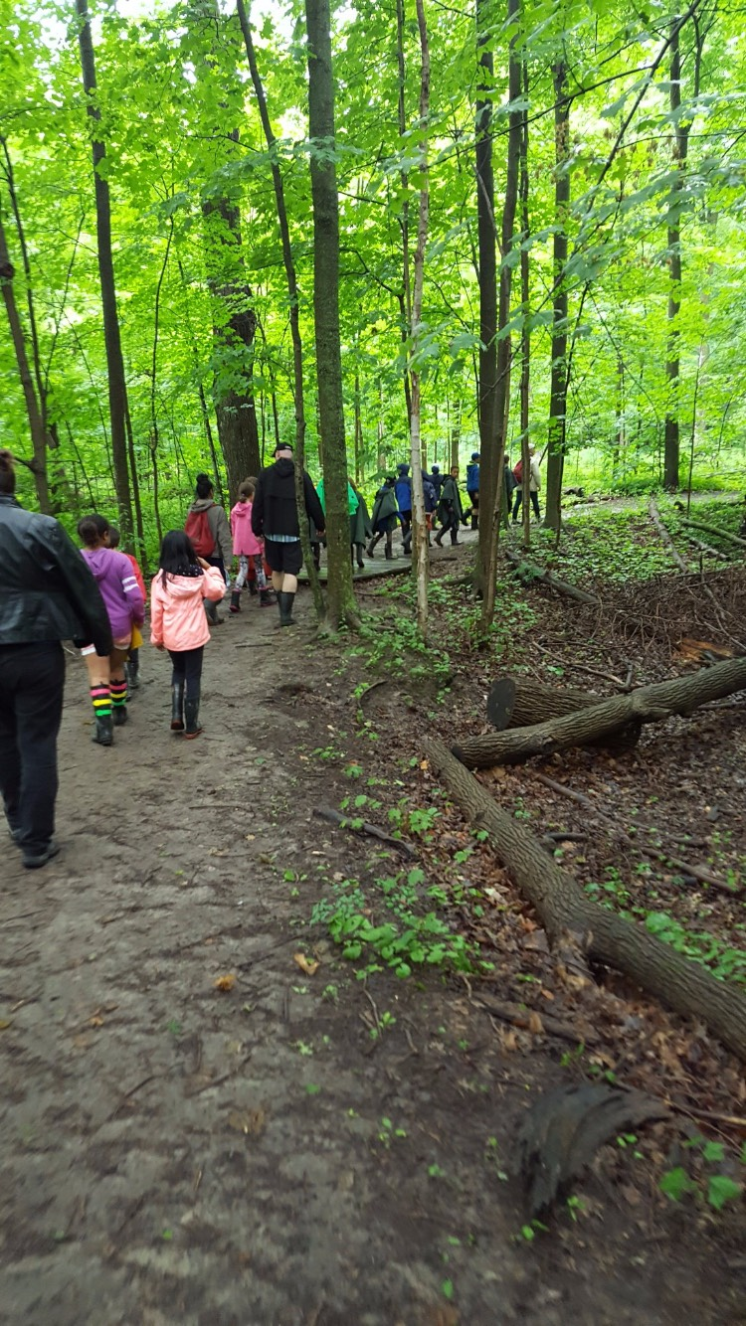
Today, we are getting ready to do something different. We are going on a field trip.

Slide 3
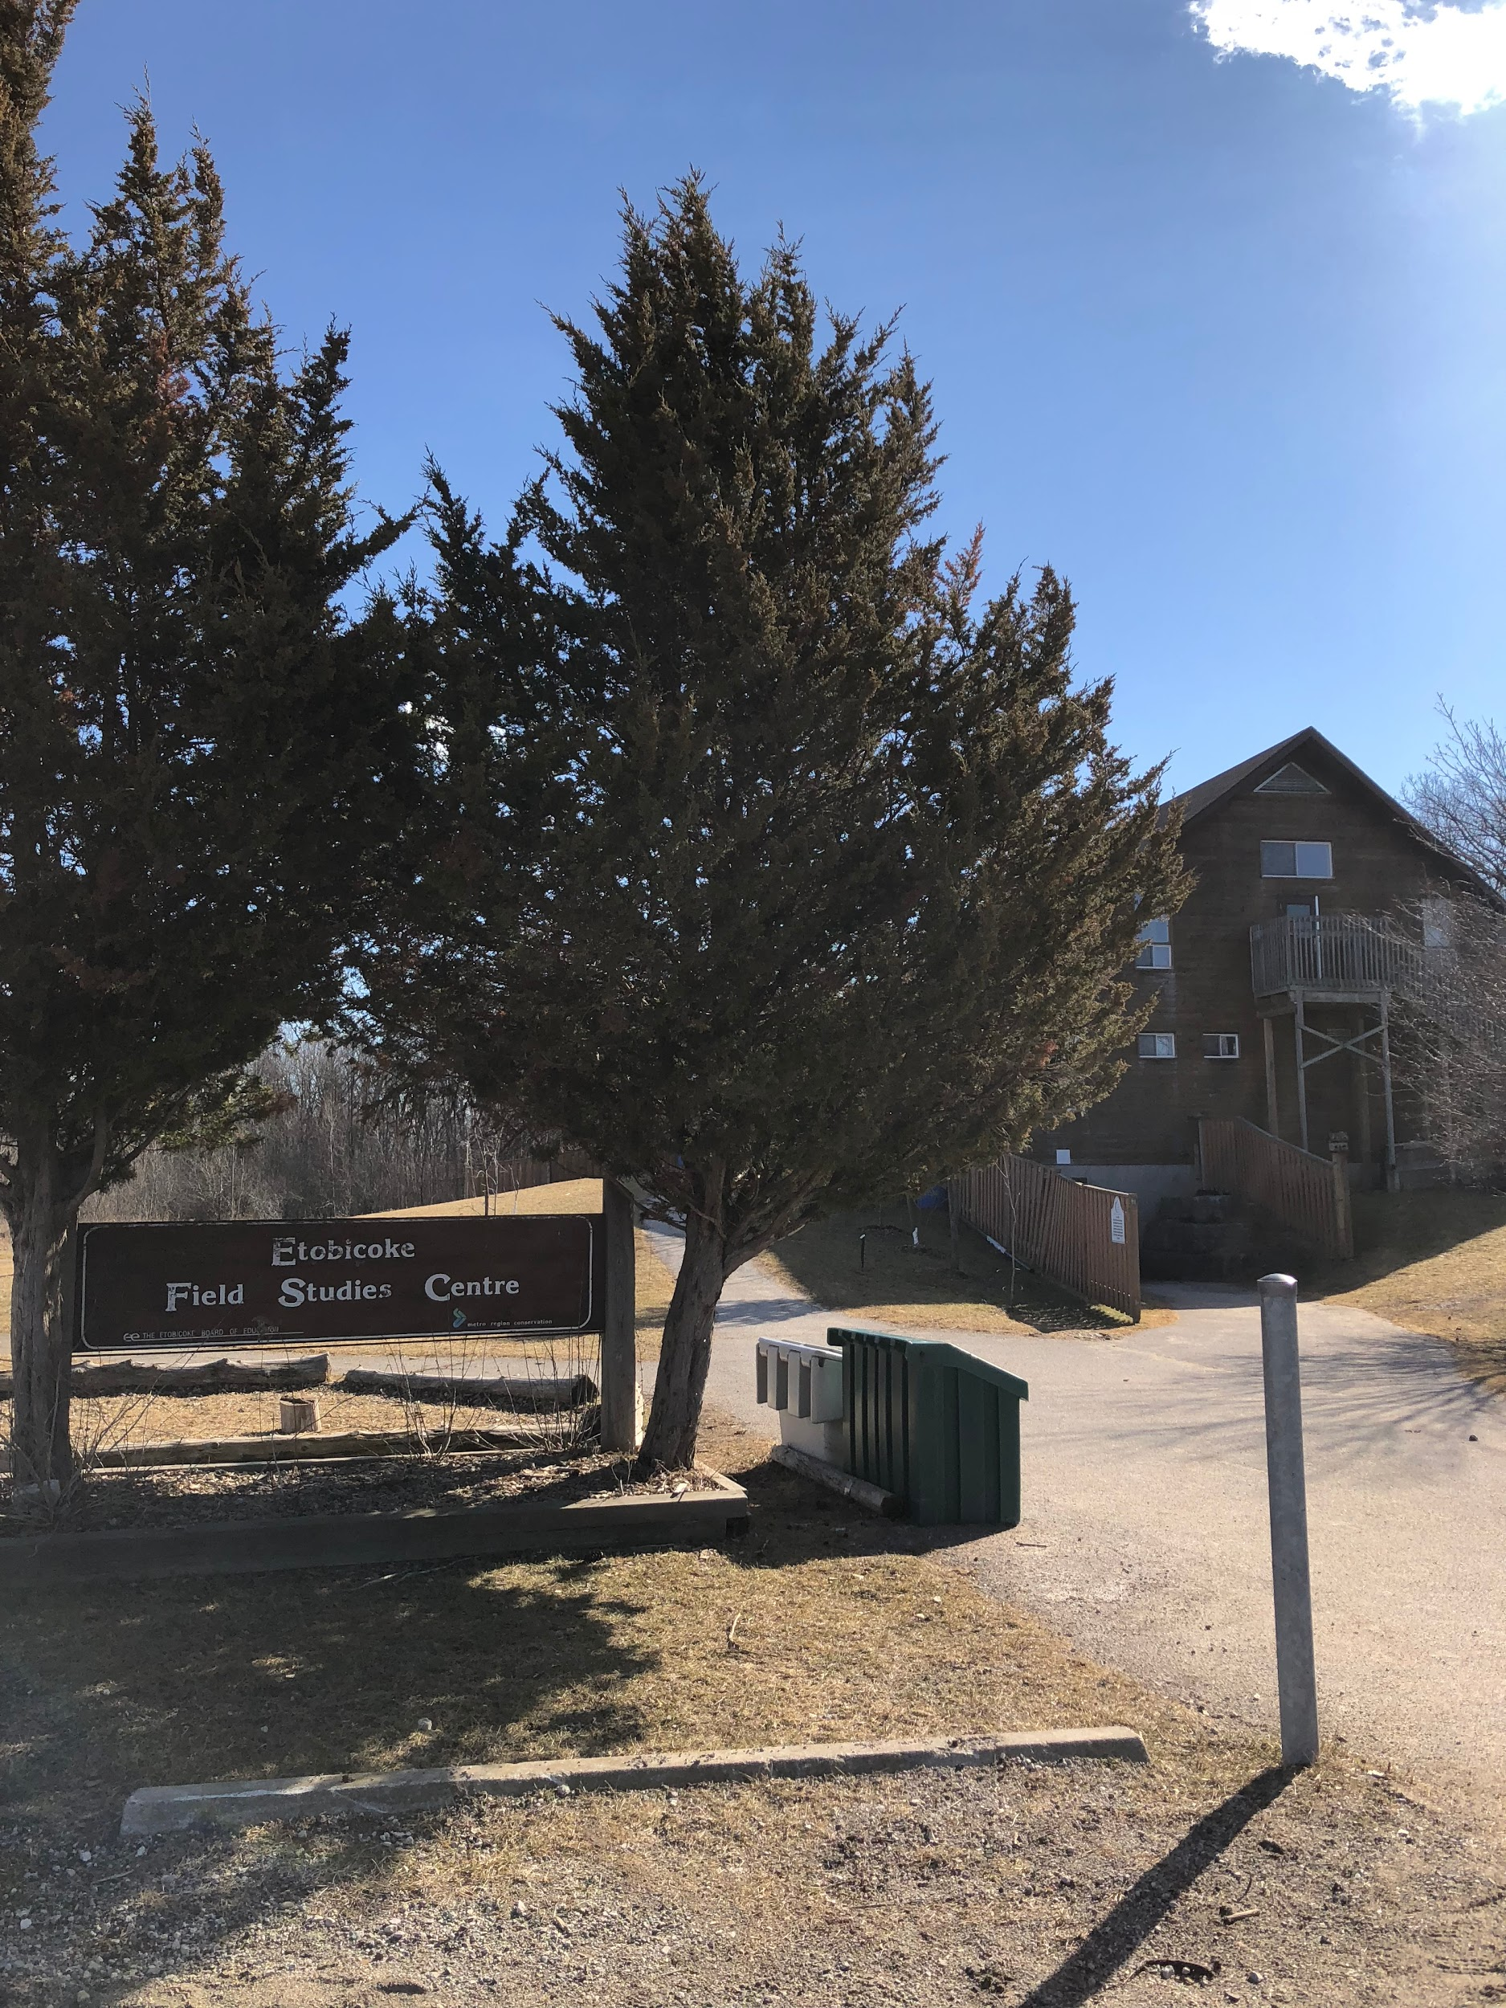
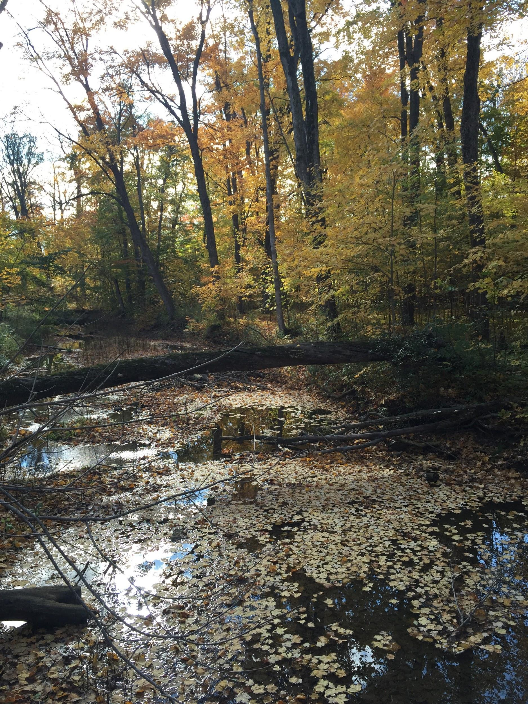
We are going to the Etobicoke Field Studies Centre for the day.

Slide 4
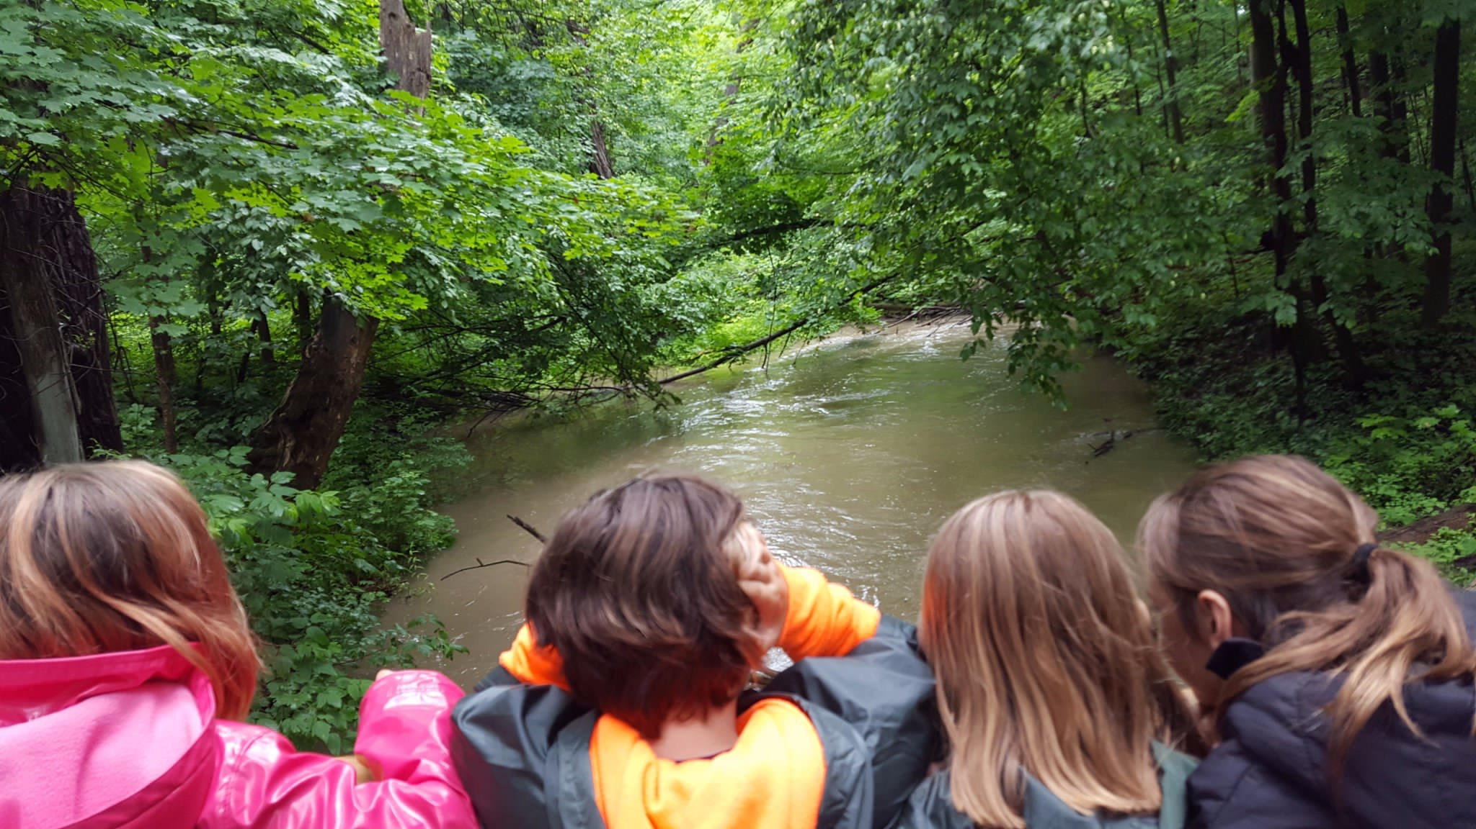
Our teacher and our friends will be with us and maybe some parents too.

Slide 5
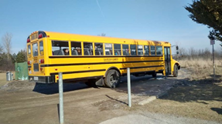
We will ride on a school bus to get there.

Slide 6
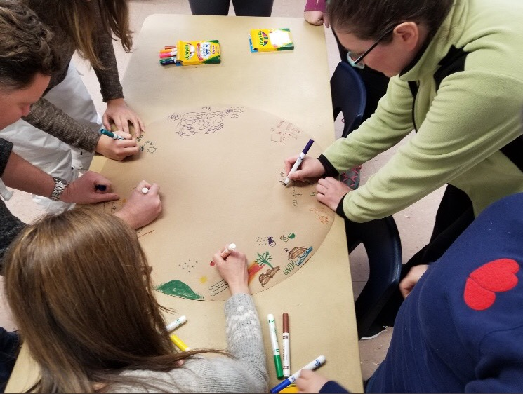
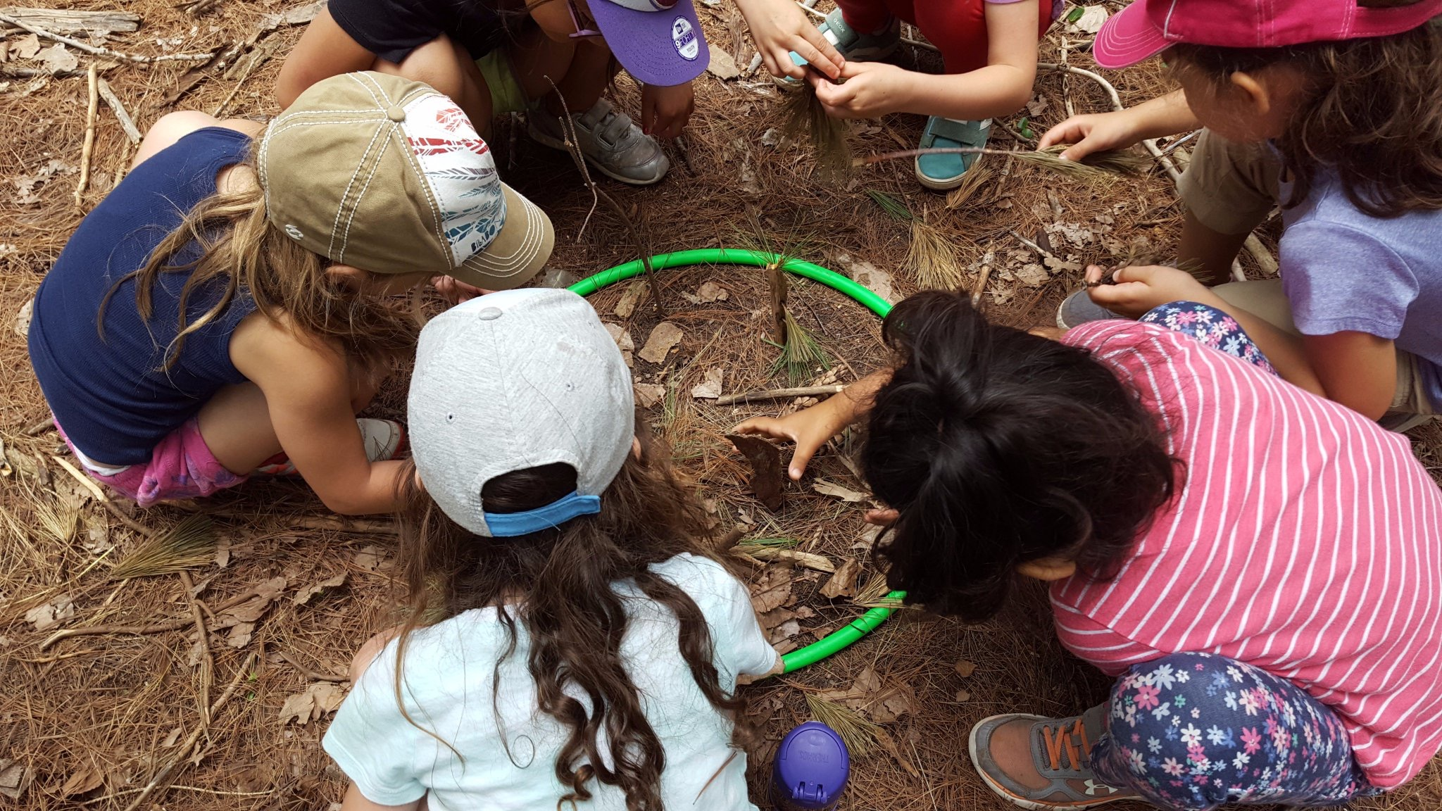
When we get to the Etobicoke Field Studies Centre, we will meet new people who will teach us about being outside.

Slide 7
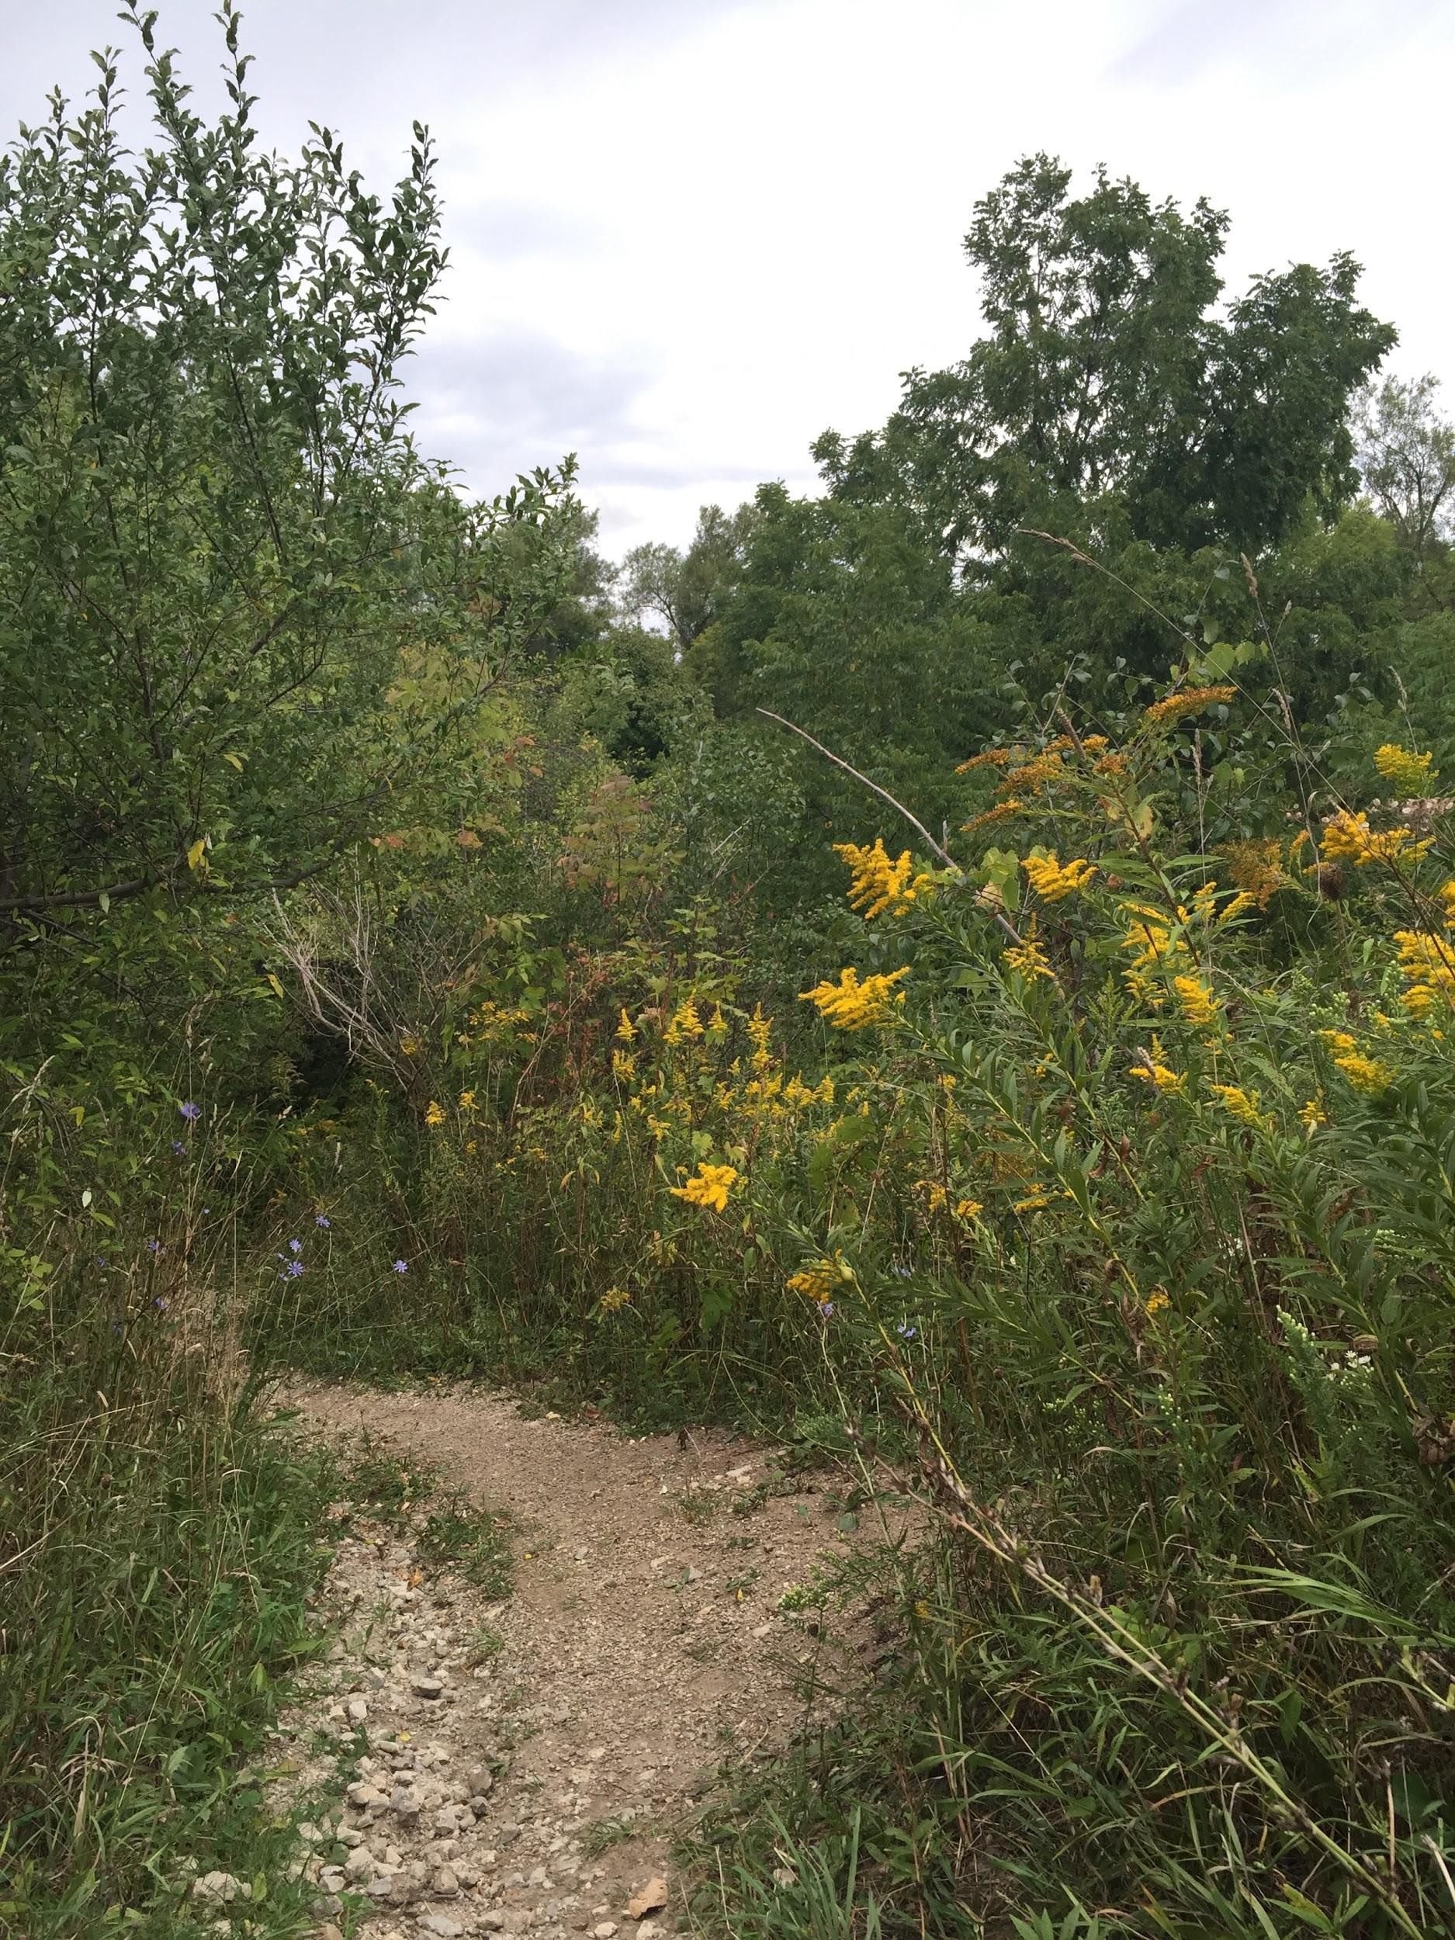
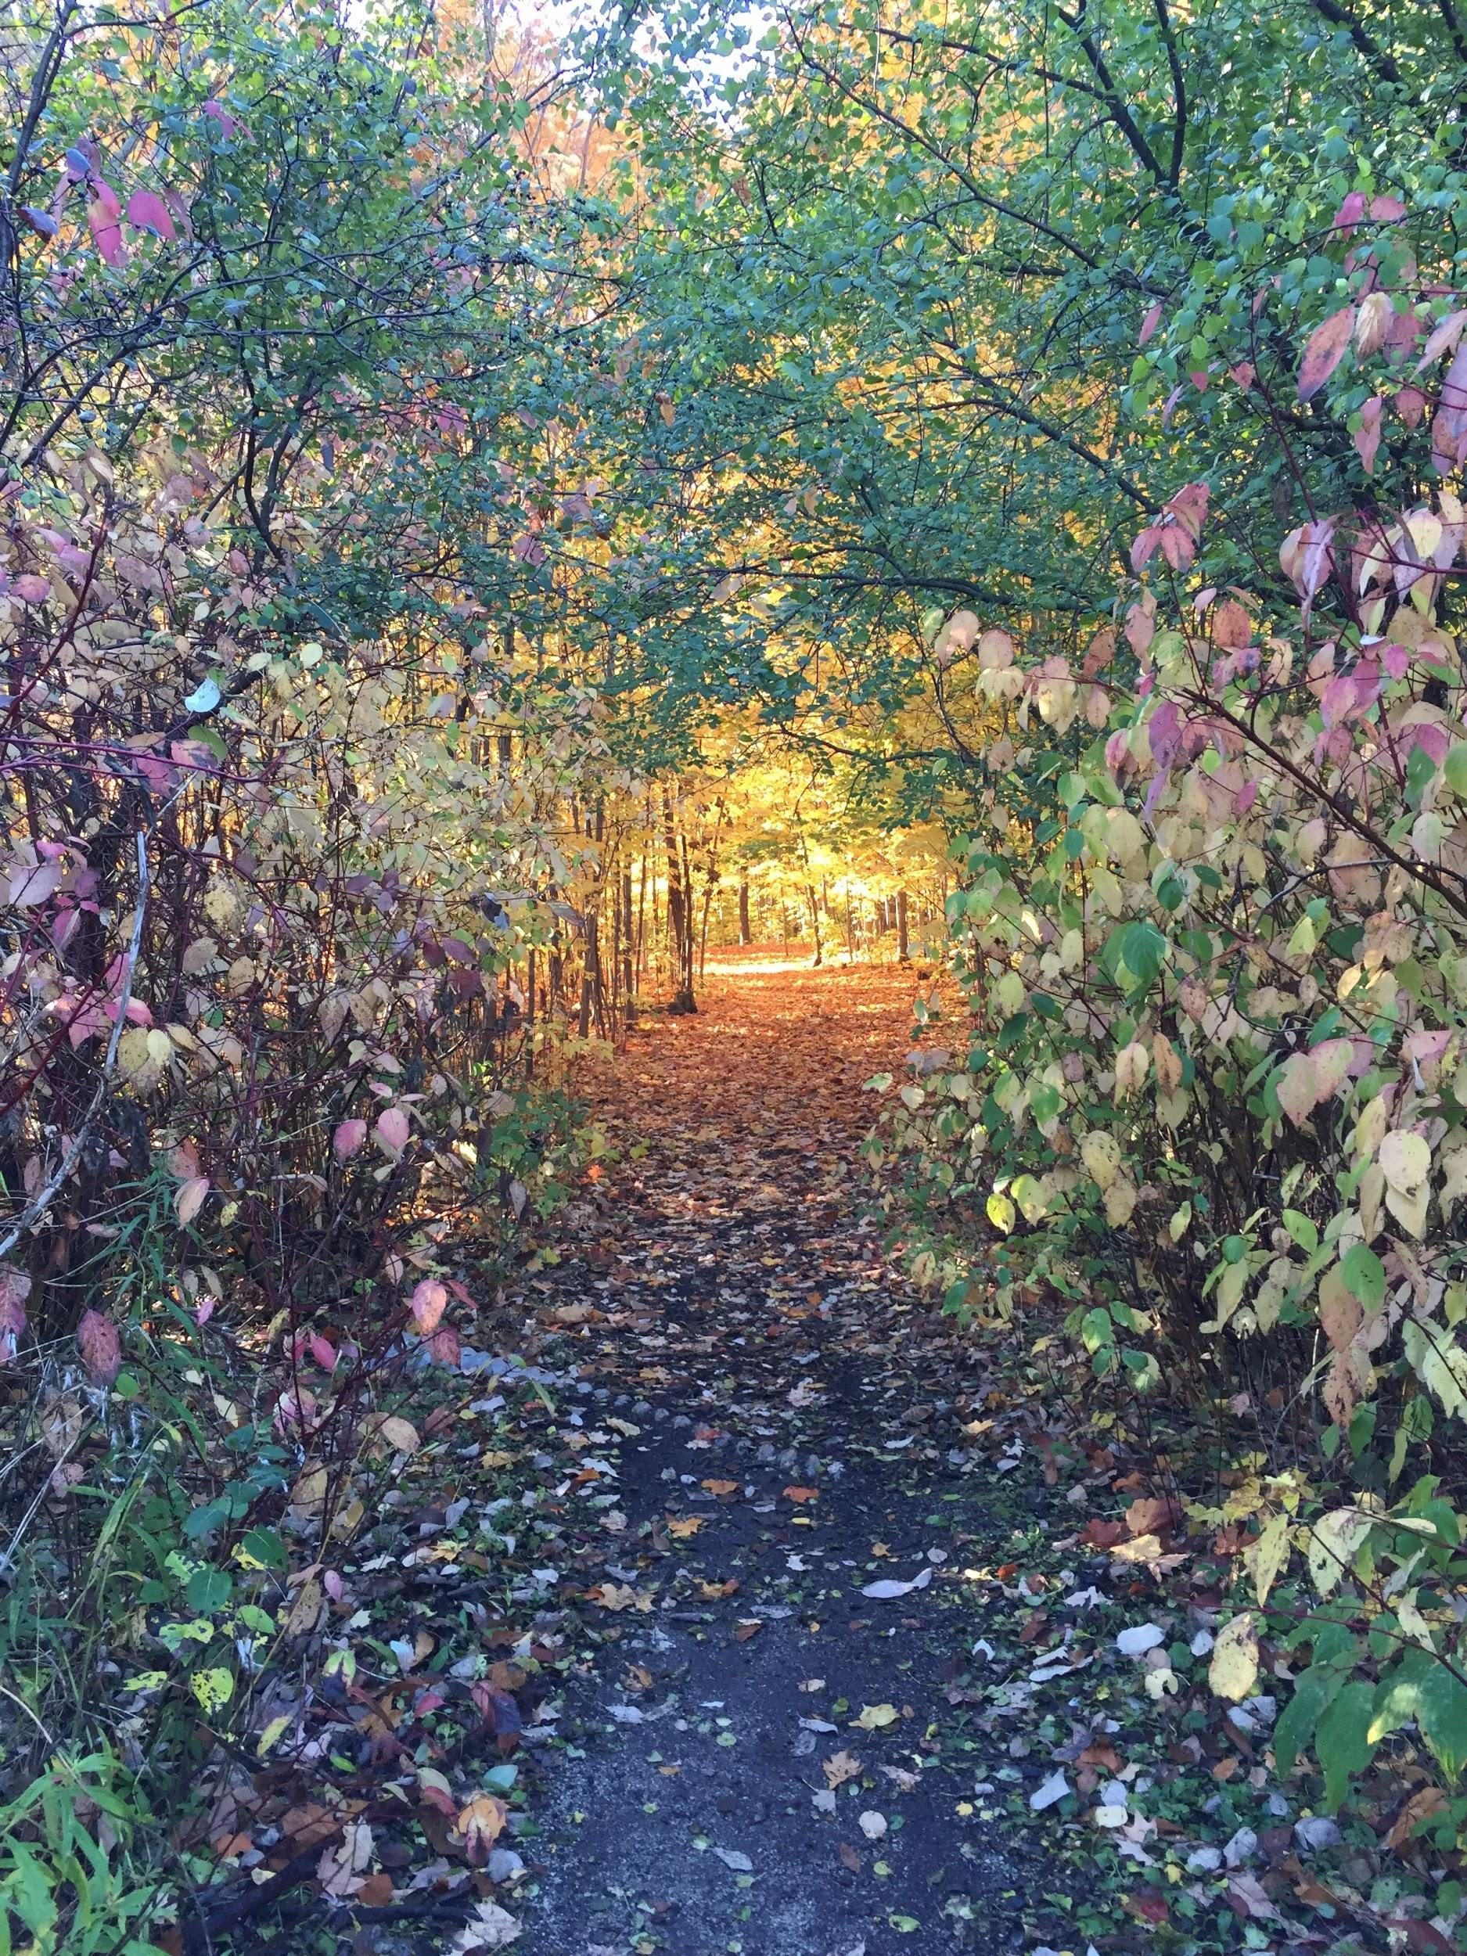
On our field trip, we will be exploring nature.

Slide 8
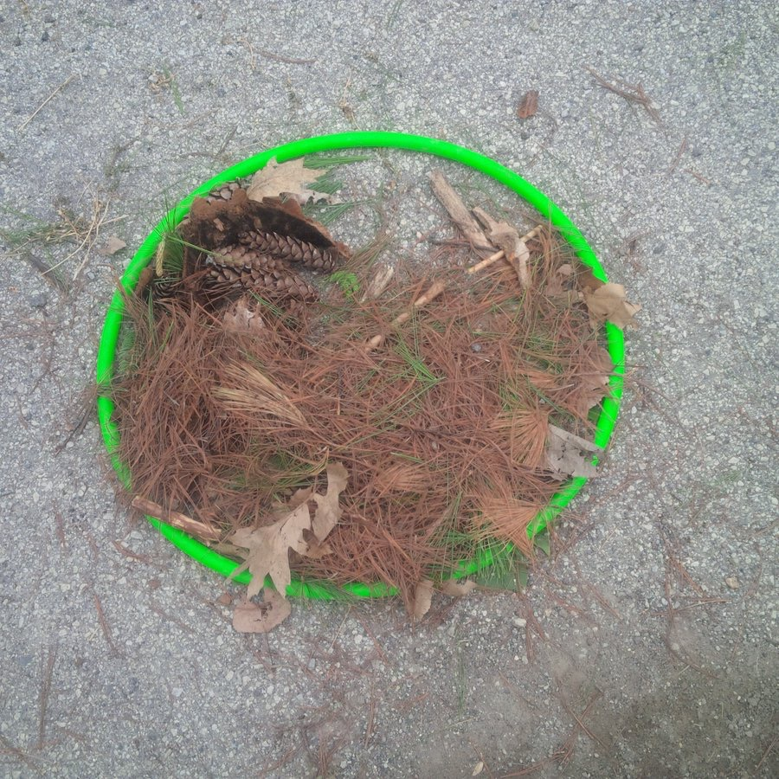
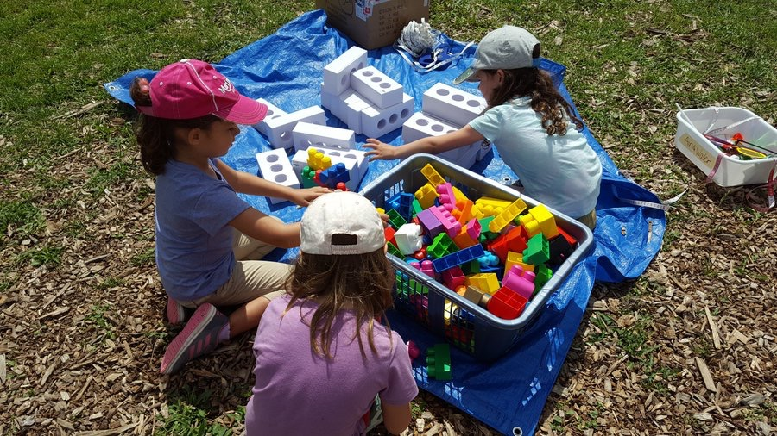
Some of the things we might do today are:
- Make art
- Use building blocks
- Look for animal clues

Slide 9
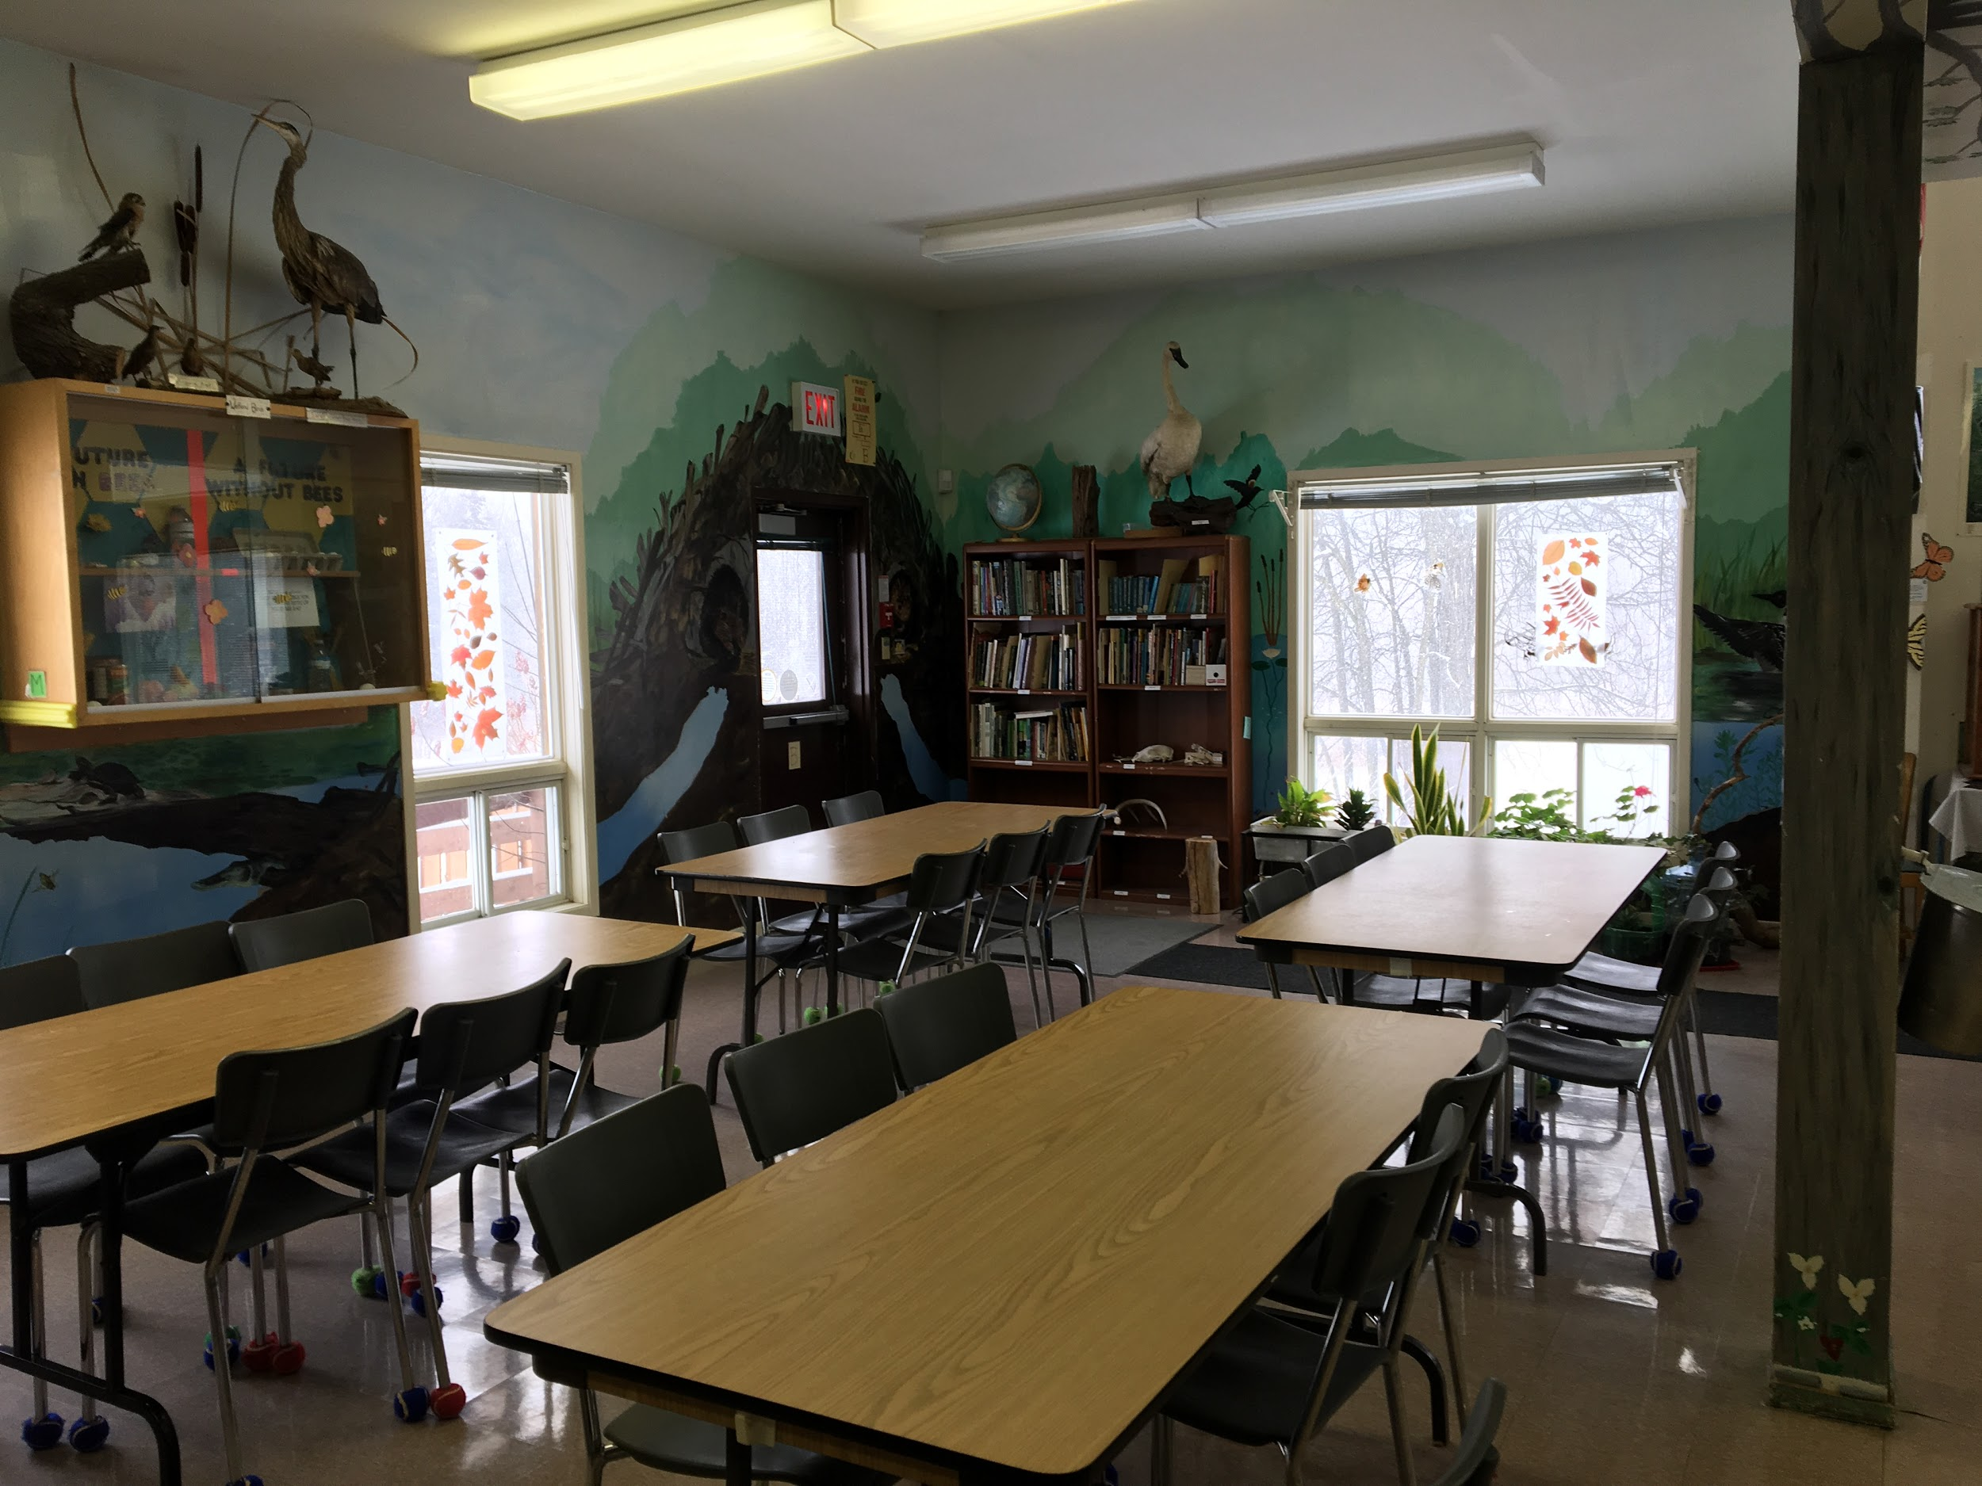
After eating our lunch, we will get ready for the afternoon.

Slide 10
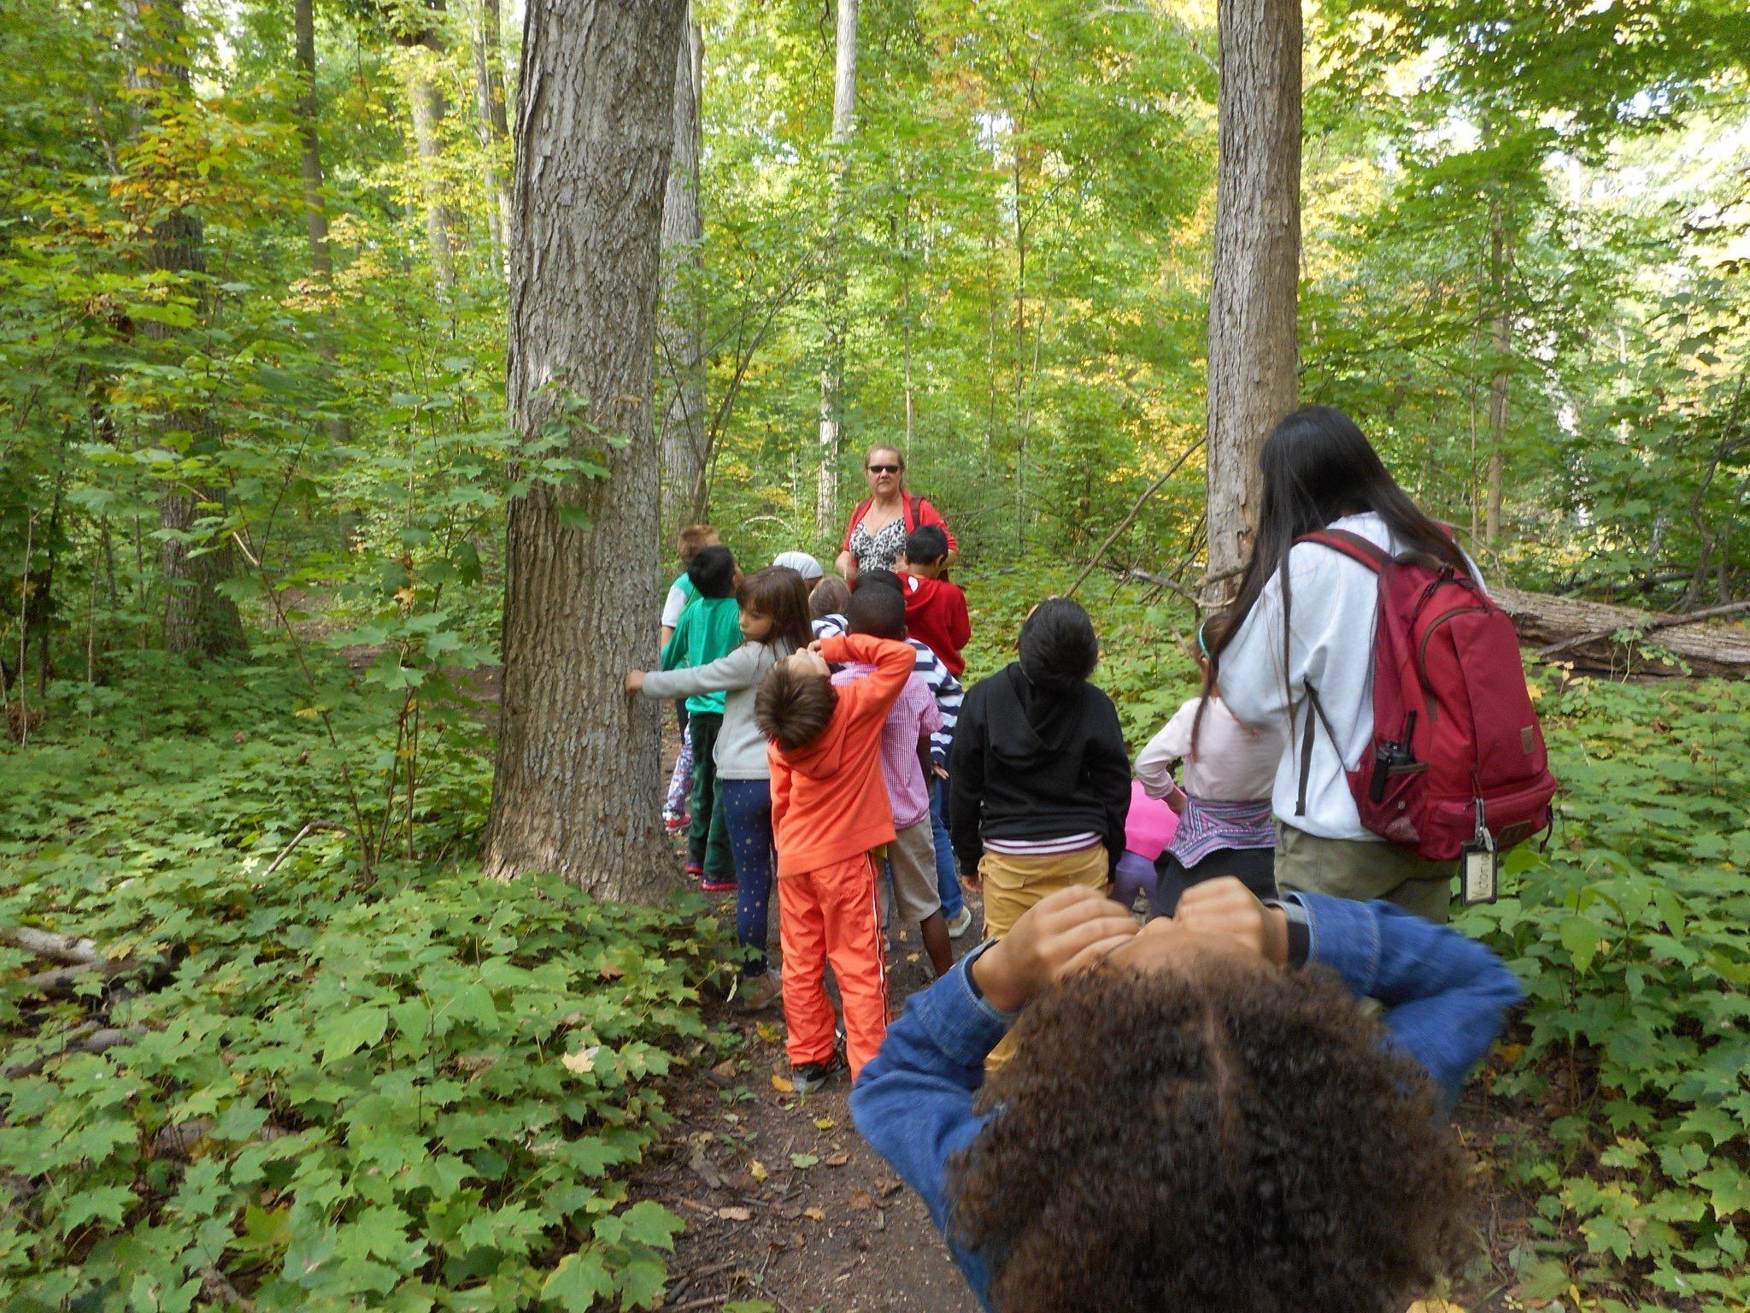
We know we will be safe on my field trip because our friends and teacher will be with us.

Slide 11
On our field trip, we will try to:
- Listen to the teacher.
- Have a positive attitude.
- Have fun!

Slide 12
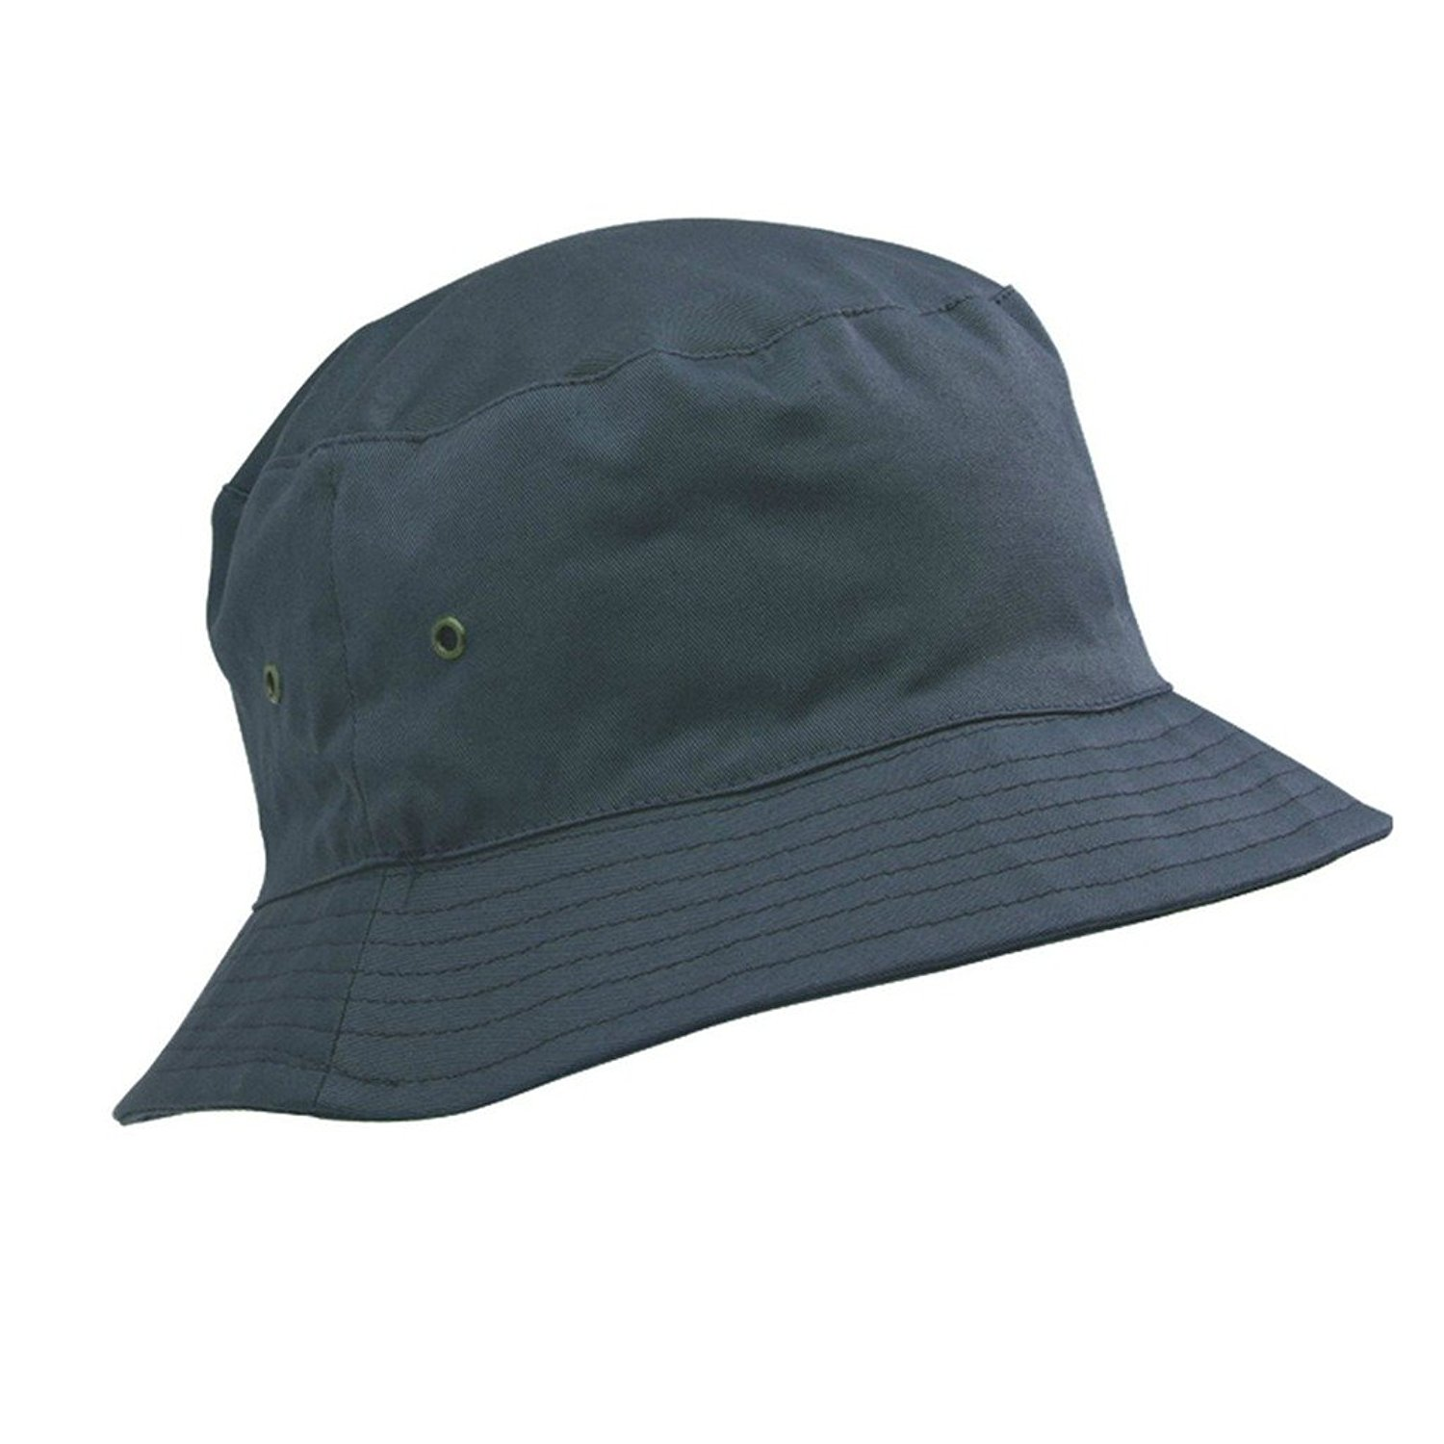
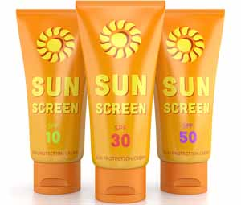
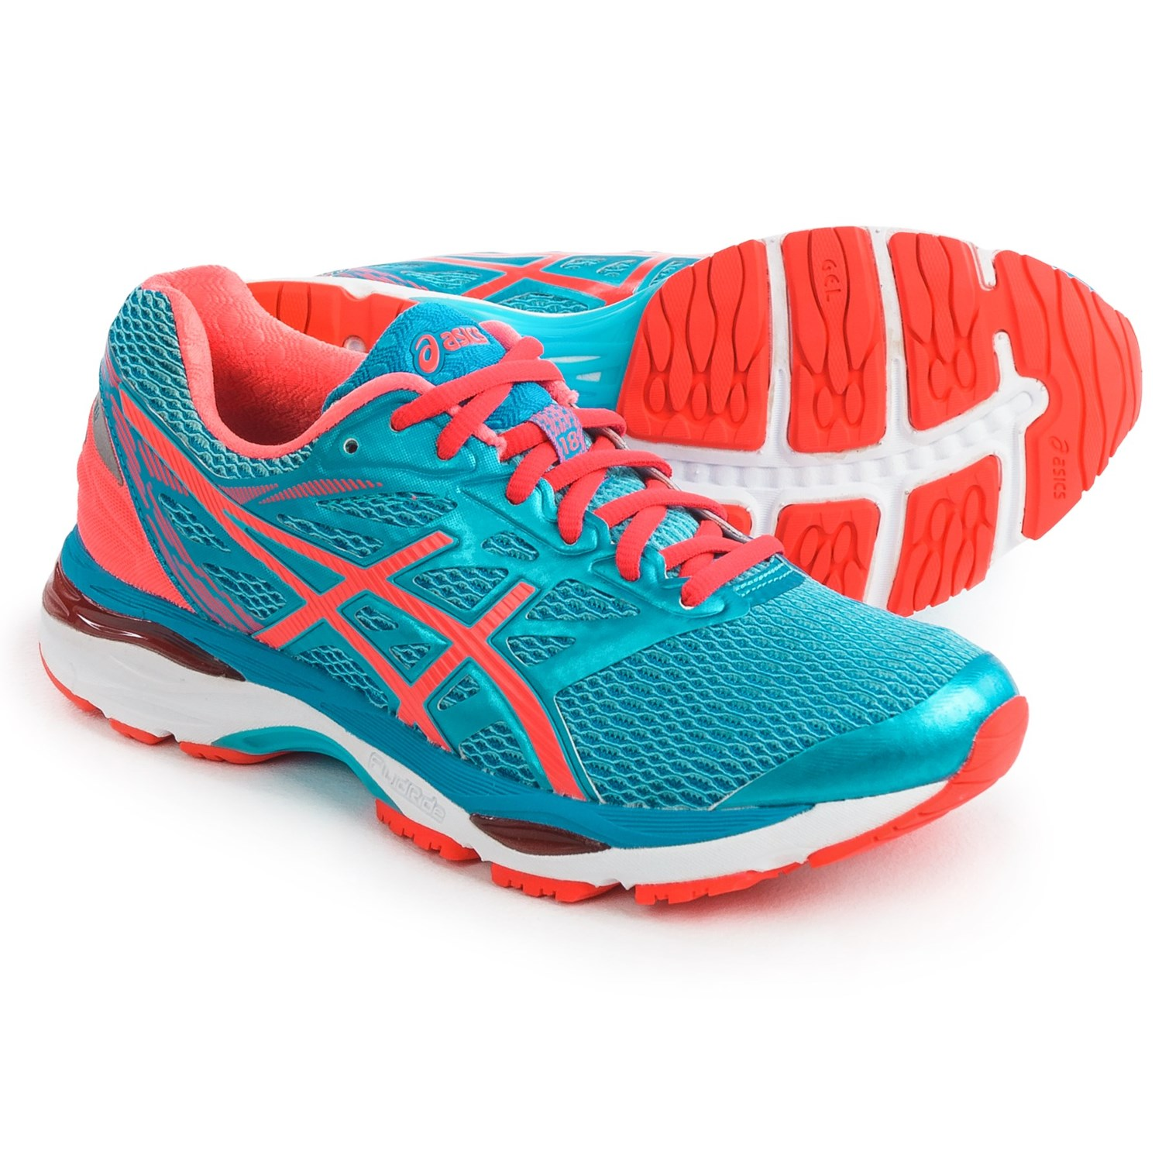
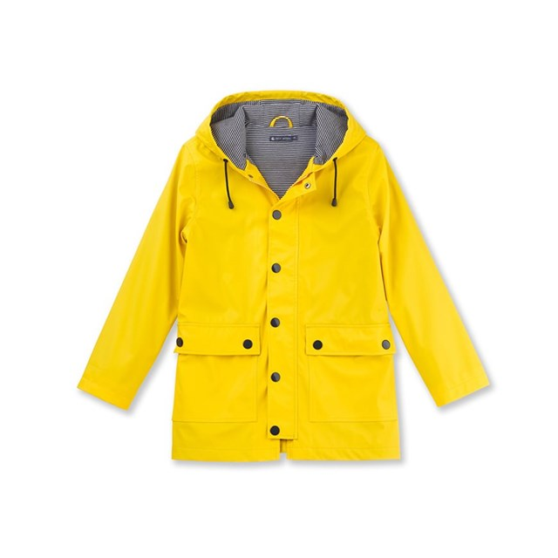
We will need to wear:
A hat
Sunscreen
Running shoes
Light sweater/coat

Slide 13
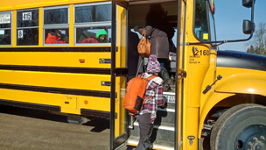
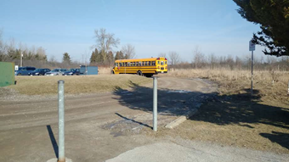
At the end of the day, we will leave the Centre and we will go back to school on a school bus.

Slide 14
Today might be different than other school days, but that is OK!

