Slide 1
Growth Mindset
&
Positive Parenting
June Yee B.Sc, B.Ed, OCT
Randolph Sealy BSW, MSW, RSW

Slide 2
Land Acknowledgement
We acknowledge we are hosted on the lands of the Mississaugas of the Anishinaabe, the Haudenosaunee Confederacy and the Wendat. We also recognize the enduring presence of all First Nations, Métis and the Inuit peoples.”

Slide 3
Growth Mindset & Positive Parenting
Review of Growth Mindset
Positive Parenting
Questions ????

Slide 4
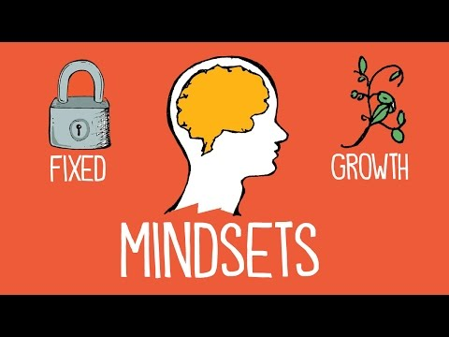
Notes:
This video we are going to show you is about Fixed vs. Growth Mindsets, a concept that was first conceived by Carol Dweck:https://www.youtube.com/watch?v=M1CHPnZfFmU

Slide 5
Growth Mindset

Slide 6
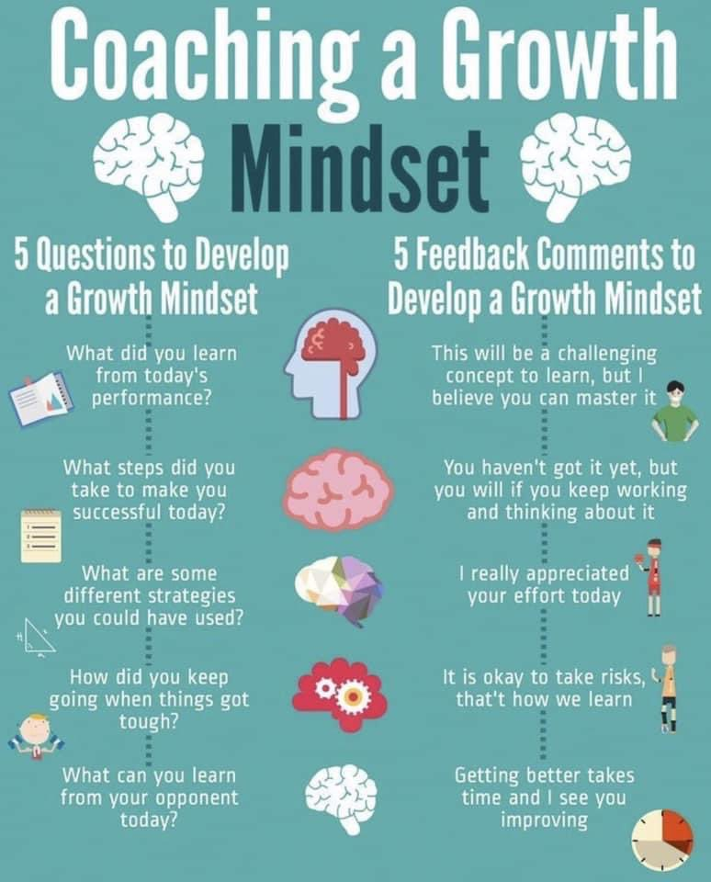

Slide 7
Setting Your Child up for Future Success

Slide 8
Positive Parenting
Parental behaviour that is based on the best interests of the child which will enable their full development:
Nurturing
Empowering & non-violent
Provides recognition and guidance
Involves setting of appropriate boundaries

Slide 9
Positive Parenting
The aim of parenting is to:
Foster positive family relationships
Exercise parental responsibility
Ensure the rights of children and adolescents in the family setting
Provide opportunities to optimize their full development
Take into consideration their welfare and well-being.

Slide 10
We want our children to behave well, and to:
Have respect for themselves and others
Be polite to others
Know how to behave in different situations
Be able to concentrate and pay attention
Share and to take turns
Know how to win and how to lose

Slide 11
What makes children behave in challenging ways?
Children do not usually misbehave just to upset or annoy their parents. There is often a reason behind a child’s behaviour.
It may be:
they are upset or anxious about school
they feel jealous of their brother or sister
they want their parent to listen to them
they want their parent to spend time with them

Slide 12
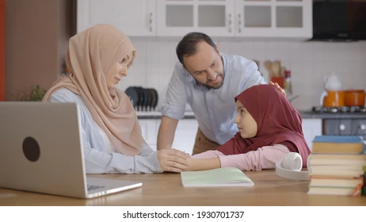
Language
Use positive words, when possible.
Tell your child what you want them to do, not what you don’t want them to do.
Try “Tidy up your toys please,” instead of “Don’t make such a mess.”

Slide 13
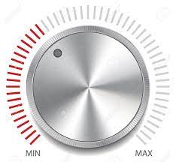
Change your tone:
Your voice is a powerful tool!
Sometimes changing your tone or volume can be enough to stop a difficult situation or get your child to do what you want.
Be calm and gentle, but firm

Slide 14
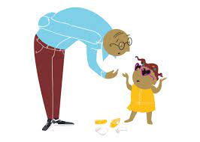
Listening/Observing
Children are just learning about and exploring their language skills
They need to be heard to develop effective communication skills
encourage your child to talk to you
try to understand their overall message
When you listen, you may hear things that you don’t like.

Slide 15
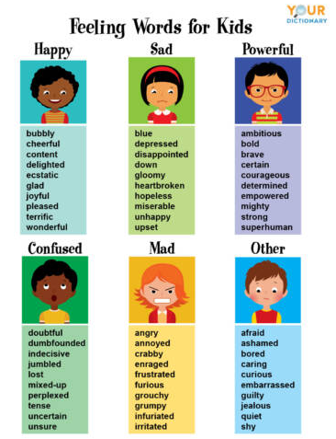
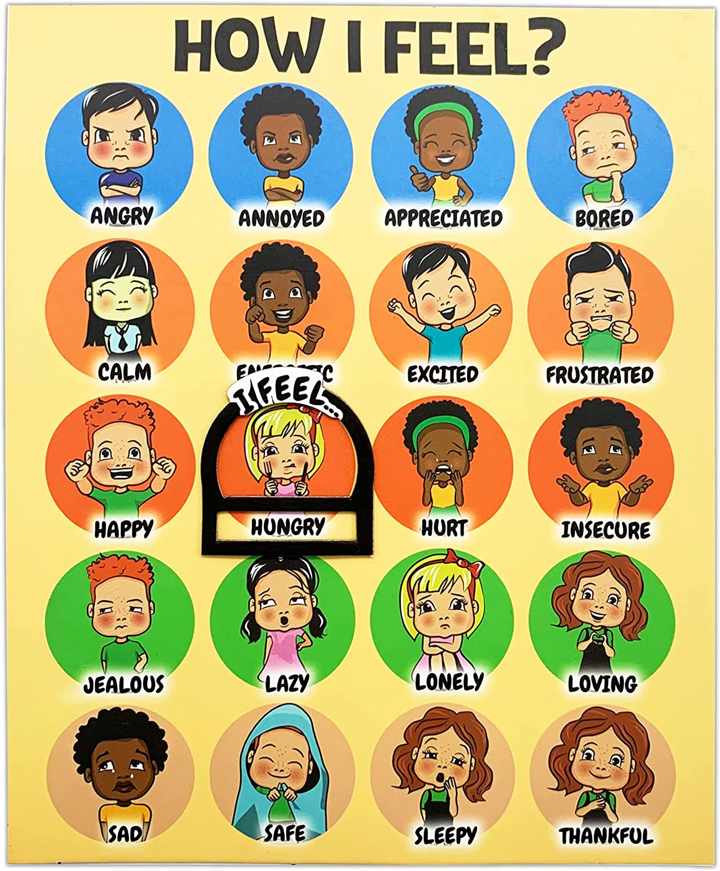
Feelings

Slide 16
Explaining
Be clear, direct and concise
Use developmentally appropriate language
If you have to say ‘no’, give your child a good reason and offer an alternative
Actions speak louder than words

Slide 17
Involve your child
Where possible talk with your child about the rules and what you expect from them
Be clear and concise
Use Discipline, not Punishment
Use natural and logical consequences when children make mistakes or misbehave

Slide 18
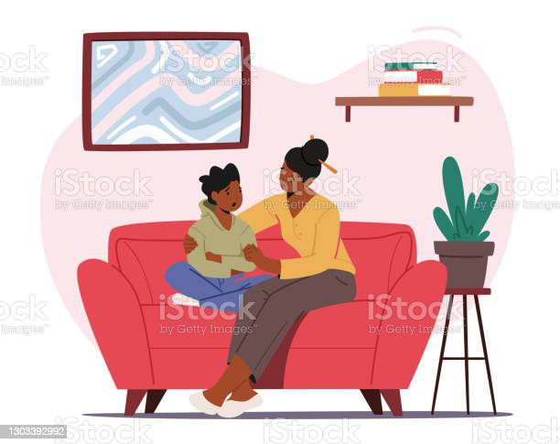
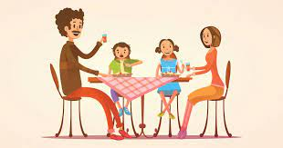
Discussion

Slide 20
Resources/Websites
Understanding the Growth Mindset: https://sites.dartmouth.edu/learning/2017/05/18/understanding-the-growth-mindset/
Three Things Most People Don’t Grasp about Growth Mindset: https://teacherbooker.com/three-things-most-people-dont-grasp-about-growth-mindset/
Best Practice Guide for Positive Parenting: A resource for practitioners working with families: https://www.researchgate.net/publication/332978612_Best_Practice_Guide_for_Positive_Parenting_A_resource_for_practitioners_working_with_families
Family iTools Module 2: Promoting Positive Parenting: www.ped.state.nm.us
Top Tips for Parents: Your Guide to Positive Parenting: https://www.womenwork.org/wp-content/uploads/2016/02/parenting-techniques.pdf

Slide 21
Thanks for Attending!!!

