Slide 1
Wednesday, December 6th, 2023
~
Lynnwood Heights JPS
SAC

Slide 2
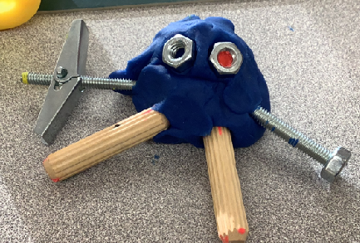
Mr. Rothman & Ms. Ahmadi - Kindergarten
Math - Patterns!
Making Words!
STEM maze activity!
Creating Robots!

Slide 3
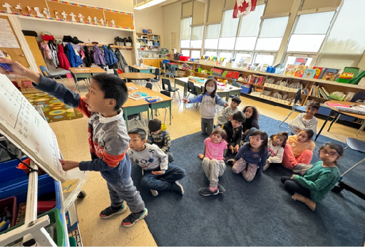
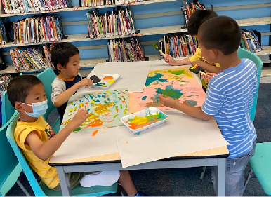
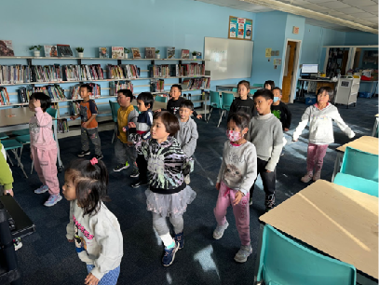
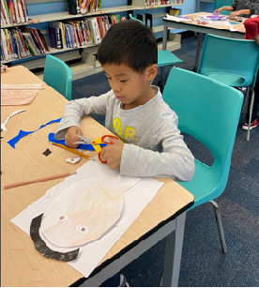
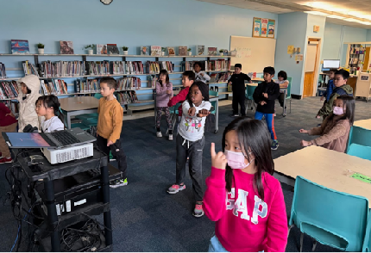
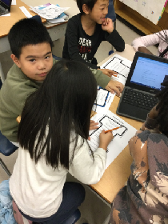
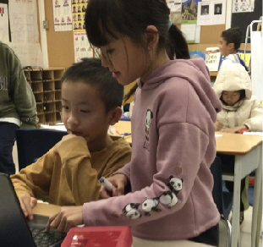
Primary Classes - Ms. Fisher, Ms. Foulidis and Ms. Lumsden
STEM maze activity!
Creating!
Sharing and learning!
Dancing!

Slide 4
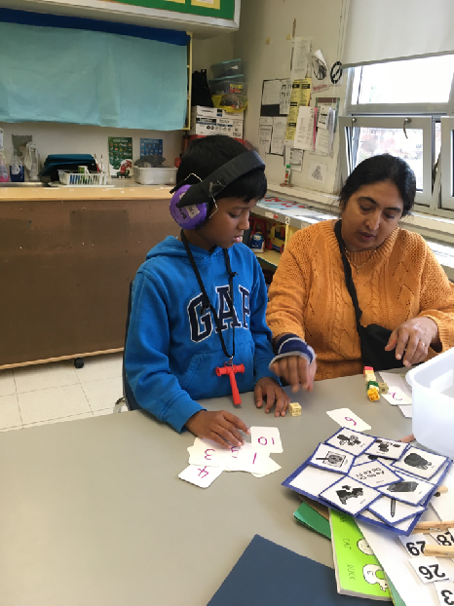
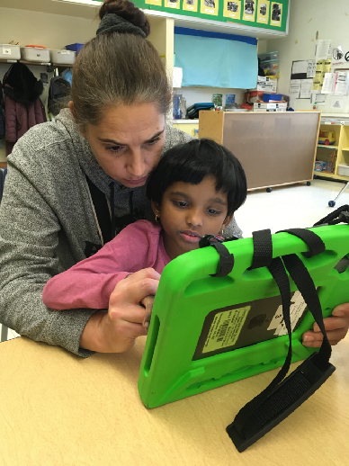
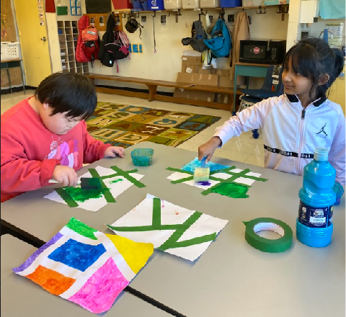
Ms. Ci, Ms. McCrae, Ms. I, Ms. Potter - Gr. 1 - 3
STEM maze activity!
Creating artwork!
Learning together!

Slide 5
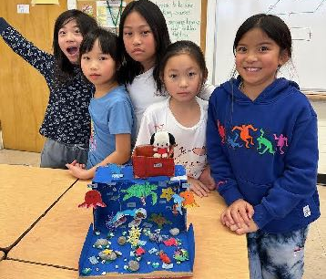
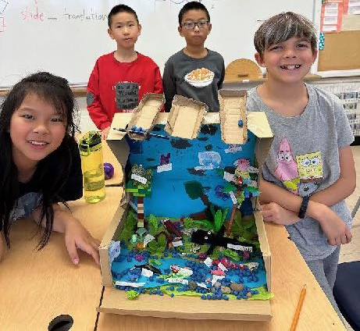
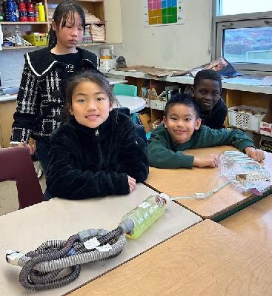
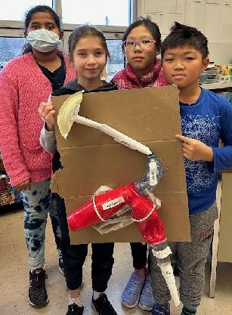
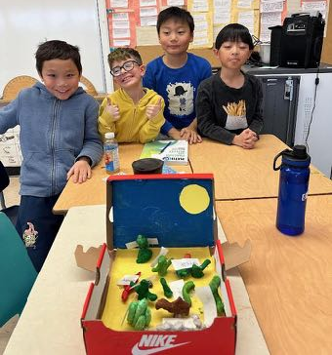
Mr. Swire - Grade 4/5
STEM maze activity!
Grade 4 - Habitat Models
Grade 5 - Digestive System Models

Slide 6
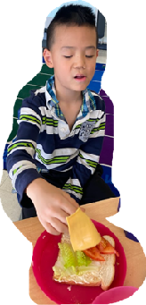
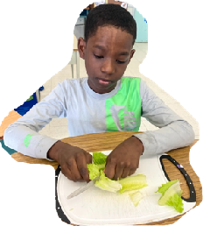
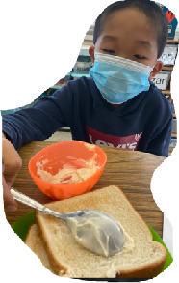
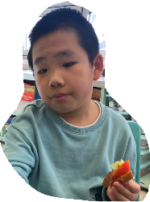
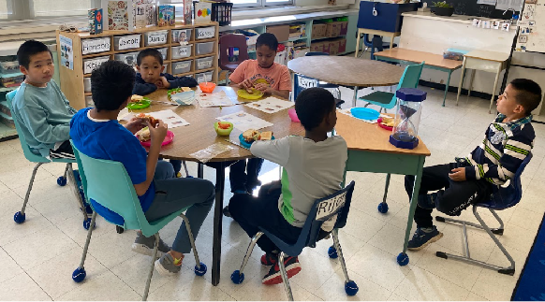
Ms. Ho, Ms. I, Ms. N and Ms. Mary - Gr. 4 - 6
Students participate in weekly/bi-weekly cooking classes.
In the month of November, we made sandwiches and macaroni salad.
We learn daily life skills such as: reading and following instructions, learning how to mix, put together, and cut food items.
STEM maze activity!

Slide 7
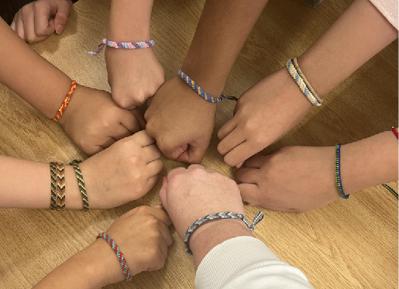
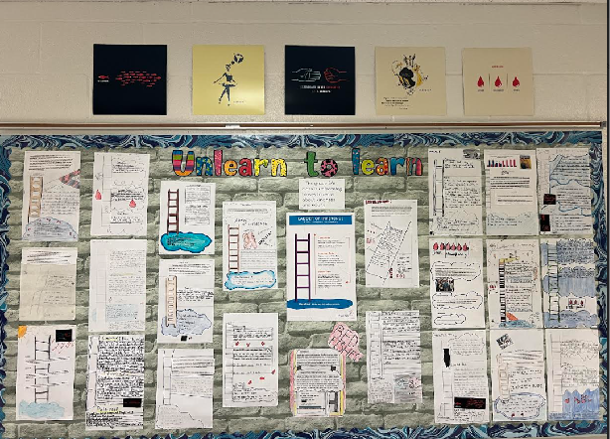
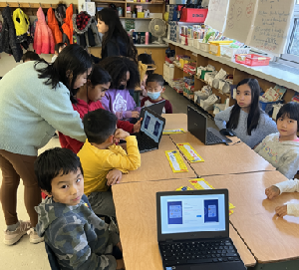
Mrs. Alexander - Grade 5/6
STEM maze activity!
- Unlearn to learn
- School Student Survey
- Friendship Bracelets
- Reading Buddy portraits

Slide 8
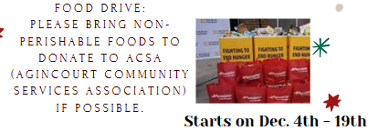
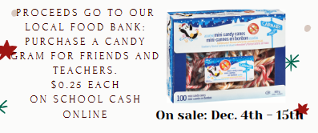
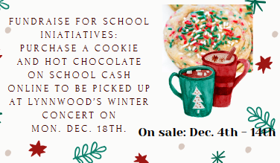
Upcoming Events
Dec. 4 - 19: Food Drive to support Agincourt Community Services Association’s food bank
Dec. 4 - 15: Candy Grams
Dec. 4 - 14: Cookie and Hot Chocolate

Slide 9
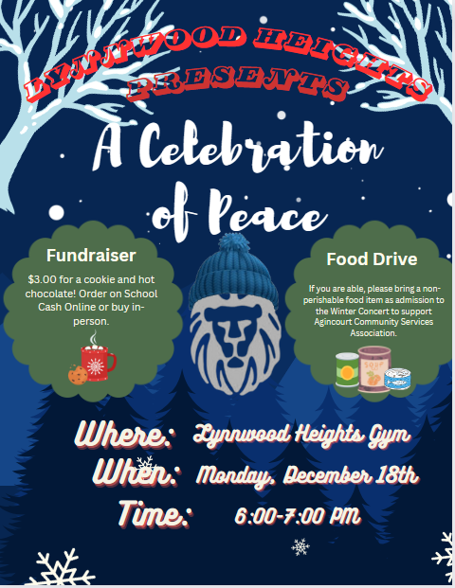
Celebrate Peace
Monday, December 18th,
6:00-7:00 pm
Bring a non-perishable food item for our food drive.
Pre-order hot chocolate and a cookie on School Cash Online to be picked up on the evening of the concert.

Slide 10
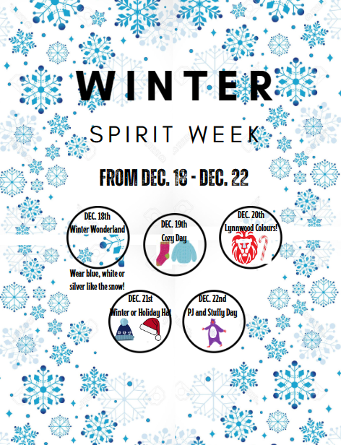
Winter Spirit Week
Some students in the Grade ⅚ Class have organized a Winter Spirit Week during the last week of school in December.
Mon., Dec. 18 - Wear blue, white or silver like the snow!
Tues., Dec. 19 - Cozy Day
Wed., Dec. 20 - Lynnwood Colours
Thurs., Dec. 21 - Winter or Holiday Hat
Fri., Dec. 22 - PJ and Stuffy Day

Slide 11
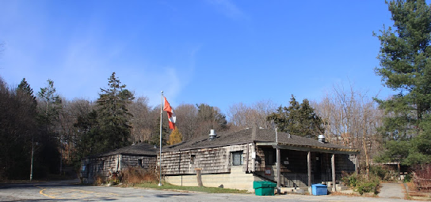
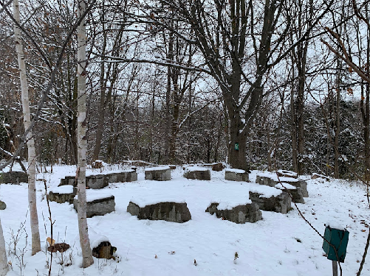
Lynnwood Goes to Forest Valley!
January 18
Grades 4/5 Habitat and Community
Grades 5/6 Biodiversity
February 20
Grade JK/SK and
Grade 1 Maple Syrup
March 7
Grades ½ and
2/3 Maple Syrup
March 28
Ms. Ho and
Ms. Ci’s classes – Maple Syrup

