Slide 1
École Sir Adam Beck Junior School
Full Day Kindergarten
Virtual Information Night
Thursday May 6, 2021, 6:30 PM
Welcome! Introductions
SAB FDK Overview, Program & Team
Student Voice
Questions

Slide 2
SCHOOL COUNCIL
Email: sabschoolcouncil@gmail.com
Co-Chairs: Paul Younger and Corinne Frey
Welcome – Corinne Frey
Partnership and Support
How to get Involved?
Check out Council news at:
Website: Website https://schoolweb.tdsb.on.ca/siradambeck/School-Council
OR
Facebook:
facebook.com/sabschoolcouncil

Slide 3
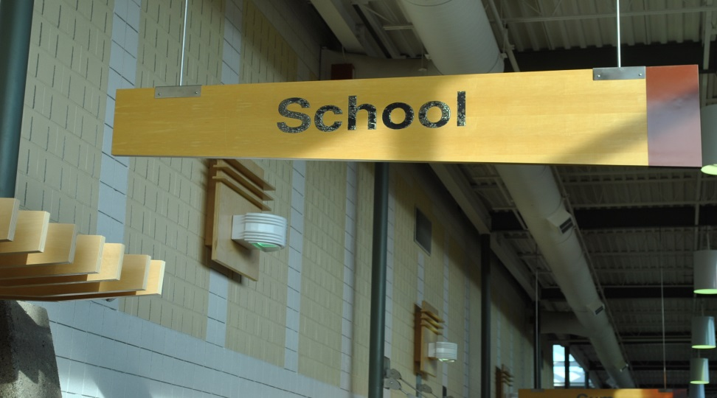
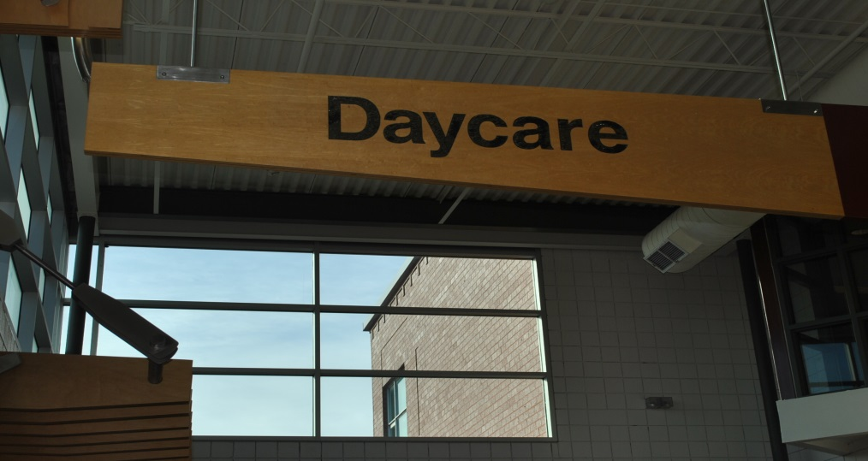
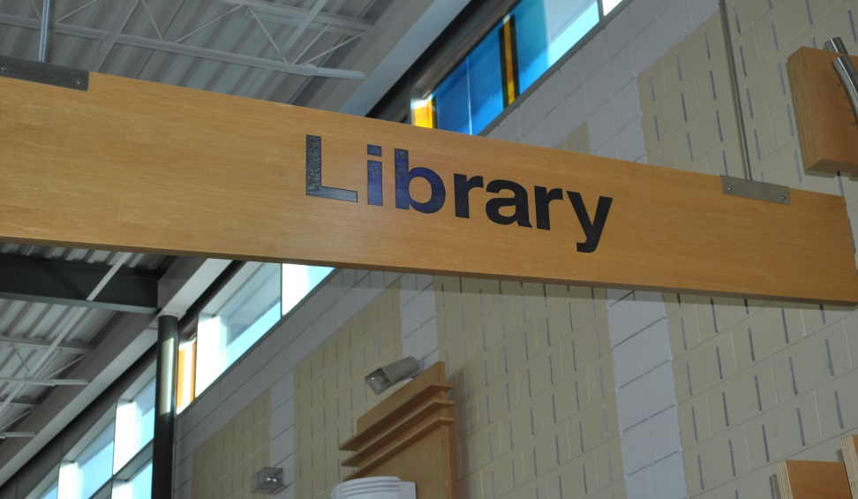
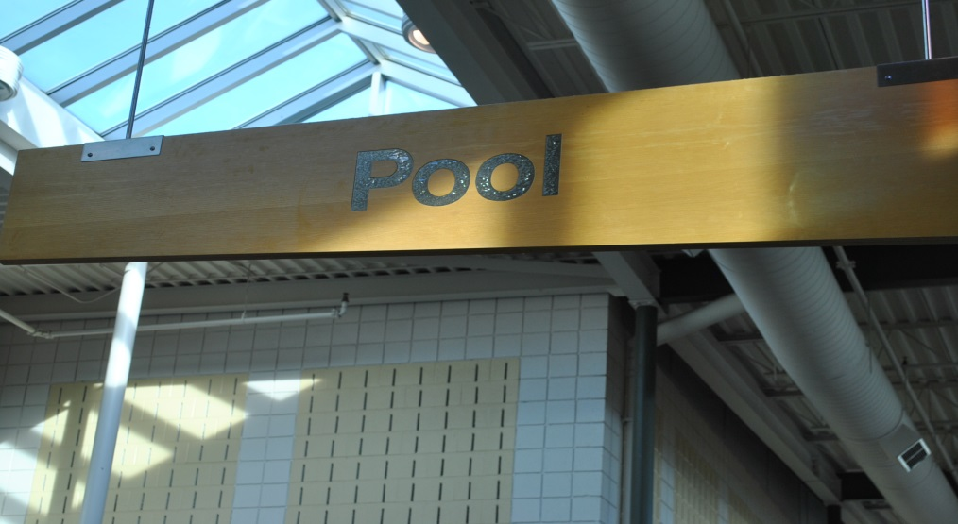
Alderwood Centre

Slide 4
Toronto Public Library – Alderwood Branch
Katherine Jutras, Library Assistant
Partnership – Collections
Learning Commons/Maker Spaces
Toronto Public Library Card
After School Programs

Slide 5
THIS YEAR’S TEAM
Regular Program French Immersion
OCT OCT
Michelle Paul Sarah Nolan
Steve Burazin Gaetan Triggiani
ECE ECE
Feroza Hamid Alice Mondenge
Jennifer Nelson Deborah Williams
(Felicity Medeiros)
LRS LRS
Atka Khatib Sherifa Douglas Manjola Domnori Crystal Brooks
FDK TIMES
8:20 – 8:35 Kindergarten Yard Supervision
8:35 – 8:40 Entry
8:40 – 11:10 AM Instructional Time
11:10 – 11:40 Lunch A
11:40 – 12:10 Lunch B
12:10 – 12:20 Lunch Clean Up and Entry
12:20 – 2:50 PM Instructional Time
2:50 Dismissal

Slide 6
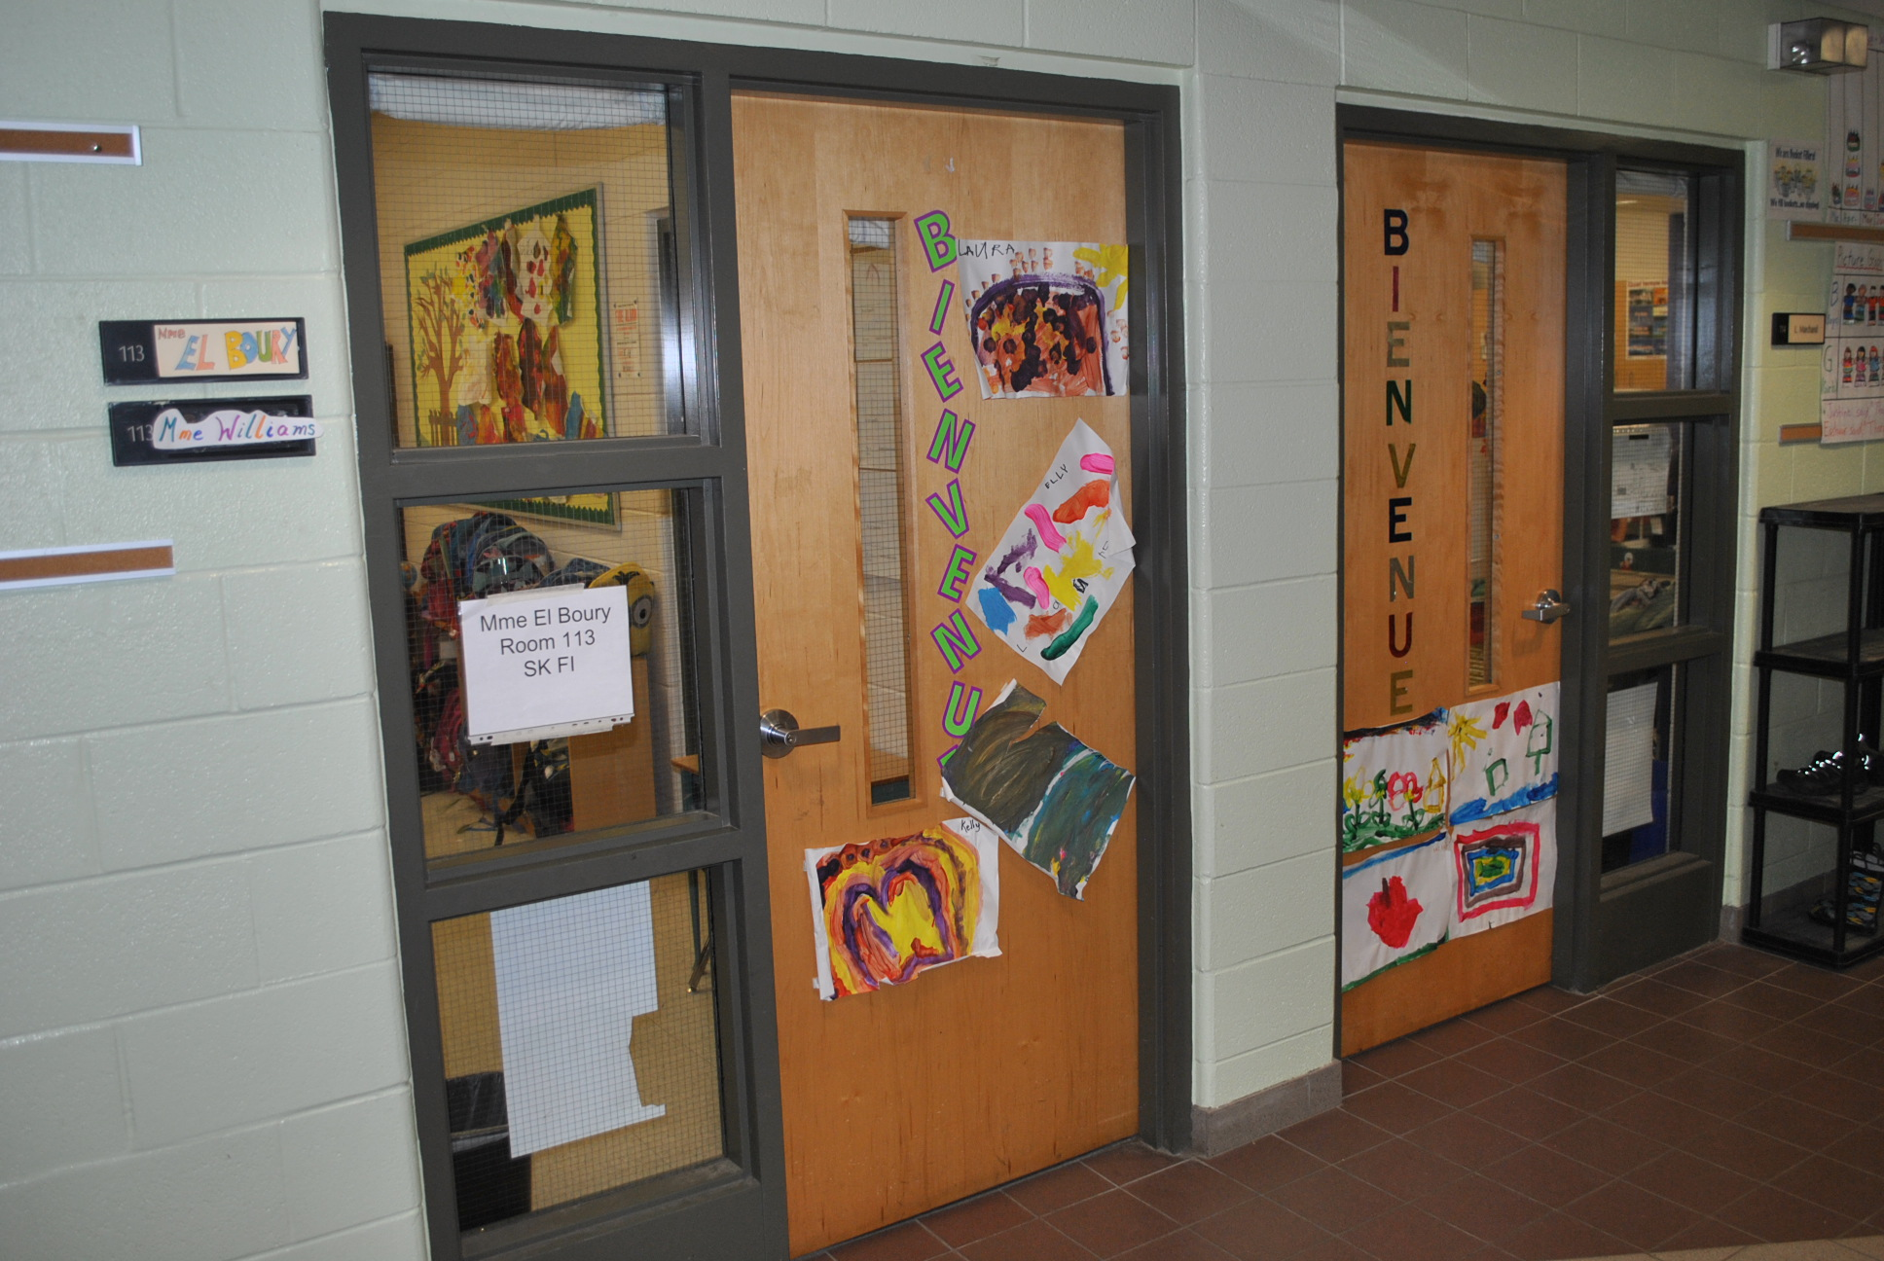
Classrooms

Slide 7
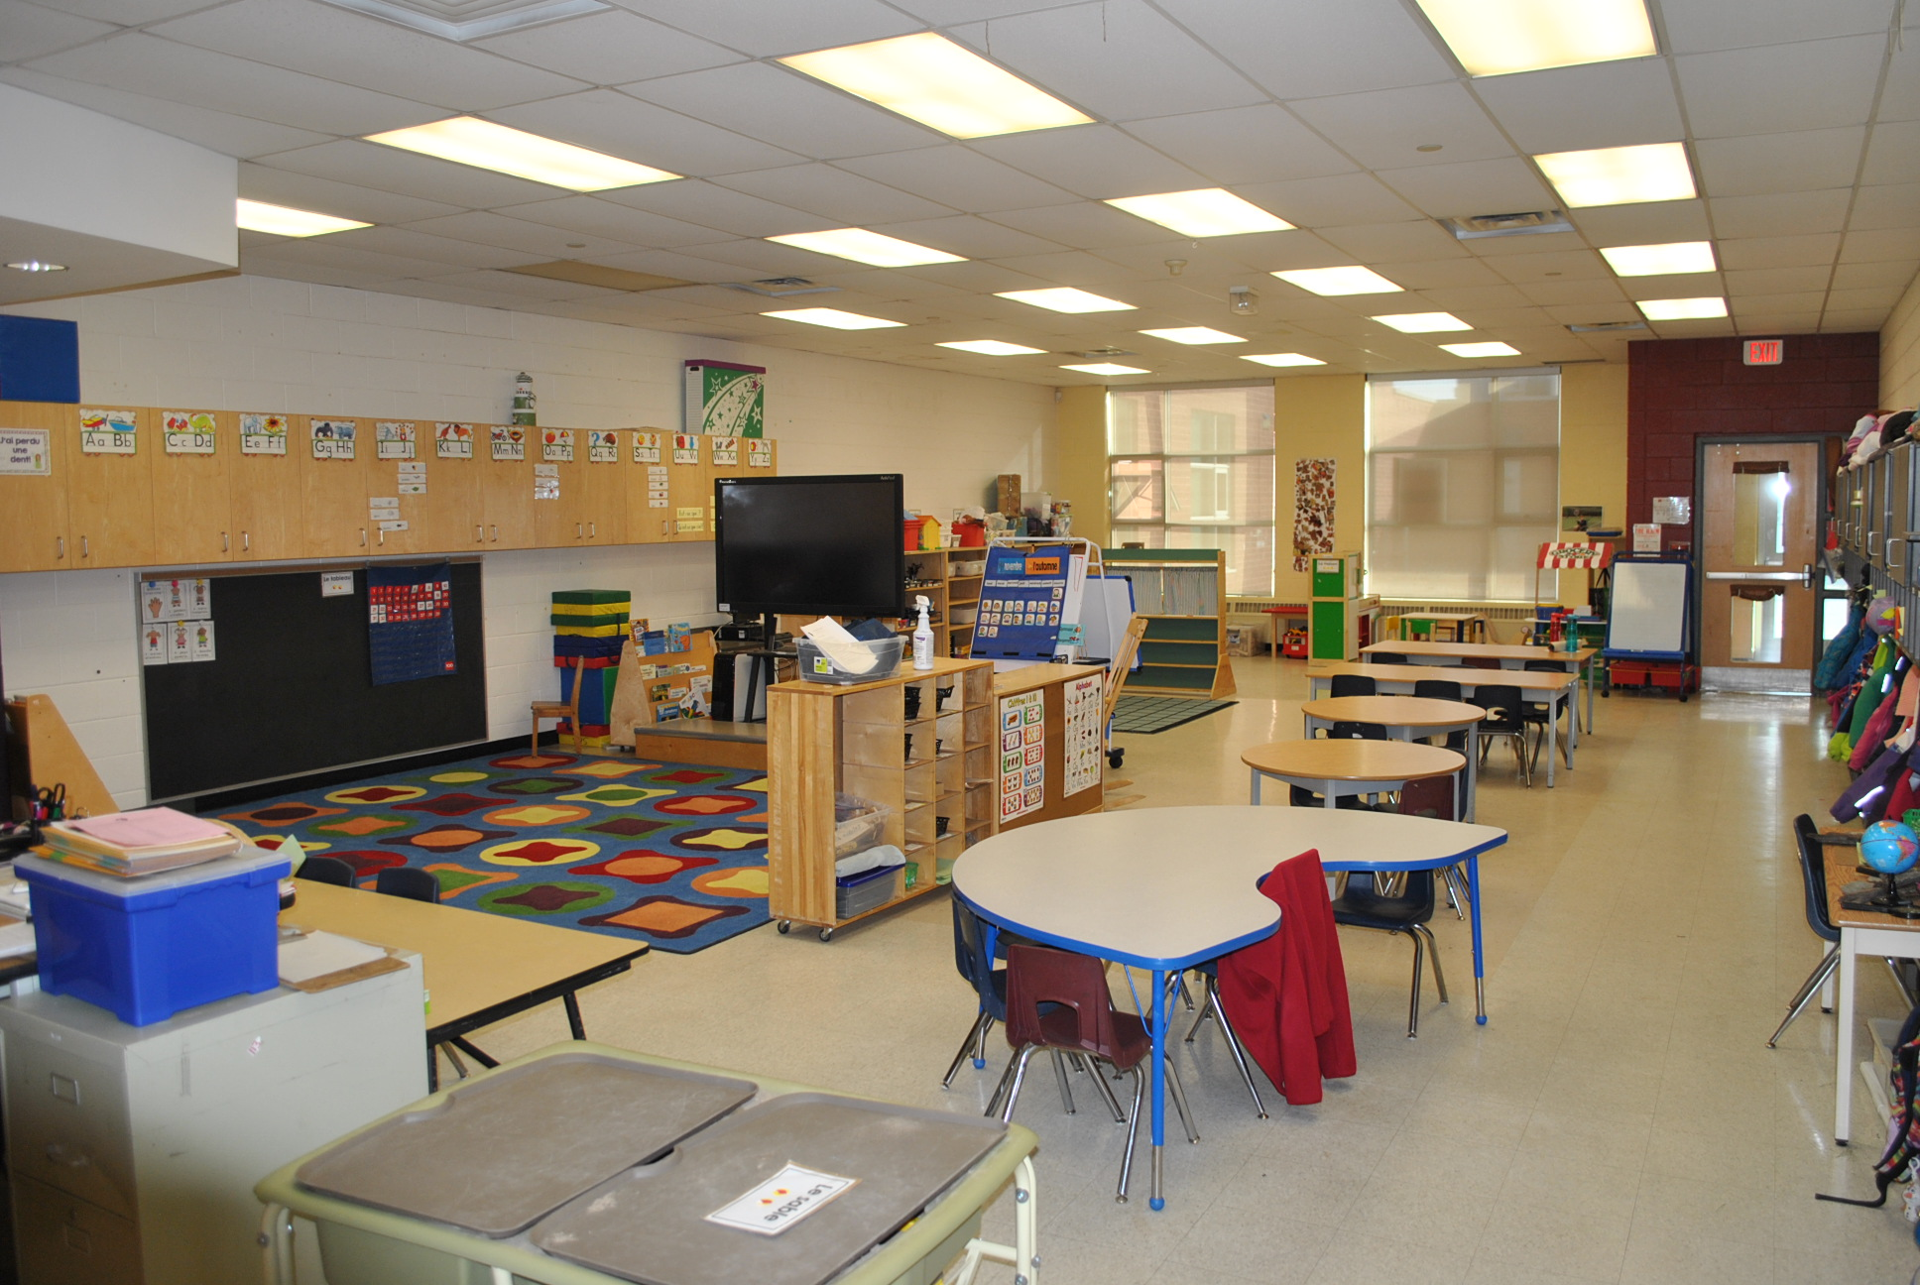
Classrooms

Slide 8
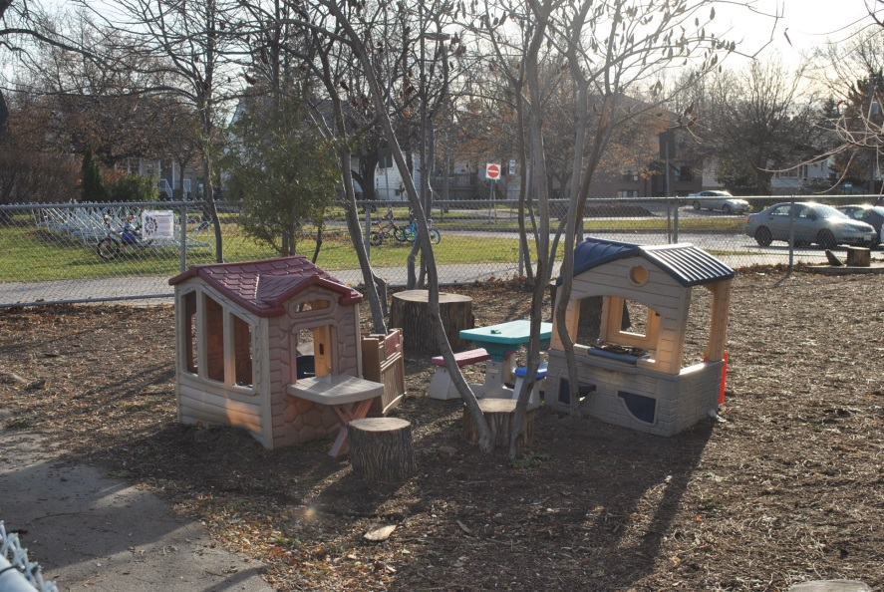
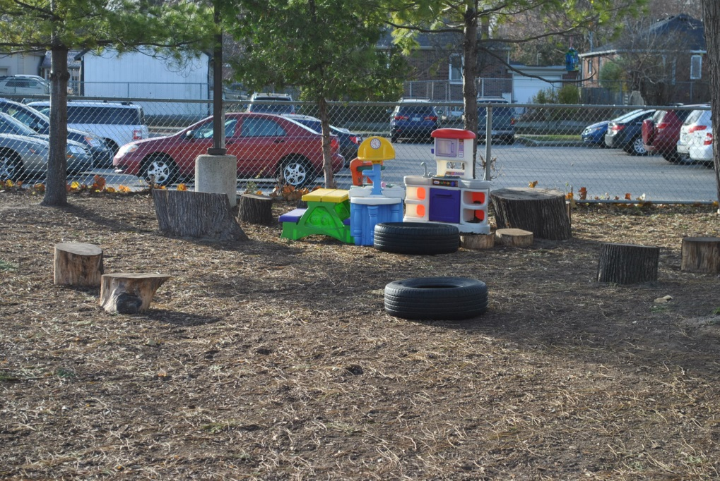
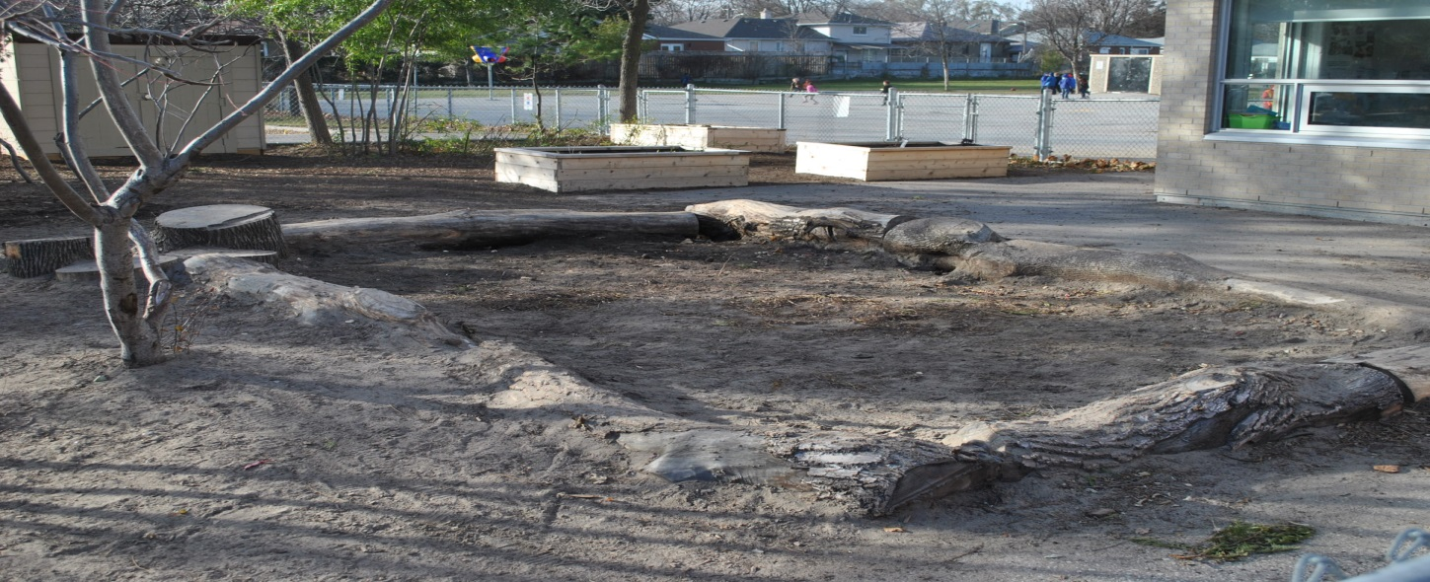
The Outdoor Naturalized Area

Slide 9
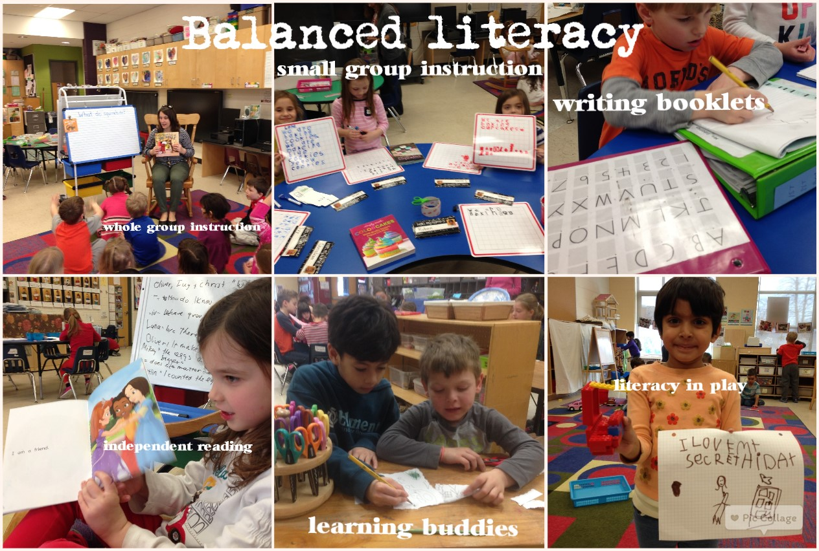
Balanced Literacy and Numeracy

Slide 10
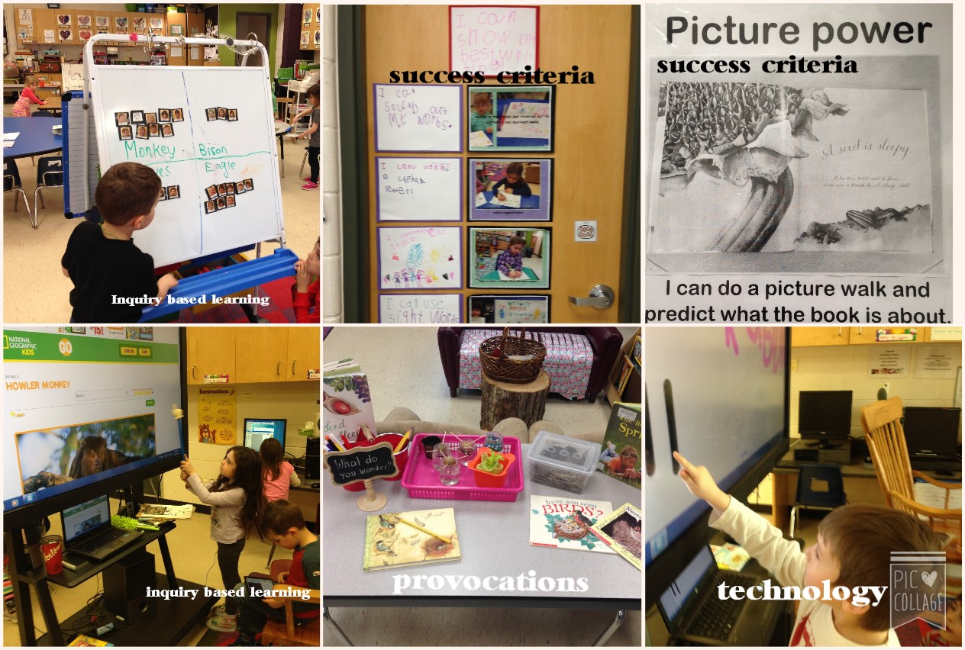
Inquiry & Technology

Slide 11
School Improvement Highlights
A Vision for Learning in the TDSB: Improvement for All Students
Each school is asked to engage in a process to determine a learning focus in three areas: achievement, well-being, and equity.
Achievement FOCI #1
Goal #1– All students reading by the end of grade 1
Goal #2– continue to build on math achievement ( increase EQAO scores +5%)
Well Being FOCI #2
Goal #1 – Every student will identify two caring adults @ SAB
Goal#2 – Every classroom will create a calm safe space for students to access in times of need.
Equity FOCI #3
Goal #1 – Introduce specific training and PD for staff to support a deeper understanding of Equity
Goal #2 - Identifying caring adults

Slide 12
School Climate
Warm Welcoming Environment
Relationships
Bucket Fillers/Caught You Caring
Inclusion and Differentiation
Teachable Moments
Inquiry and Wonder
Celebrating Mistakes
Building Independence/Confidence
Technology and Eco-Schools
Global Citizens

Slide 13
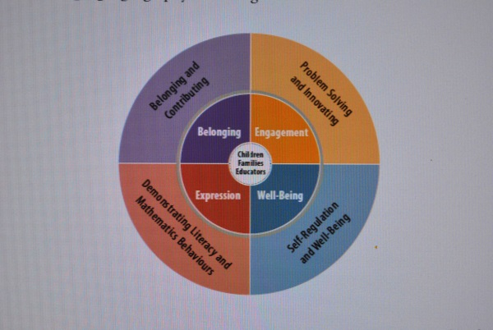
Assessment and Reporting
The four frames align with the four foundational conditions needed for children to grow and flourish − Belonging, Well-Being, Expression, and Engagement. These foundations, or ways of being, are central to the pedagogy outlined in the early learning resource How Does Learning Happen? They are conditions that children naturally seek for themselves, and they apply regardless of age, ability, culture, language, geography, or setting.
Belonging and Contributing
Self-Regulation and Well-Being
Demonstrating Literacy and Mathematics Behaviours
Problem Solving and Innovating
Figure 2. The four frames of Kindergarten (outer circle) grow out of the four foundations for learning and development set out in the early learning curriculum framework (inner circle). The foundations are essential to children’s learning in Kindergarten and beyond. The frames encompass areas of learning for which four- and five-year-olds are developmentally ready.
The Kindergarten Program p. 14

Slide 14
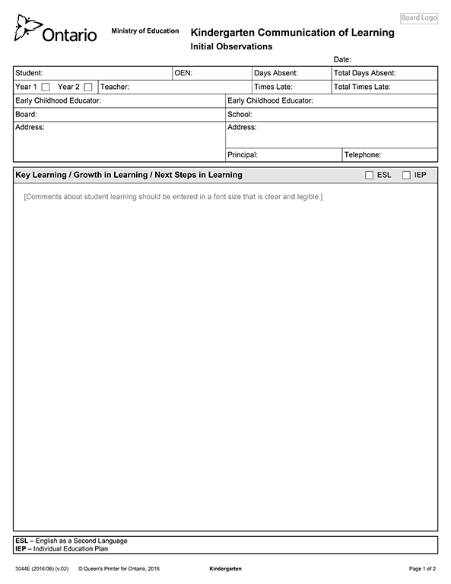
Communication of Learning

Slide 15
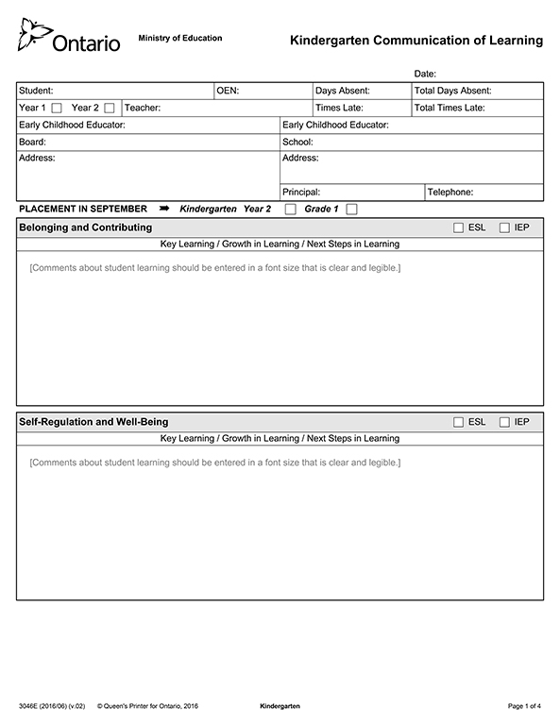
Communication of Learning cont..

Slide 16
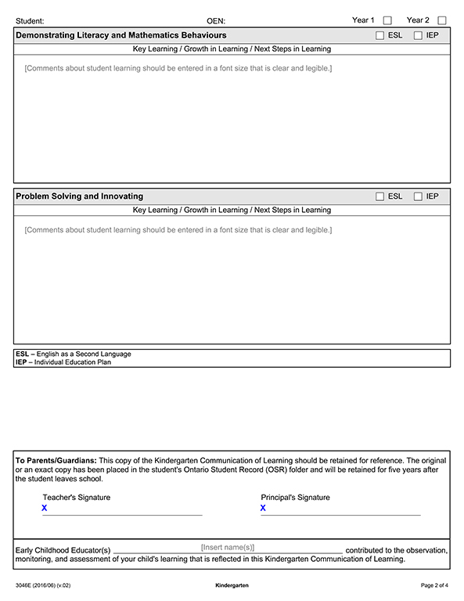

Slide 17
Specialist Subjects
Health Physical Education and Outdoor Play
Music
STEM (COVID pause)

Slide 18
COVID Safety
Cohorting
Reception Zones
Daily Screening
Regular Hand Washing/Sanitizing
Mask Wearing
Classroom HEPA Filters
Air Flow - Windows Open
Outdoor Play/Classrooms
Wellness Room
Pivot Ready

Slide 19
Student Voice
Welcome
Moving On Students (Grade 5)
Carmen and Lana

Slide 20
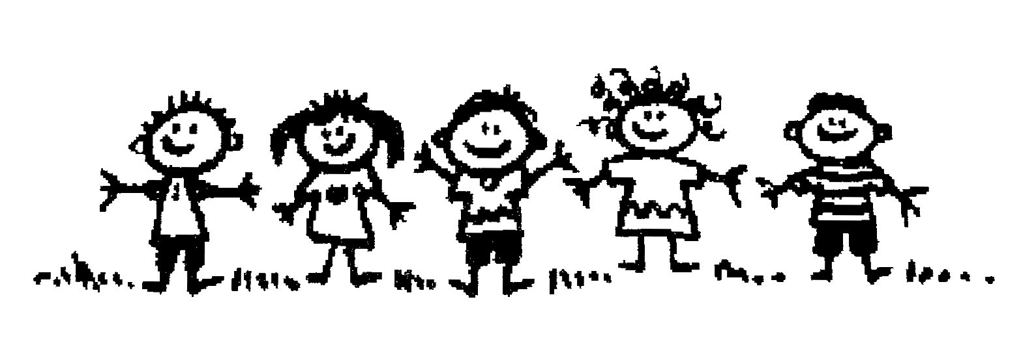
Getting Ready for Kindergarten
Here are a few ideas to help your child get ready for Kindergarten at Sir Adam Beck J.S.
Over the summer:
Phase out naps and practice using the public washrooms while out at the mall, swimming pool, etc. (the toilets at school are quite loud when they flush!)
Choose a backpack that is large enough to fit a lunch bag, shoes, clothes and the communication bag that will be provided by the teacher. Please purchase a backpack and lunch bag that has sturdy zippers. Have your child practice zipping the bag open and closed as well as packing their belongings.
Have your child practice getting dressed, fastening their shoes and opening their lunch containers, etc. Velcro shoes would be most helpful.
Visit the Alderwood Library and get a TPL card and ask the librarian to photocopy it for the school. Familiarize your child with the children’s section of the library and where they can find a favourite book.

Slide 21
Getting Ready for Kindergarten .. Continiued…
For September:
Students need a morning and afternoon snack along with their lunch. Please label snacks with “S” and lunch with “L”. A refillable water bottle is the best drink while at school.
Students need to have a pair of indoor shoes (these will stay in their cubbies at all times) and a pair of outdoor shoes.
Students need to have a complete change of clothes to keep in their cubbies.
Please label EVERYTHING!
We look forward to teaching your child during the upcoming school year!
Thank you and see you in September,
Sir Adam Beck JS FDK Team

Slide 22
Questions
Please don’t forget to visit our School website for all the latest news
https://schoolweb.tdsb.on.ca/siradambeck
https://drive.google.com/file/d/1urCpDnGHRG6R7IqbzVcnvZ6_NHy_g9yW/view?usp=sharing
Looking forward to see you and your child in September 2021
We will be in touch soon
Thank you

