Slide 1
Grade 10 and New Student Orientation
York Mills CI, fall 2013
Notes:
Have this up during Sean’s welcome and Ms. G’s intro.

Slide 2
Comfort Zone
Growth Zone
Panic Zone
Notes:
3 Zones: comfort zone is where most people are, where we do fine but we don’t take any risks. The growth zone is where we challenge ourselves and take risks, but not so much that we enter the panic zone.

Slide 3
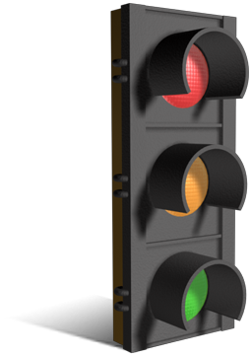
Growth mindset vs. fixed mindset
Notes:
Which sounds better?

Slide 4
INTELLIGENCE
A person’s intelligence is a fixed thing and essentially does not change.
A: Strongly Agree
B: Agree
C: Neutral
D: Disagree
E: Strongly Disagree
F: Not sure
Next three slides courtesy of York Mills Physics Department. ☺
Notes:
Put your hands up if…

Slide 5
Higher-level learning leads to brain development
Like muscle development
Strenuous physical effort = thicker muscle tissue
Strenuous mental effort = thicker brain tissue, more connections
LEADS TO HIGHER ACHIEVEMENT (BETTER MARKS)
Notes:
Like working out You can learn and improve. Your marks can go up.

Slide 6
Intelligence
A person’s intelligence is a fixed thing and essentially does not change.
A: Strongly Agree
B: Agree
C: Neutral
D: Disagree
E: Strongly Disagree
F: Not sure
Fixed
Mindset
Growth Mindset
Notes:
Which are you?

Slide 7
Growth Mindset
Students can often have a fixed mindset, meaning a set of beliefs that are essentially frozen in place, about their intelligence.
Carol Dweck’s research suggests that a growth mindset is more helpful; in it students believe that their intelligence can be developed.
Students can focus on their learning without fear of making mistakes.; they can emphasize hard work because they believe that there is nothing to discourage them from applying themselves.
Whereas, the fixed mindset would discourage them from trying because their intelligence is already at its limit.
Carol Dweck, “Mindsets and Equitable Education,” Principal Leadership, January 2010.

Slide 8
Teacher mindsets
Dweck’s research shows that students do better academically when they are taught by teachers with growth mindsets.
Student learning increases because teachers don’t simply put students into categories (good student, bad student, can’t learn, etc.)
Teachers work to move their students forward by giving them specific suggestions for how they can improve.
Fixed mindset teachers tend to think that learning is a student’s responsibility, period.
Fixed mindset teachers tend to praise students’ intelligence.
Growth mindset teachers praise students’ strategies and effort, believing they can improve and rise to challenges.

Slide 9
Visualize growth mindset
http://www.youtube.com/watch?v=o8JycfeoVzg
Video 1.16
Notes:
Little video

Slide 10
Learning & Brain functions
Executive functioning (planning and carrying out goals)
improvement can lead to increased IQ
makes the brain more efficient
Self regulation
ability to learn can be blocked by lack of self-regulation
long-term studies show correlation between self-control and success (as adults they will be healthier, less likely to commit crimes, less anti-social)
Fluid intelligence (how a person deals with a new task or problem) can be built by training working memory (short-term memory that makes vital information available).
leads to academic success
Ingrid Wickelgreen, “The Education of Character,” Scientific American Mind, Sept./Oct. 2012, pages 49-58; “Building Better Brains,” pages 59-63.

Slide 11
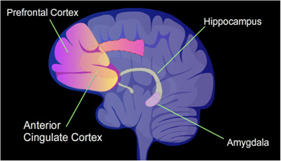
Resilience from
the Latin
re = back
salire = to leap
Gary Stix, “The Neuroscience of True Grit”, Scientific American, March 2011, pages 28-33. National Institute of Mental Health, Brain Basics: Brain Regions, N.d., http://www.nimh.nih.gov/health/educational-resources/brain-basics/brain-basics.shtml (Oct. 1, 2013).

Slide 12
resilience
Bounce back
Perseverance
Don’t give up
http://alannawonglife.com/alanna-wongs-definition-of-resilience/
Notes:
When someone goes from growth to panic or from comfort to panic

Slide 13
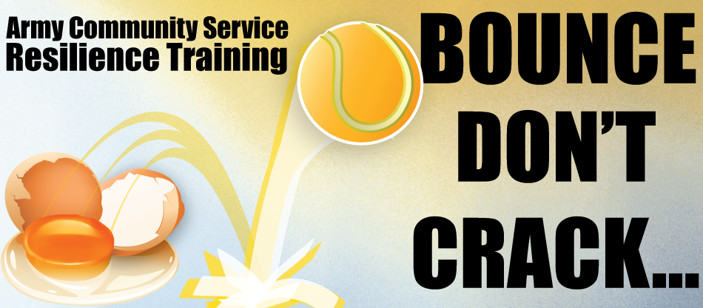
http://www.blissmwr.com/resilience/resilience_training2.aspx

Slide 14
GRIT
Angela Duckworth, Assistant Professor of Psychology at University of Pennsylvania
ted talks
http://www.pbs.org/wnet/ted-talks-education/speaker/dr-angela-lee-duckworth/
3:00 – 3:28 she defines grit
Notes:
Being a former middle school teacher she defines it quite well

Slide 15
GRIT TEST
https://sasupenn.qualtrics.com/SE/?SID=SV_06f6QSOS2pZW9qR
The grit test, University of Pennsylvania
New ideas and projects sometimes distract me from previous ones.
Setbacks don’t discourage me.
I have been obsessed with a certain idea or project for a short time but later lost interest.
I am a hard worker.
I often set a goal but later choose to pursue a different one.
I have difficulty maintaining my focus on projects that take more than a few months to complete.
I finish whatever I begin.
I am diligent.
Notes:
Let’s have a volunteer.

Slide 16
Responses
Very much like me.
Mostly like me.
Somewhat like me.
Not much like me.
Not like me at all.

Slide 17
Challenge
Risk
Chance of Failure
Greatest Opportunity to Learn
Courtesy York Mills Physics Department
Notes:
If you don’t try you won’t get results

Slide 18
Factors that contribute to resilience
A combination of factors contributes to resilience:
• Social Connection – a sense of social belonging
– social support network
• A sense of positive self-esteem, self-confidence
and optimism about the future
• A clear sense of personal values, purpose and
acknowledgement of personal responsibility for achieving a positive outcome
Next two slides are from Marc Wilshesky, Executive Director of Counselling and Disability Services at York University. Resilience: A Short Course on Managing Hardship. June 7, 2013.
Notes:
You are not born with or without resilience

Slide 19
Con’t
The capacity to make realistic plans and to
take steps to carry them out
• Effective communication and interpersonal
skills
• Ability to manage emotions and effective
problem-solving skills

Slide 20
It is not the event that causes emotional distress; rather, it is our thoughts and beliefs about the event.
Notes:
A nice little thought for you when you think you’re in the panic zone

Slide 21
Have a sense of humour
http://www.youtube.com/watch?v=mZEMRAWaVr8
Notes:
You must not take everything so seriously.

